Slide 1
EVALUATION OF MINIMUM WELL SEAL DEPTH IN IDAHO
Dale R. Ralston PhD PE PG
Ralston Hydrologic Services
Moscow, ID
January 2014

Slide 2
Why worry about a surface seal in a well?
Most aquifers have overlying low permeability layers that provide natural protection from contaminants at land surface or the shallow subsurface.
Many of the areas where wells are being drilled have surface or near surface contamination sources.
A well penetrates though the protective layers and, if not properly sealed, provides an avenue for downward movement of contaminated water from shallow zones to underlying aquifers.

Slide 3
Does the seal requirement prevent ground-water contamination?
To be effective, the seal should extend from land surface into a low hydraulic conductivity layer that overlies the aquifer.
A properly installed seal generally prevents that well from being the avenue for downward movement of contaminated near-surface.
The seal requirement should be based on geology and thus be different for different geologic settings.
The current minimum seal requirement of 38 feet provides aquifer protection in most but not all areas.

Slide 4
What are the alternative approaches for well seal requirements?
One alternative is to have the driller select the seal depth based on area geology and assume some responsibility for potential contamination problems.
A second alternative is to have the IDWR provide the required seal depth for each new well.
Neither of these approaches are workable.
The selected approach has been a state wide standard with the potential for waivers to accommodate site-specific conditions.

Slide 5
History of Minimum Well Seal Depth Requirements Within Idaho
Standards established in 1970 included a seal to a minimum of 18 feet.
After a study that started in 2002, IDWR increased the required depth of the surface seal to 38 feet in 2009.
Questions were raised in the 2013 legislative session about the appropriateness of requiring all new wells outside of the Rathdrum Prairie aquifer to be constructed with a minimum seal depth of 38 feet.
I was asked by IDWR in 2013 to do an independent study with a focus on northern Idaho.

Slide 6
Ground water in Idaho
Major aquifers in basalt (Snake Plain in southern Idaho and Columbia River Basalt in northern Idaho).
Major aquifers in sediments (Treasure Valley in southern Idaho and Rathdrum Prairie in northern Idaho).
Additional aquifers in sandstone, limestone ……
Many domestic wells developed in areas where major or minor aquifers have not been identified – well yields are small.

Slide 7
Major Aquifers in
Northern Idaho
From Graham and Campbell (1981)

Slide 8
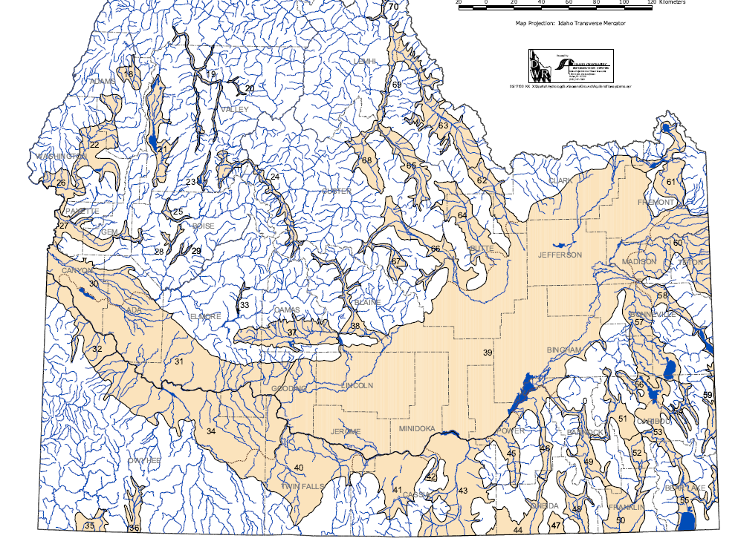
Major Aquifers in
Southern Idaho
From Graham and Campbell (1981)

Slide 9
Water
Water Wells in Idaho
Red -- Public Supply Wells
Green – Private wells
99% of wells are private
75% of wells have 6” casing 67% of well are less than 200 feet deep
More than 166,000 well driller reports are on file
(from IDWR, 2013)

Slide 10
Water
Water Wells in Northern Idaho
Red -- Public Supply Wells
Green – Private wells
(from IDWR, 2013)

Slide 11
Wells near Coeur d’Alene
(from IDWR, 2013)

Slide 12
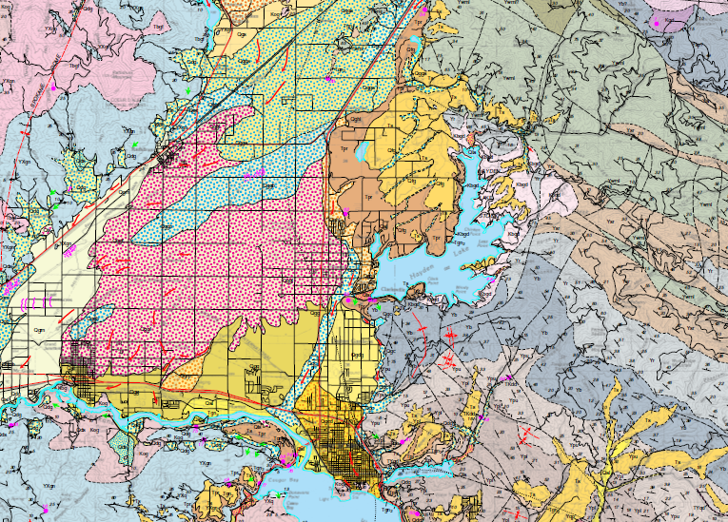
Geology of Idaho is complex
Geologic map of the Coeur d’Alene Area – IGS (Lewis and others ,2002)

Slide 13
How widespread are the near surface sources of contamination?
Identified major contaminant sources.
Land-use related contaminant sources such as agriculture.
Individual septic disposal systems

Slide 14
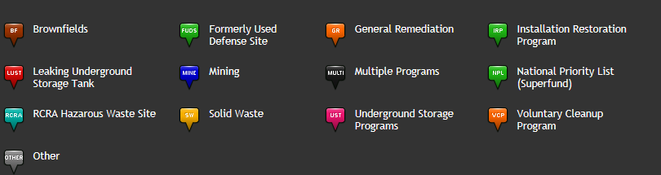
IDEQ Website

Slide 15
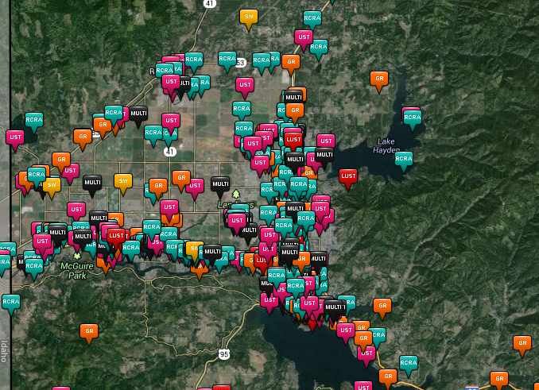
IDEQ Website
Southern Rathdrum Prairie Area

Slide 16
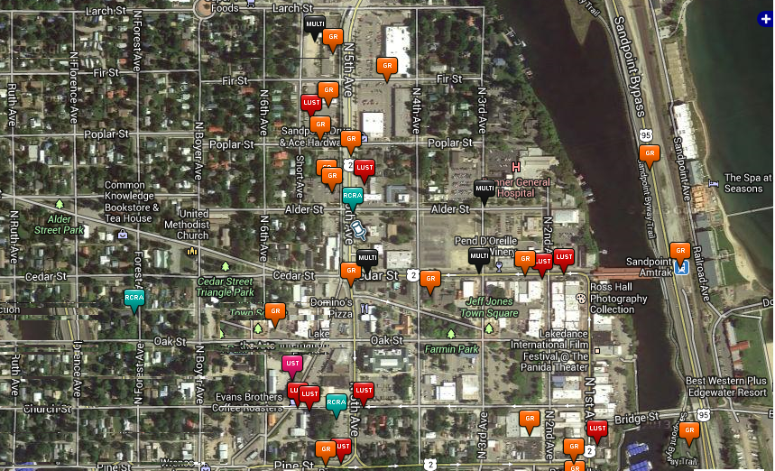
IDEQ Website
Downtown Sandpoint Area

Slide 17


Common ground water factors
First, there are layers of low hydraulic conductivity material overlying most aquifers in Idaho.
  Most of this material is sedimentary and was deposited in a stream or lake or was weathered in place.
  Hydraulic conductivity is much higher parallel to bedding(horizontal) than across bedding (vertical).
  This characteristic also is present in the SVRP aquifer. 4:1 ratio of horizontal to vertical in the CdA area (model)
sand
clay
sand

Slide 18
Common ground water factors
  Layers of solid rock can also limit vertical flow from the surface to aquifers.
  The dense center of a basalt flow can act to isolate an aquifer between basalt flows from land surface.
  This is particularly the case in northern Idaho where the flows of the Columbia River Basalt Group are thick and extend over a large area.
  Basalt flows on the Snake Plain of southern Idaho tend to be thinner and less laterally extensive and thus do not form an effective confining layer.

Slide 19
Common ground water factors
Second, the quality of ground water within most areas of the state is excellent.
  Some areas have elevated natural constituents such as arsenic and fluoride.
  Local areas impacted by land uses such as elevated nitrate concentrations in agricultural areas.
  Specific areas impacted by a single contaminant source.

Slide 20
Common ground water factors
Third, wells constructed with inadequate well seals have the potential to and currently provide an avenue for contaminated water from the shallow subsurface to flow downward into aquifers that are relied on as drinking water sources.
  I have worked at sites where poor well seals in wells located near sites with near surface contaminant sources have resulted in elevated contaminate concentrations in lower ground water systems.
  Camas Prairie nitrate area of concern is an example.

Slide 21
Nitrate Areas of Concern
One of Idaho’s nitrate areas of concern is north and east of Cottonwood.
Background nitrate levels should be near 1 mg/l.
Maximum contaminant level standard is 10 mg/l.
Camas Prairie nitrate area of concern includes about 187,000 acres.
52 percent of wells have nitrate levels exceeding 5 mg/l.

Slide 22
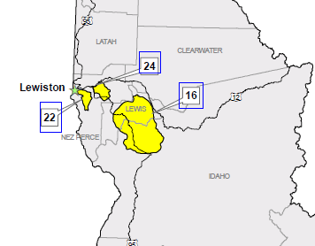
Camas Prairie nitrate area of concern
Northern Idaho nitrate areas of concern – from IDEQ website

Slide 23
Ground-Water Characteristics of the Camas Prairie in Northern Idaho
Thick, mostly horizontal basalt flows.
Aquifers occur along flow contacts -- top of underlying flow and bottom of overlying flow.
Centers of flows are dense and have very low hydraulic conductivity; this limits vertical flow of water.
Historic problems of long-term water-level decline in municipal wells because the dense flow interiors limit aquifer recharge from precipitation.

Slide 24
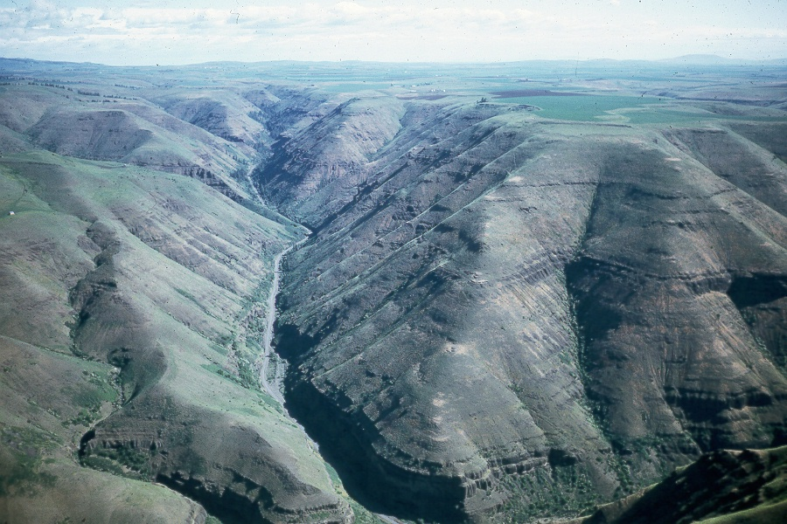
John Bond
Looking north up the Graves Creek Canyon near Cottonwood

Slide 25
How can nitrate get into basalt aquifers that are located hundreds of feet below land surface?
University of Idaho study examined the potential for downward movement of water with elevated nitrate through the sequence of basalt on the Camas Prairie and concluded that travel time would exceed 100’s of years.
Shallow ground water leaking past surface casing into uncased or cased boreholes likely has led to the elevated nitrate values.
Amount of drainage down each well may be small because shallow sediment overlying basalt has low hydraulic conductivity.

Slide 26
How Extensive is the Nitrate Problem?
This nitrate area of concern likely would not exist if a proper surface seal had been installed in all wells.
Elevated nitrate levels may only occur around wells with poor surface seals. Widespread contamination of the aquifer may not be present.
Recent well near Winchester located near farm fields.
Basalt was penetrated at a depth of 15 feet.
Public supply well; seal was installed in basalt to a depth of 58 feet.
2013 analysis showed less than 1 mg/l nitrate.

Slide 27
IDWR Well Seal Study - 1
IDWR conducted a study prior to finalizing the revised well drilling standards in 2009.
  Review of 697 randomly selected driller’s reports from 44 counties in Idaho to evaluate whether 18-foot, 38-foot or 58-foot seals would provide protection for ground-water quality based on geologic conditions.
  The review was based on identifying the depth to the first confining layer (clay/silt or consolidated rock) and comparing this information with alternative seal depths of 18 feet,38 feet and 58 feet.

Slide 28
IDWR Study - 2
IDWR study.
  218 of the 697 wells encountered the first confining layer within 18 feet (31 percent).
  238 of the 697 wells encountered the first confining layer between 18 and 38 feet (34 percent).
  109 of the 697 wells encountered the first confining layer between 38 and 58 feet (16 percent).
  132 of the 697 wells encountered the first confining layer below 58 feet or were currently sealed to greater than 58 feet (19 percent).

Slide 29
IDWR Study - 3
IDWR study.
  A seal to 18 feet would be effective for 31 percent of the wells.
  A seal to 38 feet would be effective for 65 percent of the wells.
  A seal to 58 feet would be effective for 81 percent of the wells.
  I checked about 100 of the 697 wells that were included in the IDWR study and generally agreed with their picks on depth to confining layers.

Slide 30
Ralston study -1
I conducted a similar examination of well driller’s reports in the area from Riggins to the Canadian border.
Townships were selected to represent various geologic settings and well development areas in northern Idaho.
About three wells were selected from each township for inclusion in the study; from upper, middle and lower portions of the township.
Excluded wells with incomplete information.

Slide 31
Ralston study -2
Logs for 181 wells were examined.
Based on available geology, I judged whether an 18 foot, 38 foot or 58 foot seal would be appropriate.
The decision of the appropriate seal depth was easy for about two-thirds of the wells
The decision relative to well seal depth was difficult in the remaining wells mostly because of problems in interpreting the geologic information given (i.e. 0 to 30 feet - clay with sand layers; or 0 to 45 feet - soft and hard layers of basalt).

Slide 32
Ralston study -3
About 50 percent of the wells encountered the first confining layer within 18 feet.
About 40 percent of the wells encountered the first confining layer between 18 and 38 feet.
About 10 percent of the wells encountered the first confining layer at a depth greater than 38 feet.
In comparison, the IDWR results were 31 percent, 34 percent and 16 percent for the three different seal depths.

Slide 33
Ralston study -4
From a geologic viewpoint, a seal to 18 feet would have been effective for about 50 percent of the wells included in the Ralston analysis.
A seal to 38 feet would have been effective for about 90 percent of the wells included in the Ralston analysis.
The Ralston study supports the IDWR decision in 2009 to increase the required seal depth from 18 feet to 38 feet.

Slide 34
Ralston study -5
I compared my recommended seal depth to the seal depth given on the well driller’s reports.
Only 14 of the 181 wells included in the analysis were drilled during or after 2009; Thus 92% of the wells were drilled when the minimum seal depth requirement was 18 feet.

Slide 35
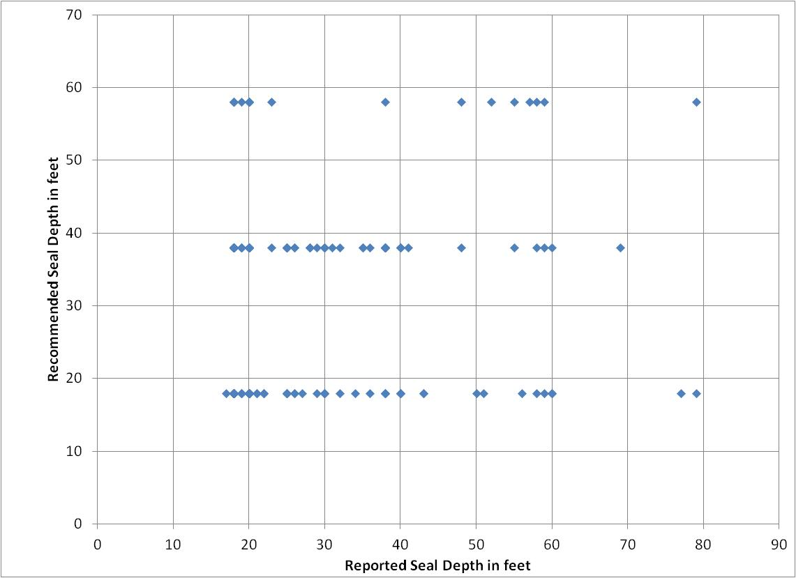
Well Seal Depth Comparison for Ralston Study
Single data point can represent multiple wells
116 ft
145 ft

Slide 36
Ralston study -6
A number of the wells included in the study had a surface seal deeper than the required minimum.
  About 27% of the wells that I judged to need an 18-foot seal had an installed seal to 38 feet or greater.
  About 26% of the wells that I judged to need a 38-foot seal had an installed seal of 38 feet or greater.
  About 43% of the wells that I judged to need a 58-foot seal had an installed seal of 38 feet or greater.
A number of drillers in Idaho have been installing seal depths greater than the minimum requirement.

Slide 37
Cost Analysis - 1
Constructing a surface seal to 38 feet increases the cost of the well as compared to an 18-foot seal.
Four drilling firms active in northern Idaho were asked to provide cost information relative to installation of a 38-foot seal versus an 18-foot seal for a 200-foot domestic well.
The comparison was based on installation of 6-inch diameter casing which requires that 10-inch diameter temporary casing and/or open hole be constructed to a depth of 18 or 38 feet for the installation of seal material.

Slide 38
Cost Analysis - 2
The costs are given for one or both of the following conditions.
  Only unconsolidated material is encountered in the depth interval of the surface seal; temporary surface casing would be required to a depth of 18 or 38 feet.
  Consolidated material is encountered in the depth interval of the surface sea; temporary surface casing would be required only to the top of the rock.
The drillers provided the cost information with the understanding that they would not be individually identified.

Slide 39
Cost Analysis - 3
Driller #1
  Cost information represents unconsolidated material in the seal depth interval.
  20-foot seal would be $520 for drilling plus $350 for the seal material for a total of $870.
  40-foot seal would be $1,040 for drilling plus $550 for the seal material for a total of $1,590.
  The estimated difference in cost between an 20-foot seal and a 40-foot seal in unconsolidated material is $550.

Slide 40
Cost Analysis - 4
Driller #2
  Cost information was not differentiated between unconsolidated or consolidated material in the seal depth interval.
  Cost of about $600 for an 18-foot seal in a “perfect hole”.
  Cost of about $1,040 for a 38-foot seal in a “perfect hole.”
  The estimated difference in cost between an 18-foot seal and a 38-foot seal in a “perfect hole” is $440.
  Seal costs in difficult circumstances can be $2,500 for a 38-foot seal and half that for an 18-foot seal.

Slide 41
Cost Analysis - 5
Driller #3
  Cost information was given for unconsolidated material in the seal depth interval. Total costs are for a 200-foot well including well cap, permit, PVC screen, 6-inch steel casing and seal.
  Cost is $9,245 for the well with an 18-foot seal.
  Cost is $10,065 for the well with a 38-foot seal.
  The estimated difference in cost between an 18-foot seal and a 38-foot seal is $820. This is about 9 percent of the cost of the well.

Slide 42
Cost Analysis - 6
Driller #4
  Cost information was given for both unconsolidated and consolidated material in the seal depth interval.
  In unconsolidated material, a well with a 38-foot seal would cost about $1,080 more than the same well with an 18-foot seal.
  In consolidated material, a well with a 38-foot seal would cost about $1,050 more than the same well with an 18-foot seal.

Slide 43
Cost Analysis - 7
Summary
  Installation of a well seal to 38 feet costs more than installation of a well seal to 18 feet.
  Data provided by four drilling firms in northern Idaho show that the increased cost of a 38-foot seal as compared to an 18-foot seal surrounding a 6-inch diameter steel casing for a domestic well is in the range of $440 to $1,080.
  One driller noted that the greater seal depth added about 9% to the cost of the well.

Slide 44
Waivers: an Alternative for Individual Circumstances
Waivers of the minimum standards are provided for in the Well Construction Rules
2,149 wells were drilled in 2013
28 waivers for sealing requirements were submitted to IDWR in 2013 (1.3% of wells drilled)
27 of the waivers were approved
IDWR has been flexible working with drillers to comply with the rules
From IDWR, 2013

Slide 45
Summary and Conclusions -1
Installation of a well seal is a one-time cost that will provide protection for the aquifer for the life of the well, which can be many decades.
Requiring a deeper seal on new wells is a relatively small price to pay to protect the water resource that is the drinking water source for more than 90 percent of Idaho residents.
The deeper seal depth also provides additional protection of the water supply for the well owner.

Slide 46
Summary and Conclusions -2
To be effective, the seal should be installed into the uppermost confining layer that overlies the aquifer.
The statewide IDWR (2008) well study and the Ralston (2013) study of wells in northern Idaho both show that a minimum seal depth of 38 feet provides more protection of ground-water quality than does a minimum seal depth of 18 feet because a greater percentage of the wells would have a seal that penetrates a confining layer.

Slide 47
Summary and Conclusions -3
IDWR Waiver program provides the needed avenue to deal with specific areas where a 38-foot seal may not be needed.
I believe that the present program administered by IDWR provides an effective balance between protection of the ground-water resource of the state and flexibility for well construction in local areas.

Slide 48
Summary and Conclusions -4
Requiring a deeper seal on new wells is a relatively small price to pay to protect the water resource that is the drinking water source for more than 90 percent of Idaho residents.
The focus should be on protection of ground-water quality. Remediating problems of ground-water contamination not only is very expensive but often is unsuccessful.

Slide 49
Thank you!!

