Slide 1
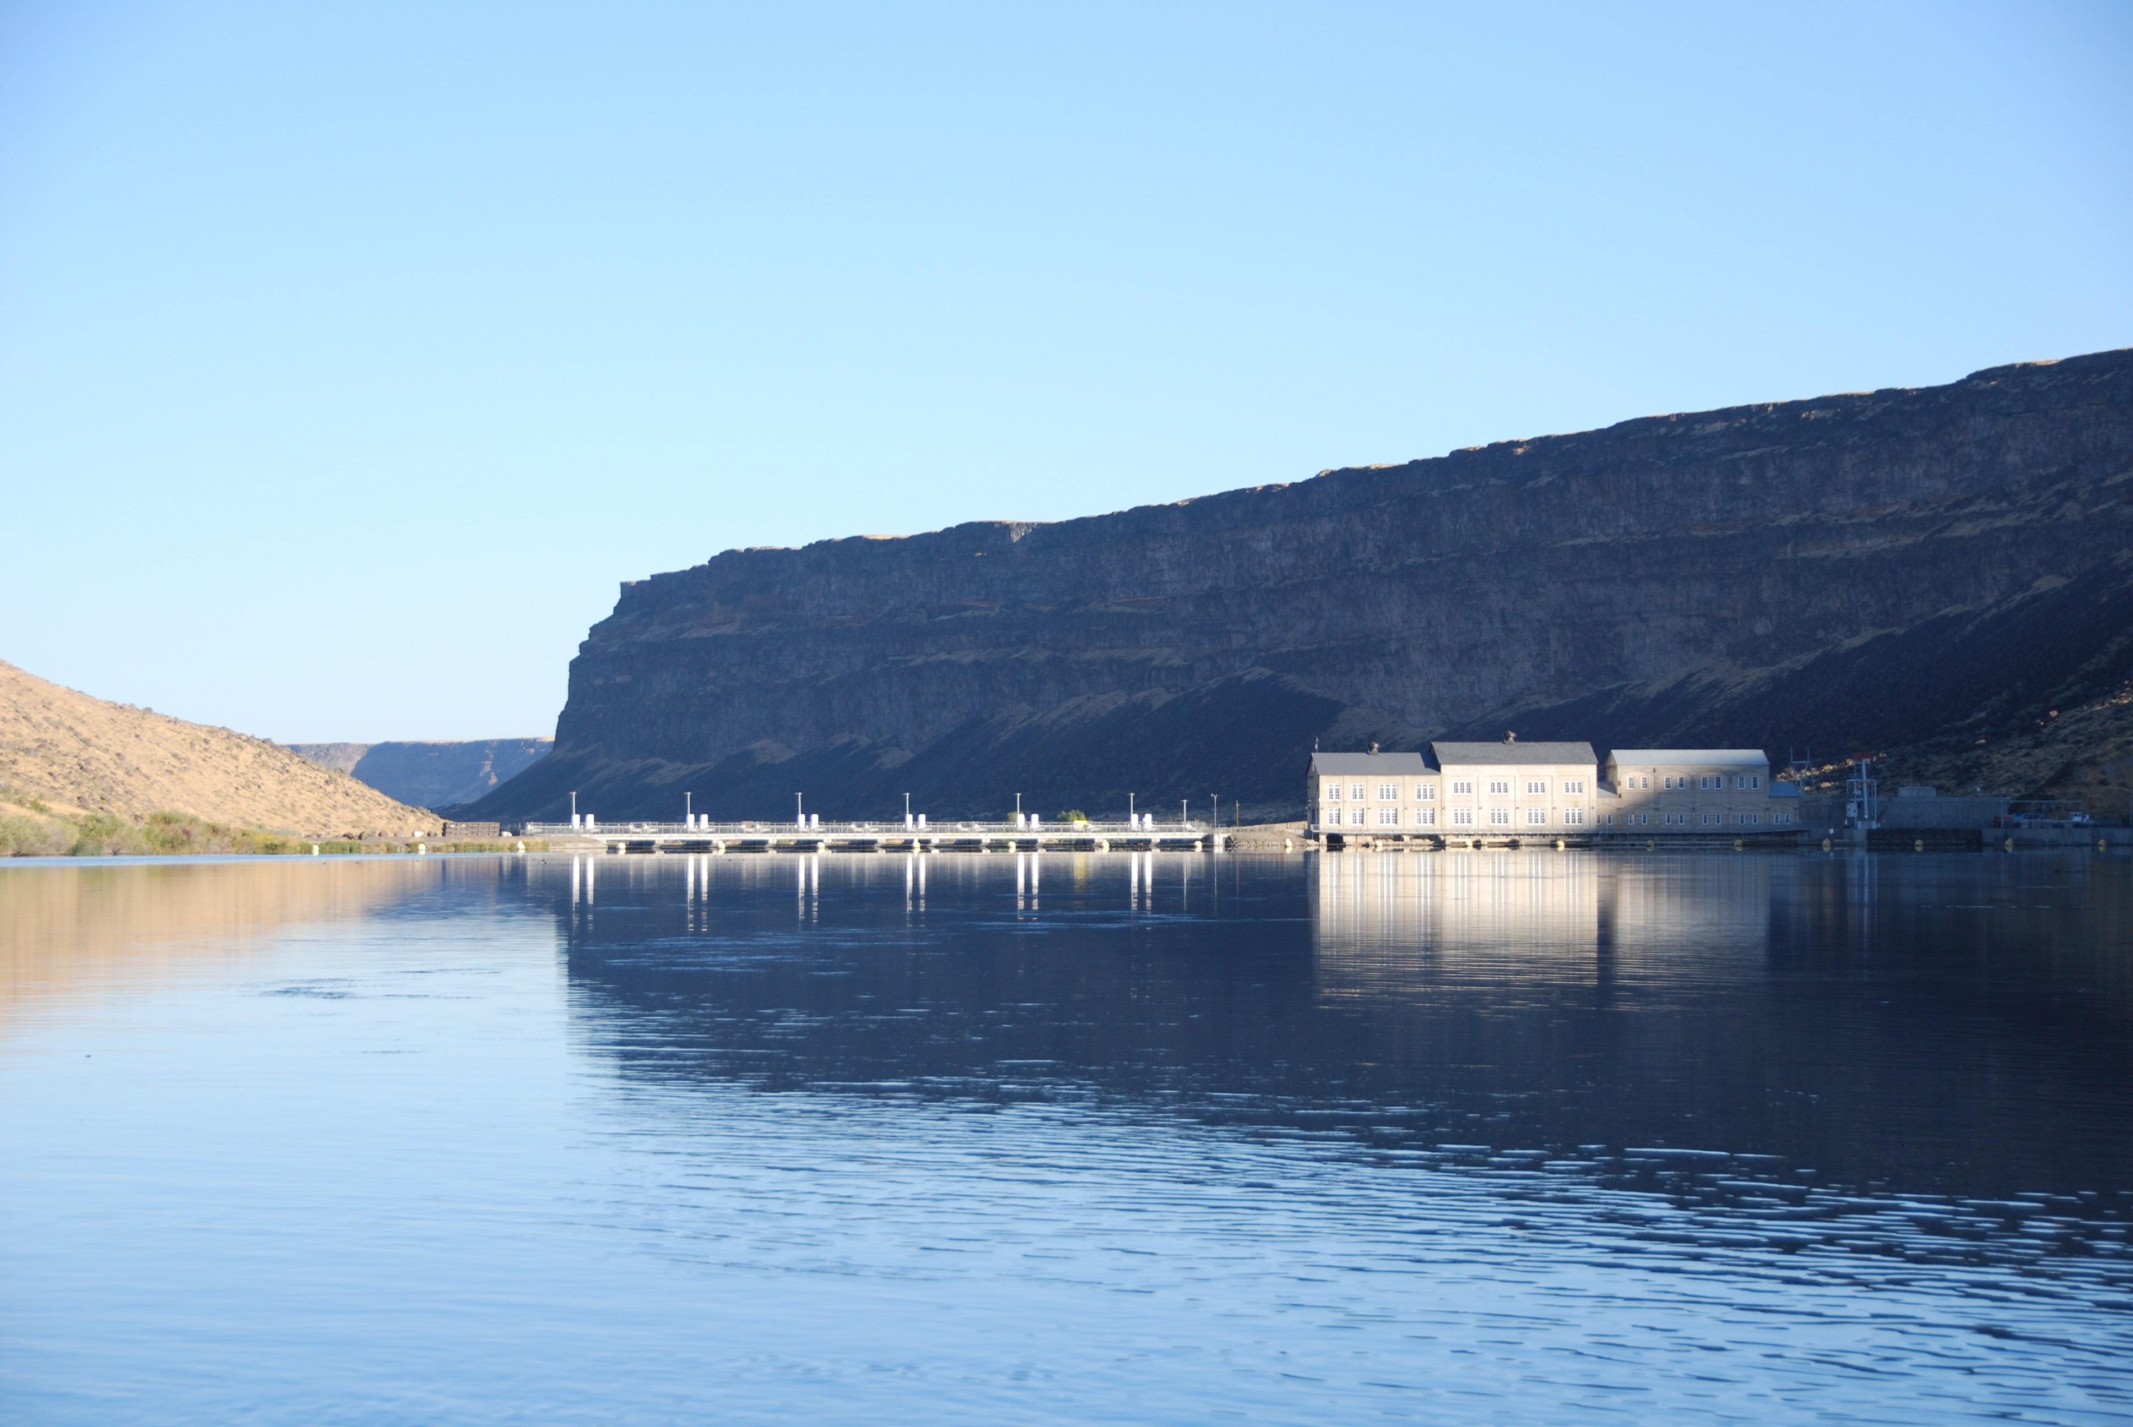


Swan Falls AADF Update
Presented by Ethan Geisler
July 29th, 2025

Slide 2

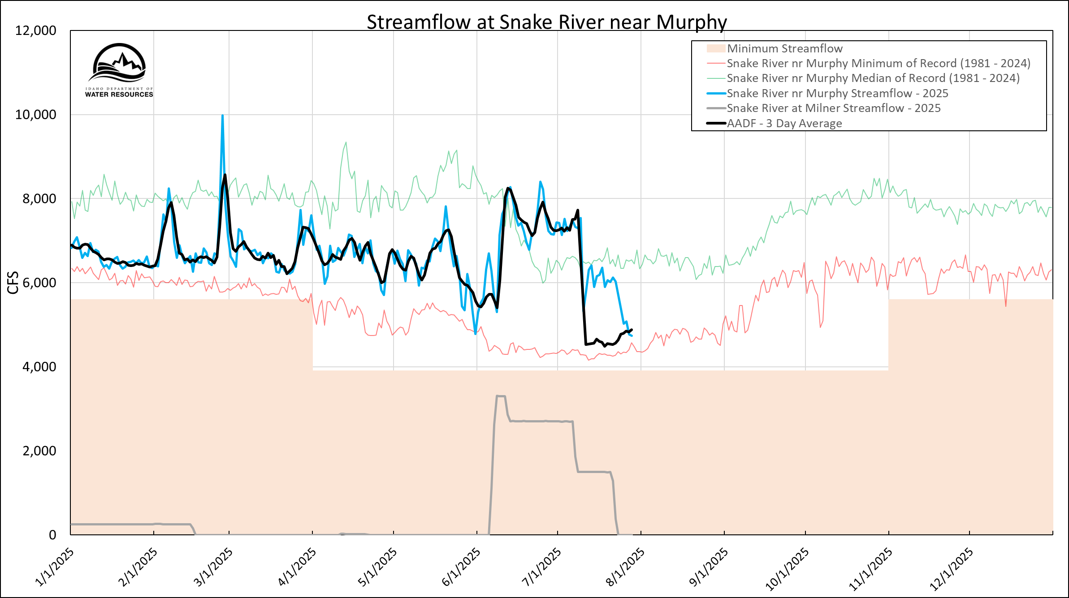
2025
Notes:
REMIND FOLKS WHAT EACH LINE IS
Key Points:
From January to mid March the AADF is below the Snake near Murphy Median of record.

Slide 3
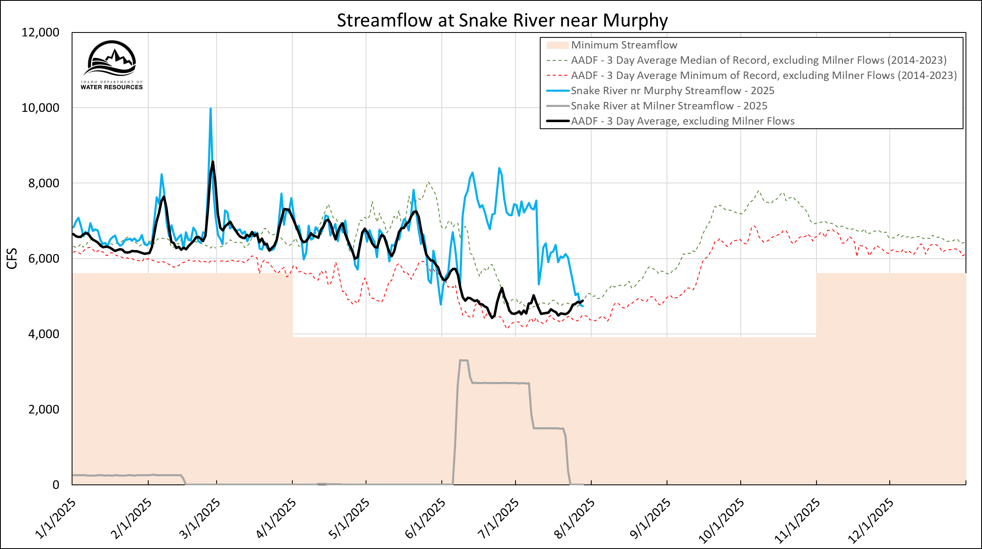
2025
AADF Without Milner Flow
Notes:
Key Points:
1. In between the median and minimum of record for AADF -3 day average excluding milner flows

Slide 4
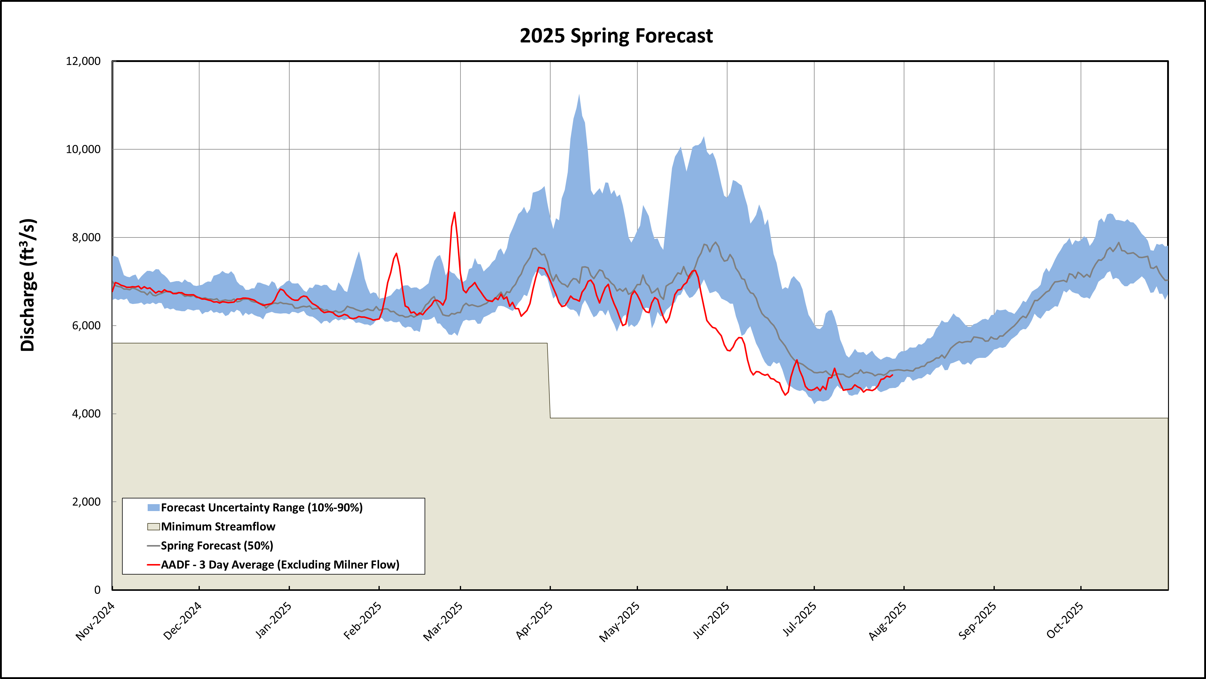
With NRCS April Bruneau River SWSI (1.2)
10th Percentile Forecast =
4,218 cfs (July 1st)
Notes:
Key Points:

Slide 5
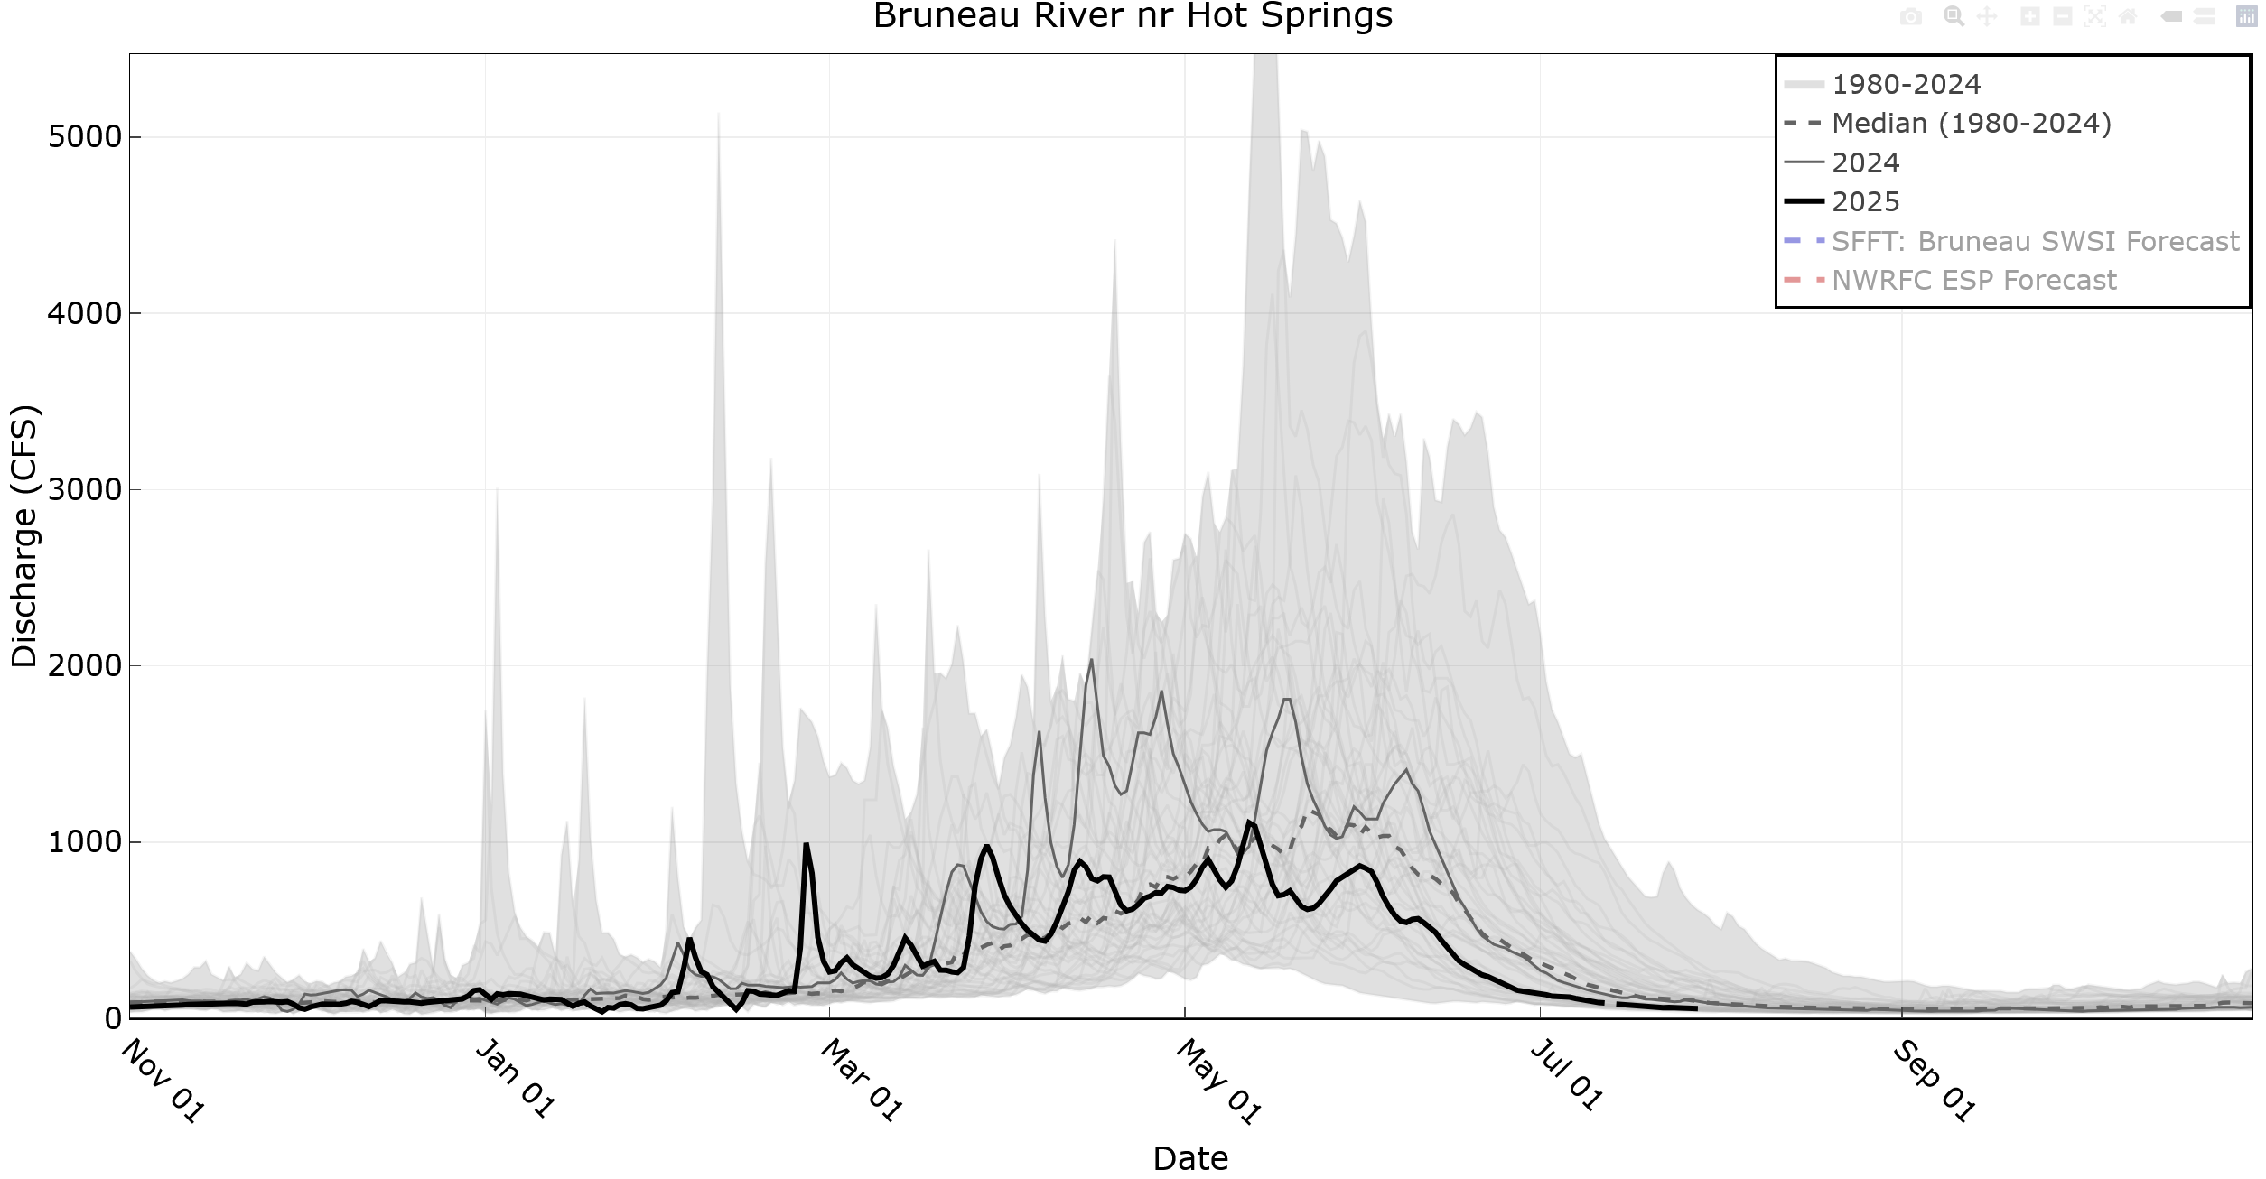
Notes:
For these return flow plots, the thick black line is 2024, the thin grey line is 2023, and the shaded area is this historical range.

Slide 6
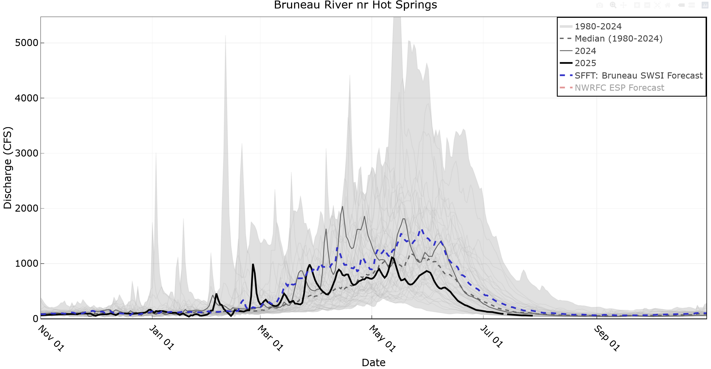
April Bruneau River SWSI (1.2)
Notes:
For these return flow plots, the thick black line is 2024, the thin grey line is 2023, and the shaded area is this historical range.

Slide 7
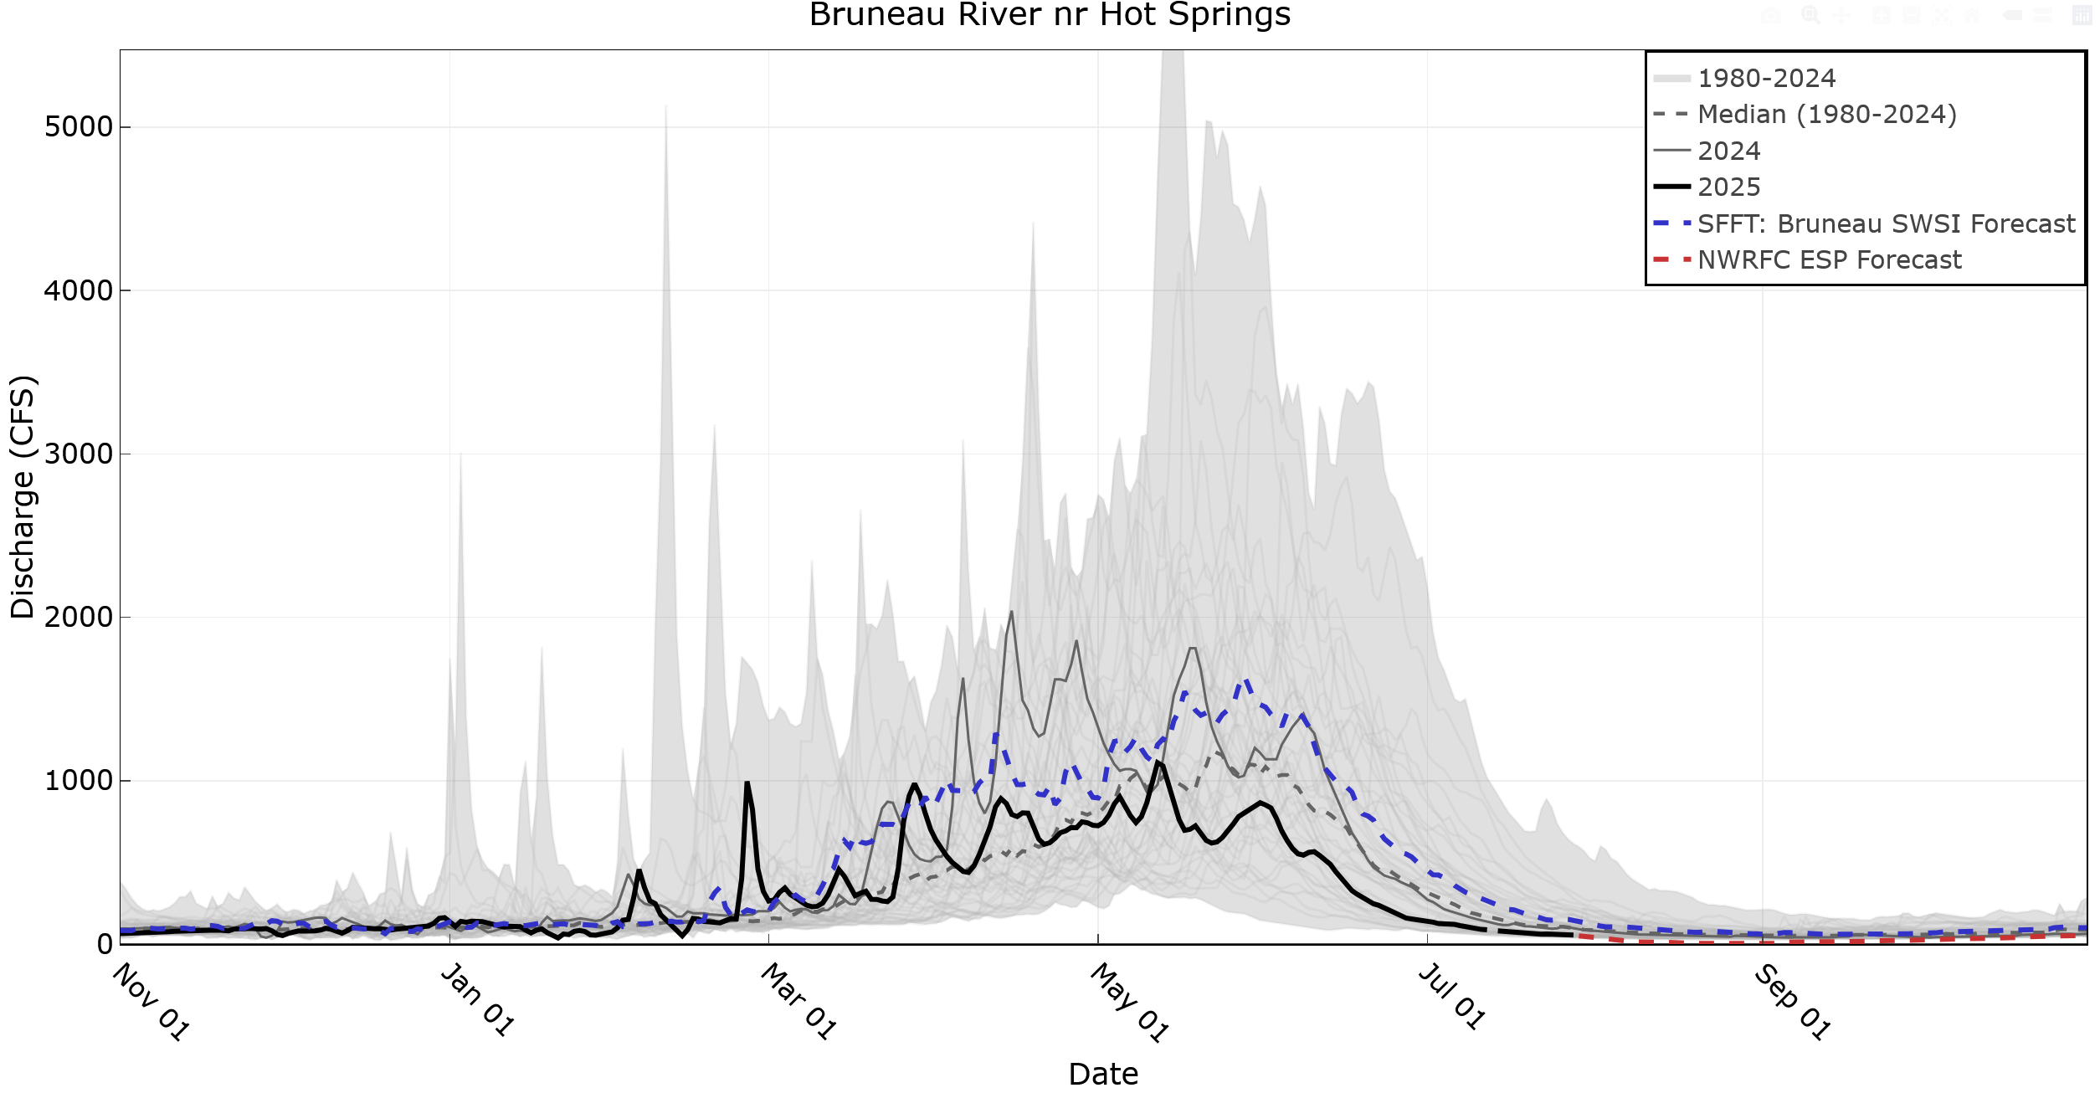
April Bruneau River SWSI (1.2)
Notes:
For these return flow plots, the thick black line is 2024, the thin grey line is 2023, and the shaded area is this historical range.

Slide 8

May Bruneau River SWSI (-0.5)
Notes:
For these return flow plots, the thick black line is 2024, the thin grey line is 2023, and the shaded area is this historical range.

Slide 9
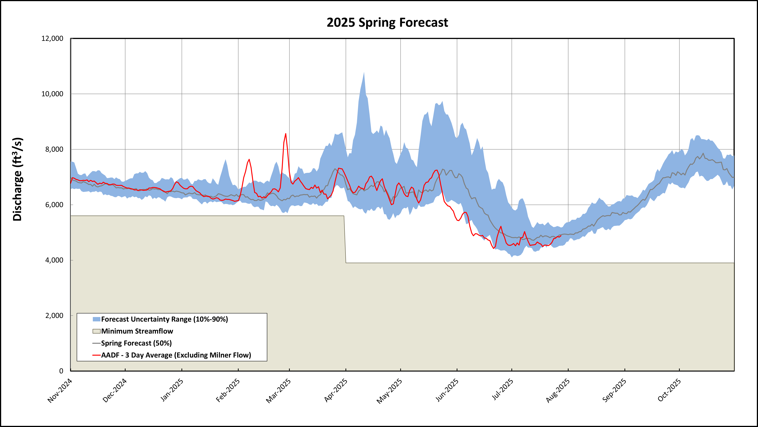
With NRCS May Bruneau River SWSI (-0.5)
Notes:
Key Points:

Slide 10
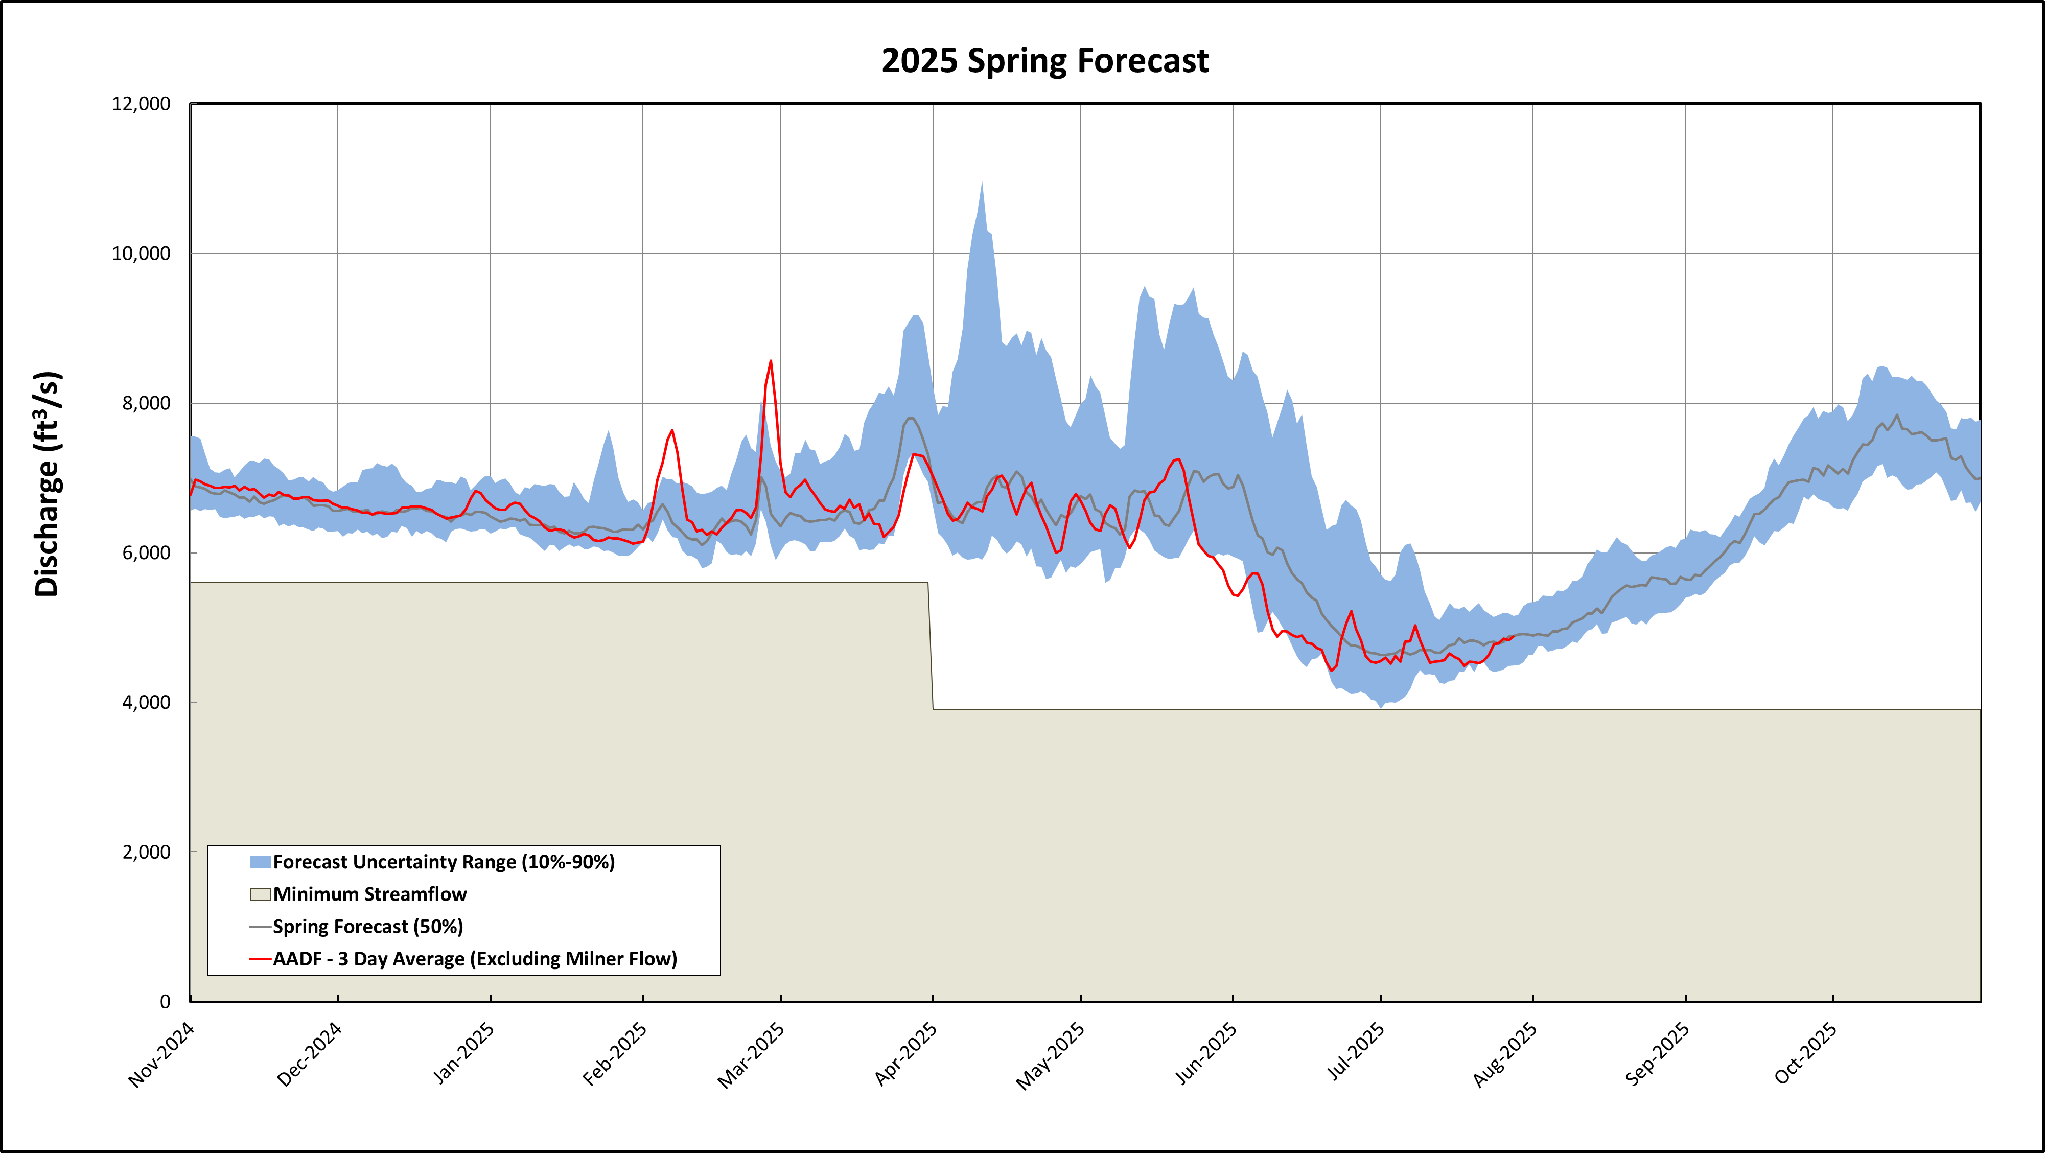
Bruneau River: observed streamflow data (11/1 to 7/28) & NWRFC ESP Forecast (7/29 to 10/31)
Notes:
Key Points:

Slide 11
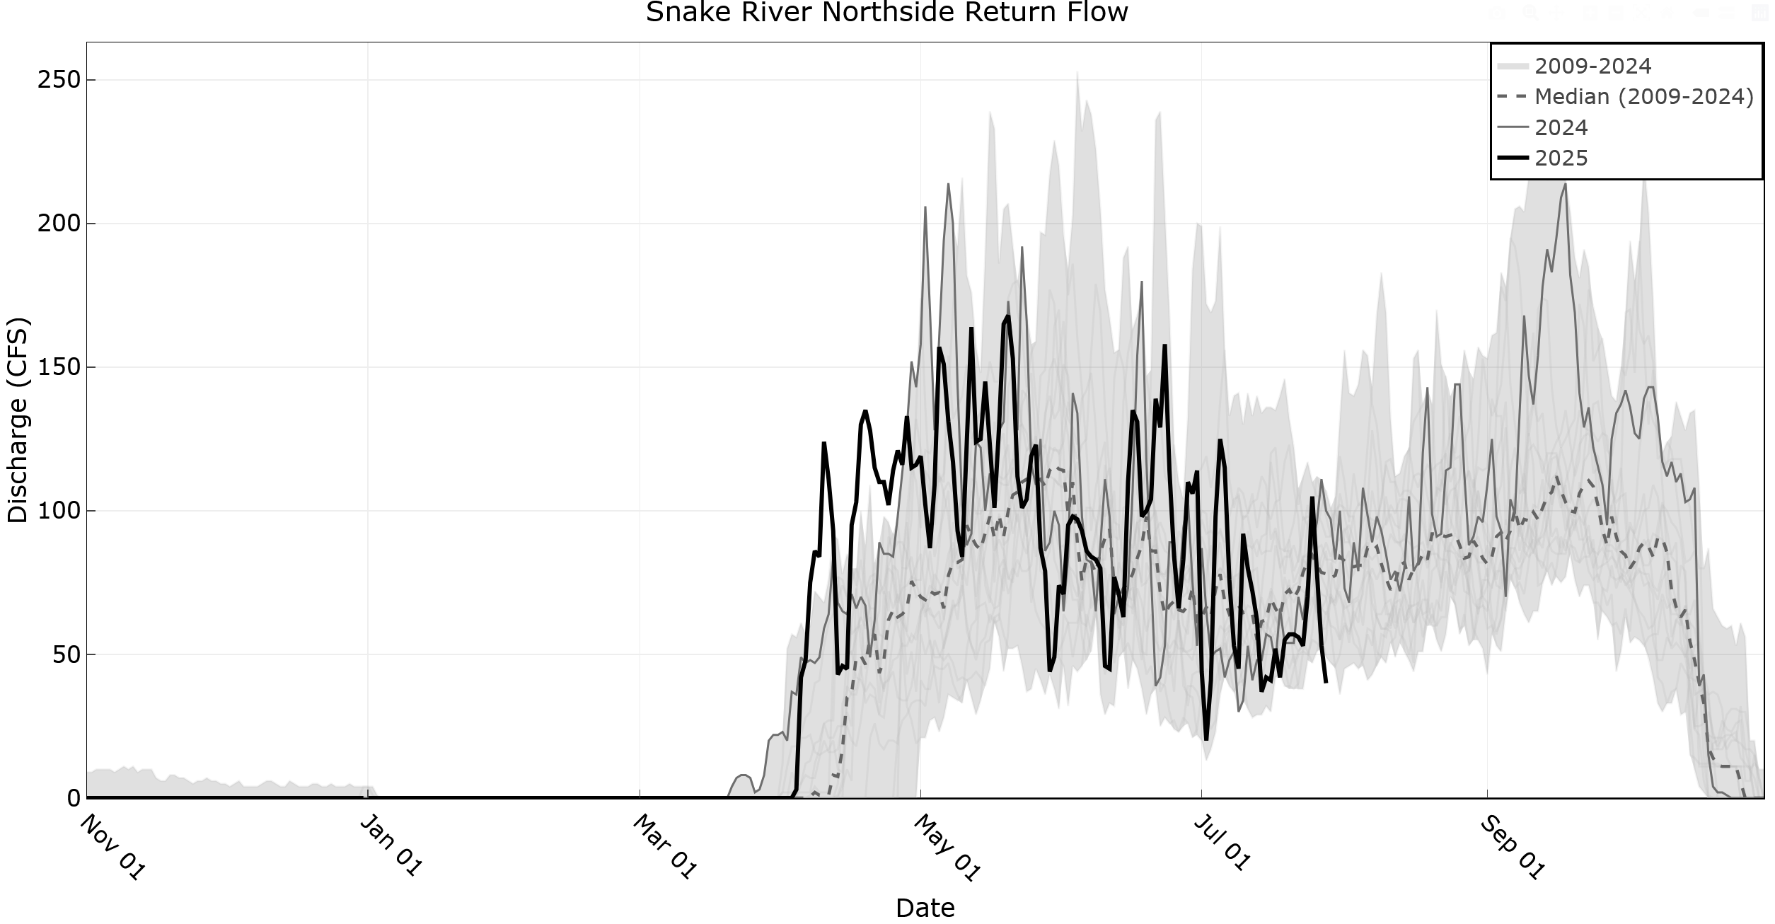
Notes:
Consistently below the median, but higher flows than last year.

Slide 12
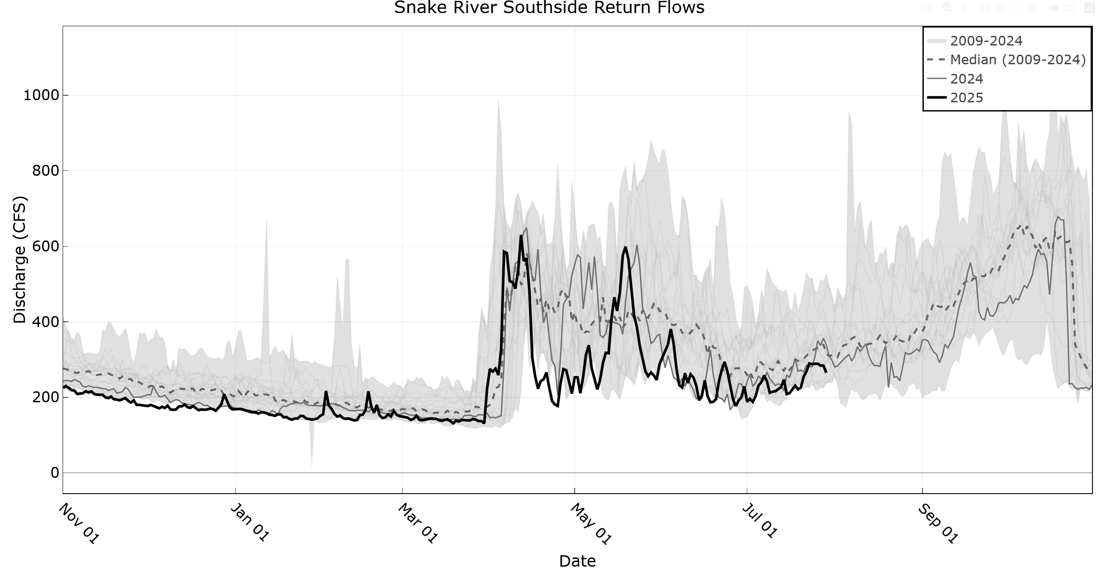
Notes:
Southside was following median, however since June has had flows towards the lower end of the historical range.

Slide 13
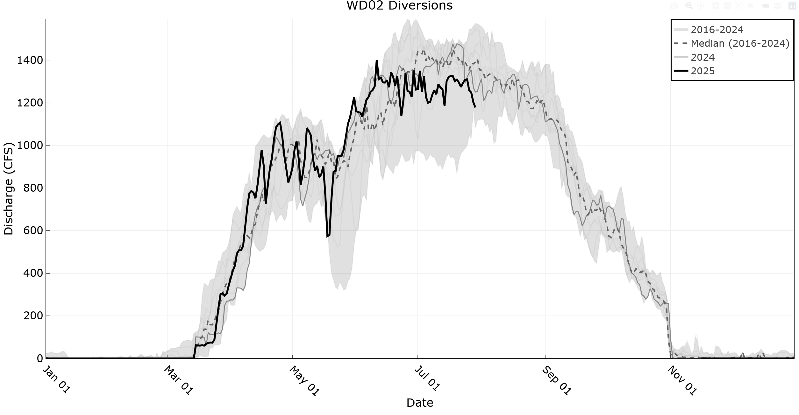
Notes:
Consistently below the median, but higher flows than last year.

Slide 14
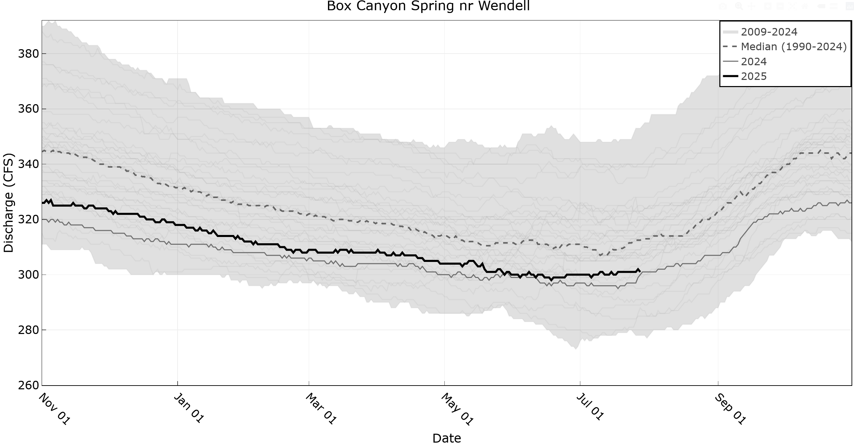
Notes:
Consistently below the median, but higher flows than last year.

