Slide 1
Milner to Swan Fall Reach Gain Statistics
Swan Falls Technical Group Meeting
May 8, 2025

Slide 2
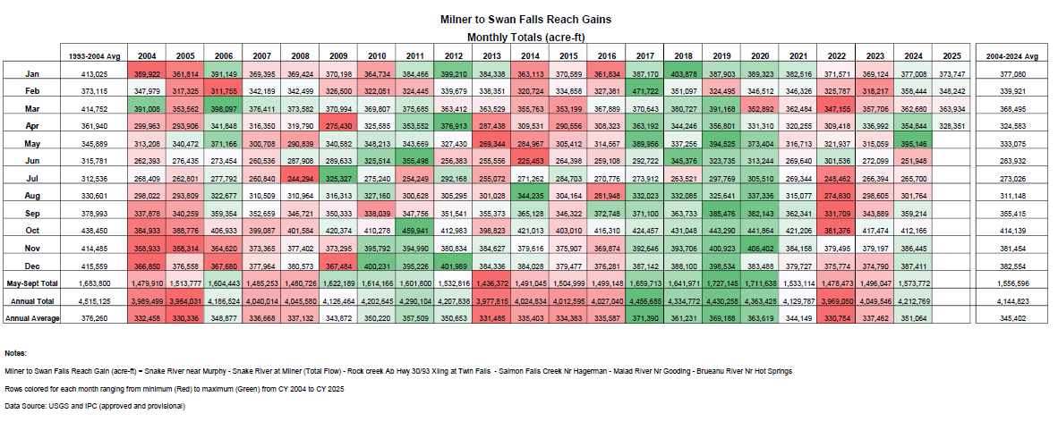

Slide 3
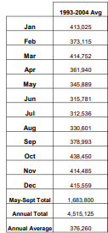
Row colored gradient ranging from minimum (Red) to maximum (Green) from 2004 to 2025

Slide 4
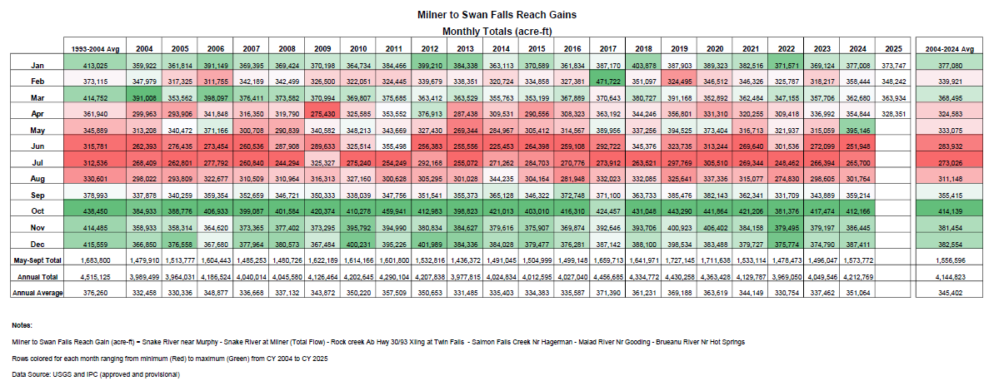
Column colored gradient ranging from minimum (Red) to maximum (Green) from January to December

Slide 5
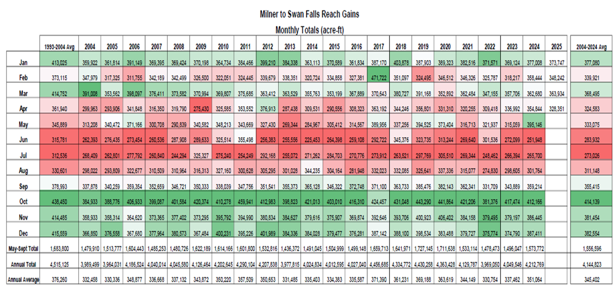
Column colored gradient ranging from minimum (Red) to maximum (Green)

Slide 6
