Slide 1
Swan Falls AADF Update
Presented by Ethan Geisler
February 11th, 2025

Slide 2
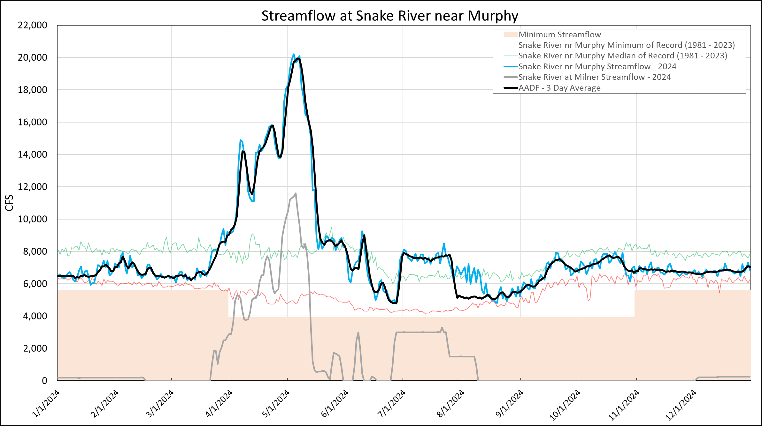
2024
Flood Operations
USBR Flow Aug
IPC Storage
Notes:
REMIND FOLKS WHAT EACH LINE IS
Key Points:
From January to mid March the AADF is below the Snake near Murphy Median of record.

Slide 3
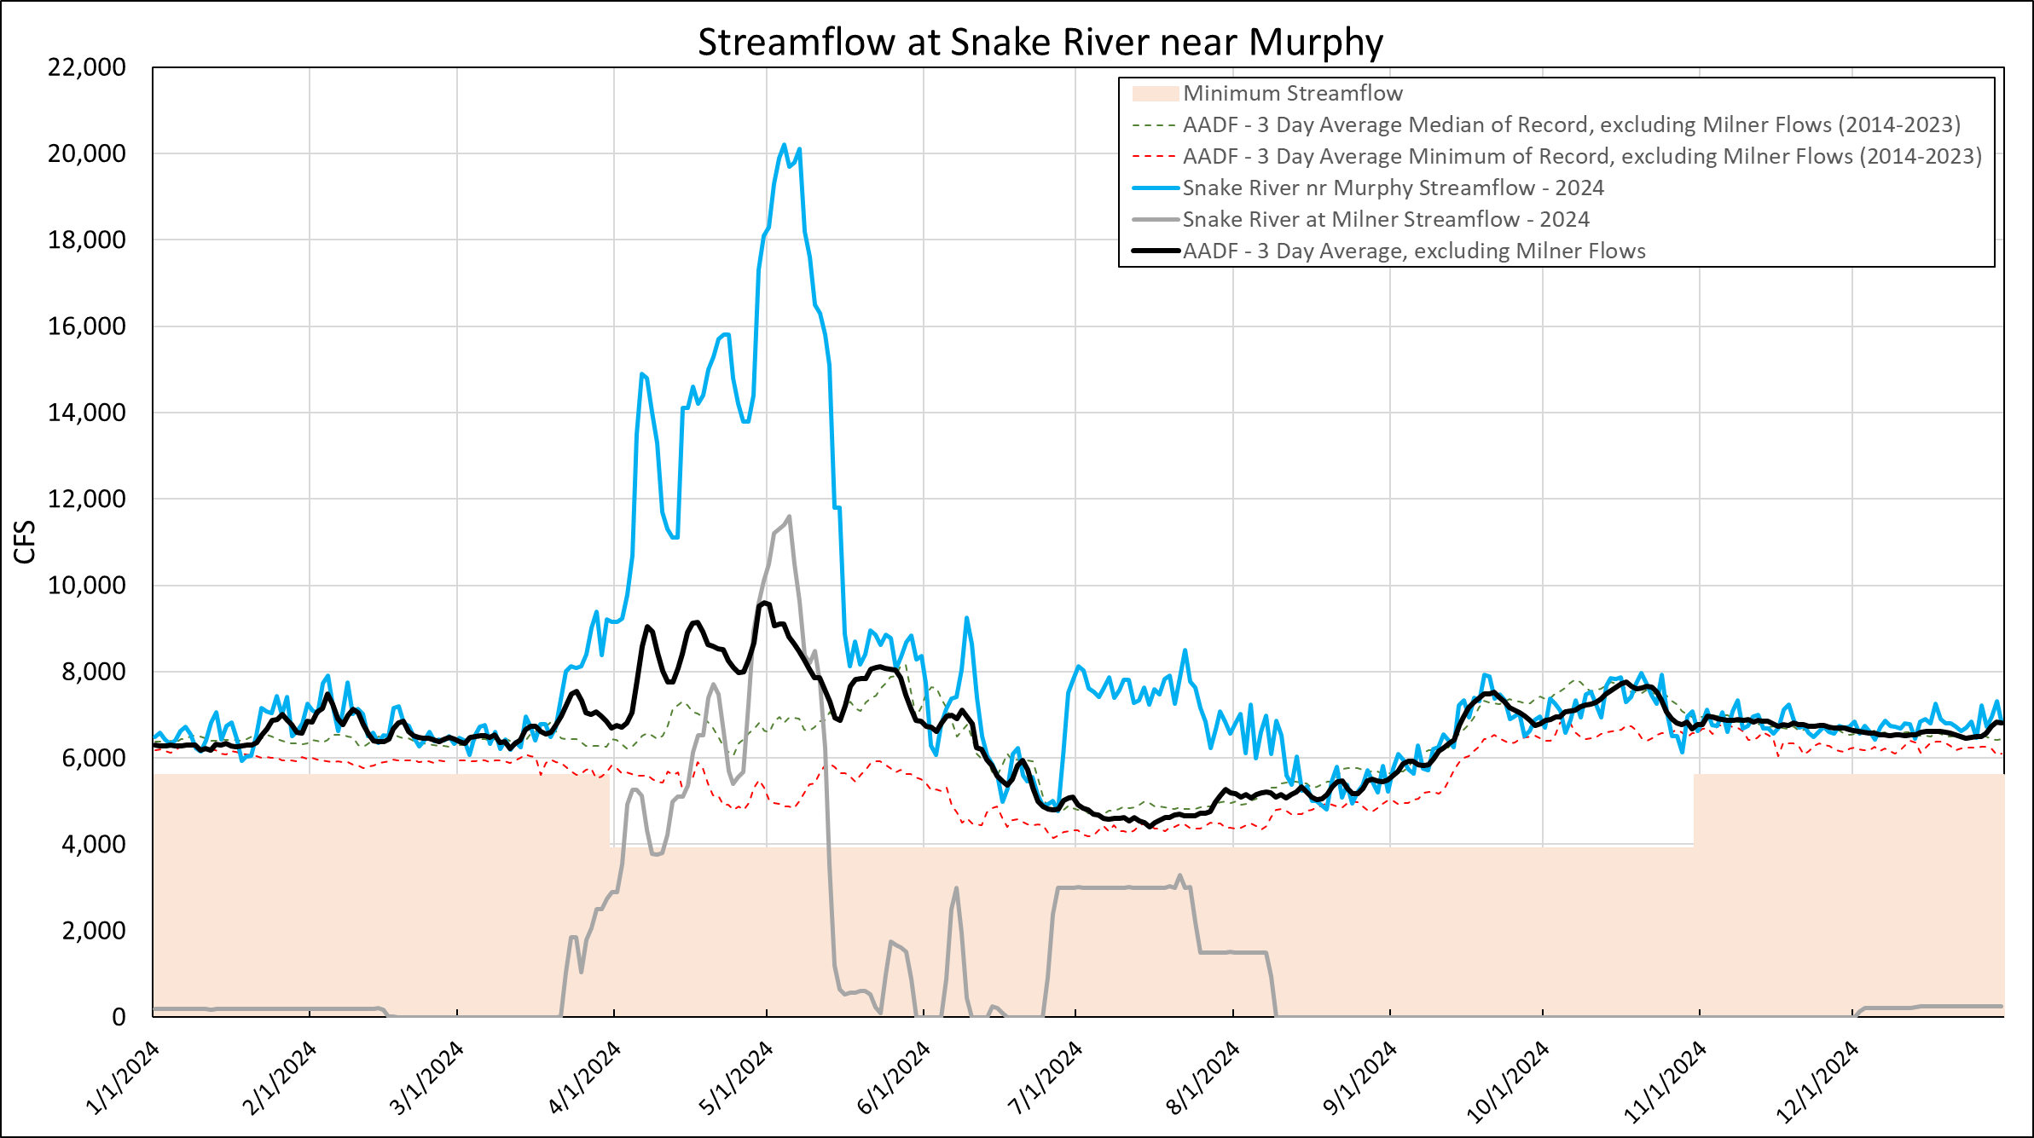
2024
AADF Without Milner Flow
Flood Operations
USBR Flow Aug
IPC Storage
Notes:
REMIND FOLKS WHAT EACH LINE IS
Key Points:
From January to mid March the AADF is below the Snake near Murphy Median of record.

Slide 4
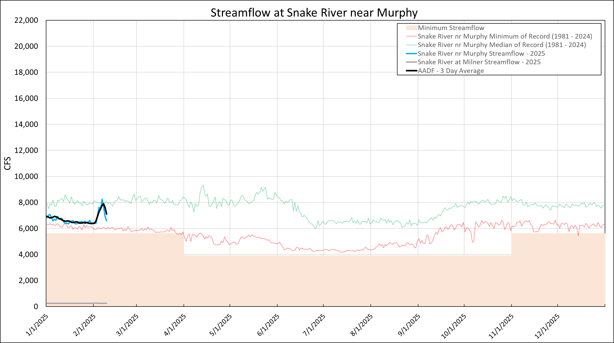
2025
Notes:
REMIND FOLKS WHAT EACH LINE IS
Key Points:
From January to mid March the AADF is below the Snake near Murphy Median of record.

Slide 5
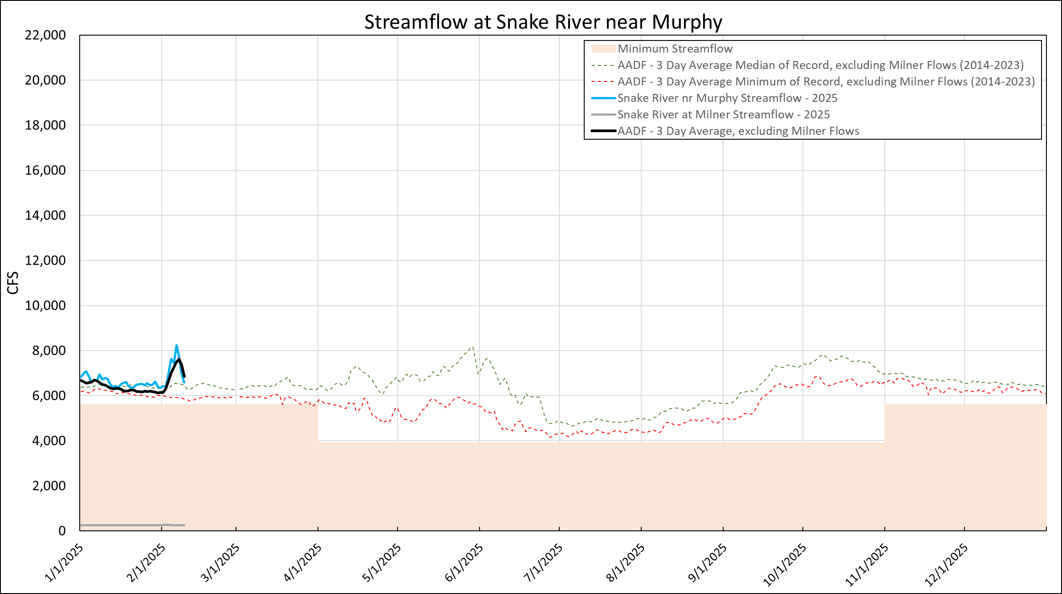
2025
AADF Without Milner Flow
Notes:
Key Points:
1. In between the median and minimum of record for AADF -3 day average excluding milner flows

Slide 6
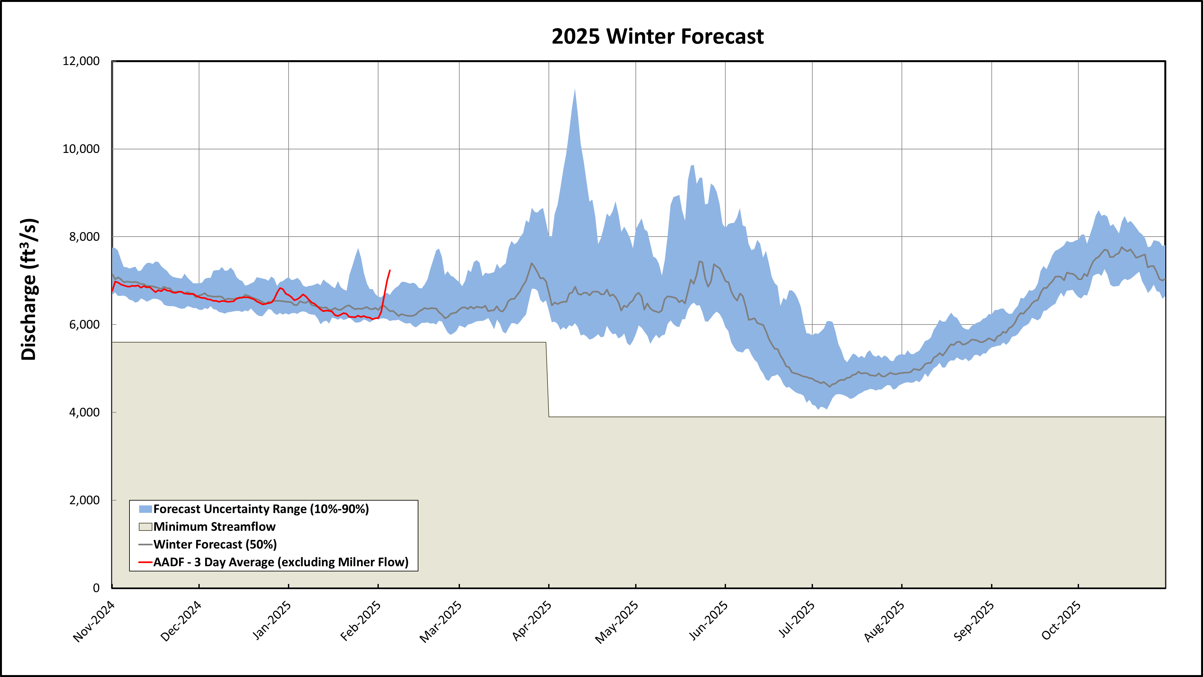
10th Percentile Forecast = 4,059 cfs (July 3rd )
Notes:
Key Points:

Slide 7
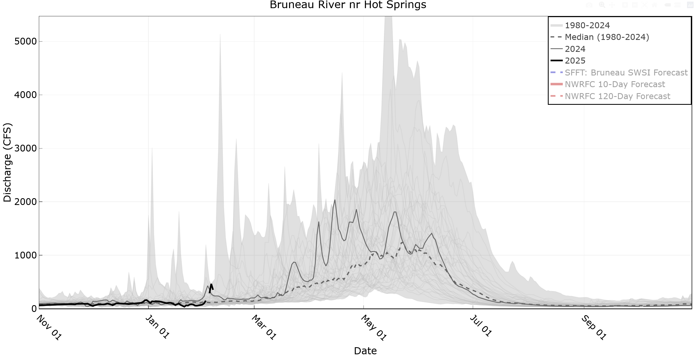
Notes:
For these return flow plots, the thick black line is 2024, the thin grey line is 2023, and the shaded area is this historical range.

Slide 8
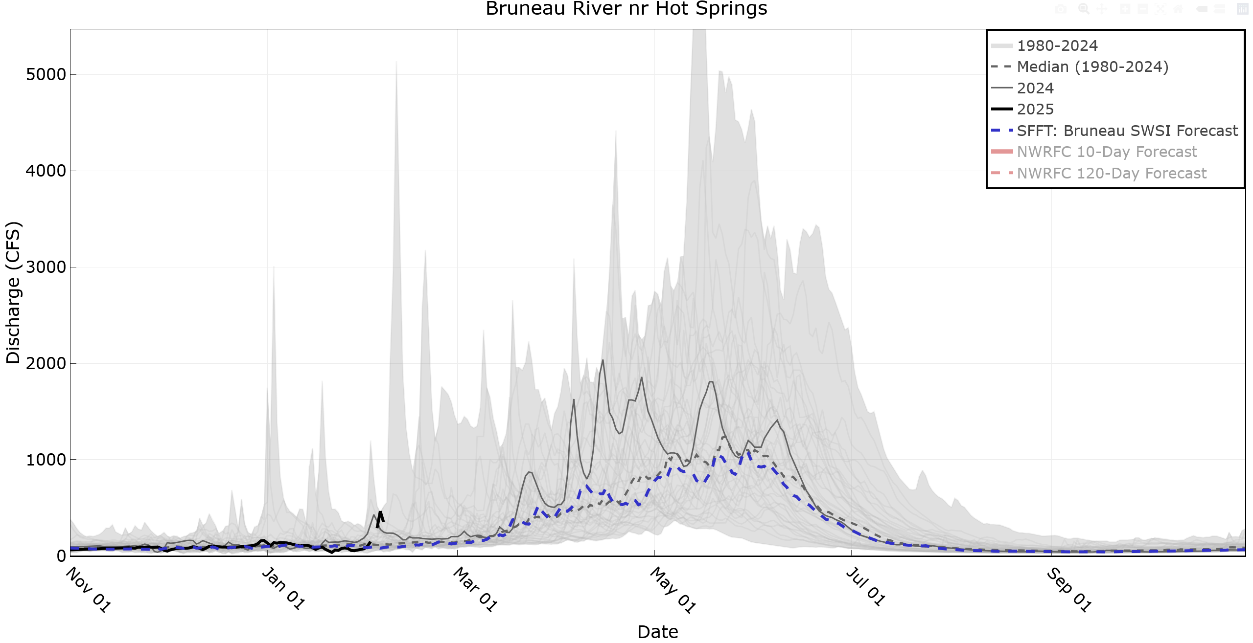
Notes:
For these return flow plots, the thick black line is 2024, the thin grey line is 2023, and the shaded area is this historical range.

Slide 9
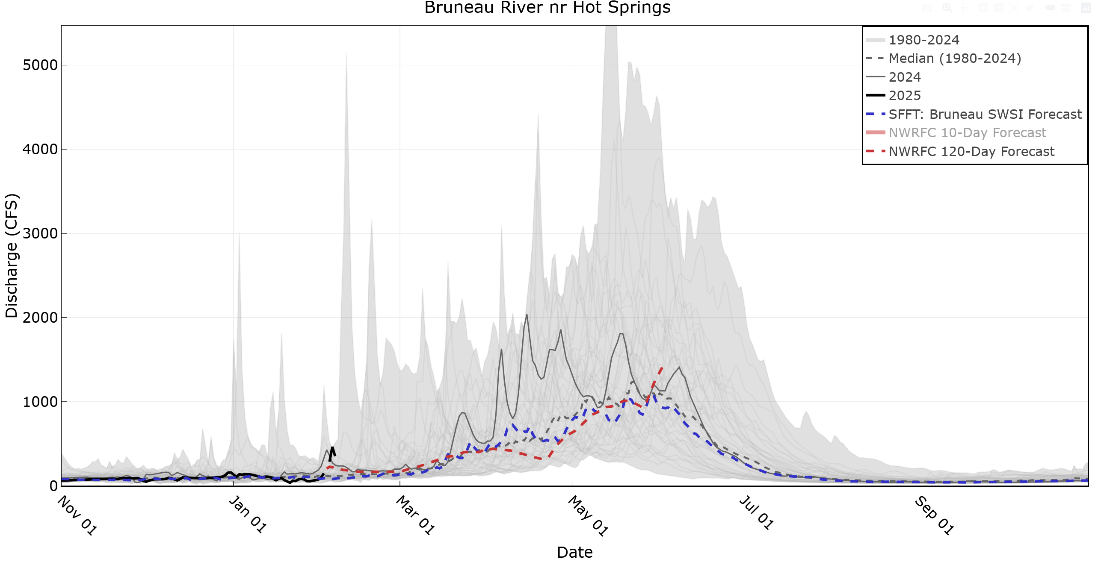
Notes:
For these return flow plots, the thick black line is 2024, the thin grey line is 2023, and the shaded area is this historical range.

Slide 10
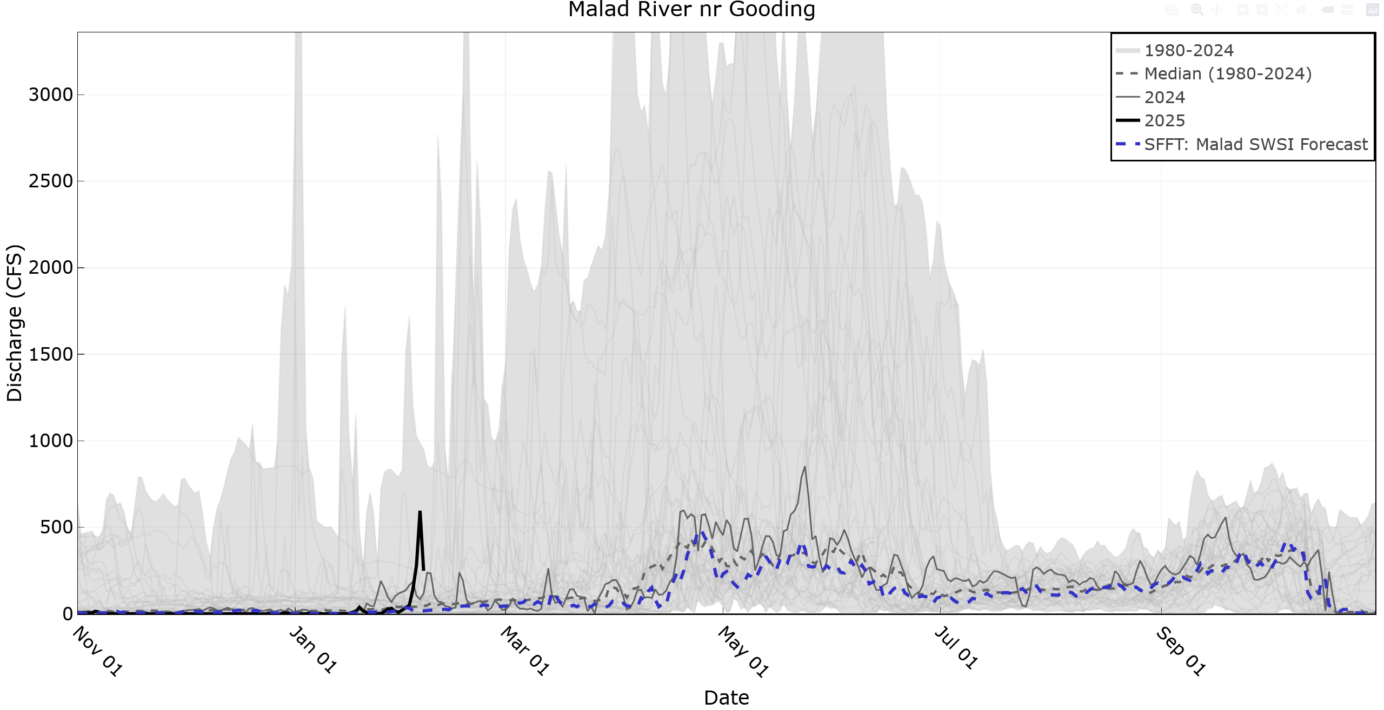

Slide 11
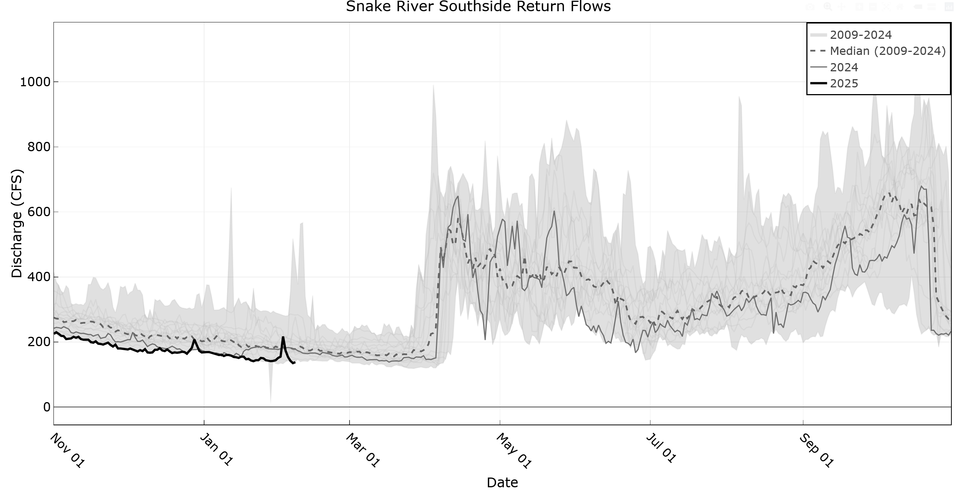
Notes:
Southside was following median, however since June has had flows towards the lower end of the historical range.

Slide 12
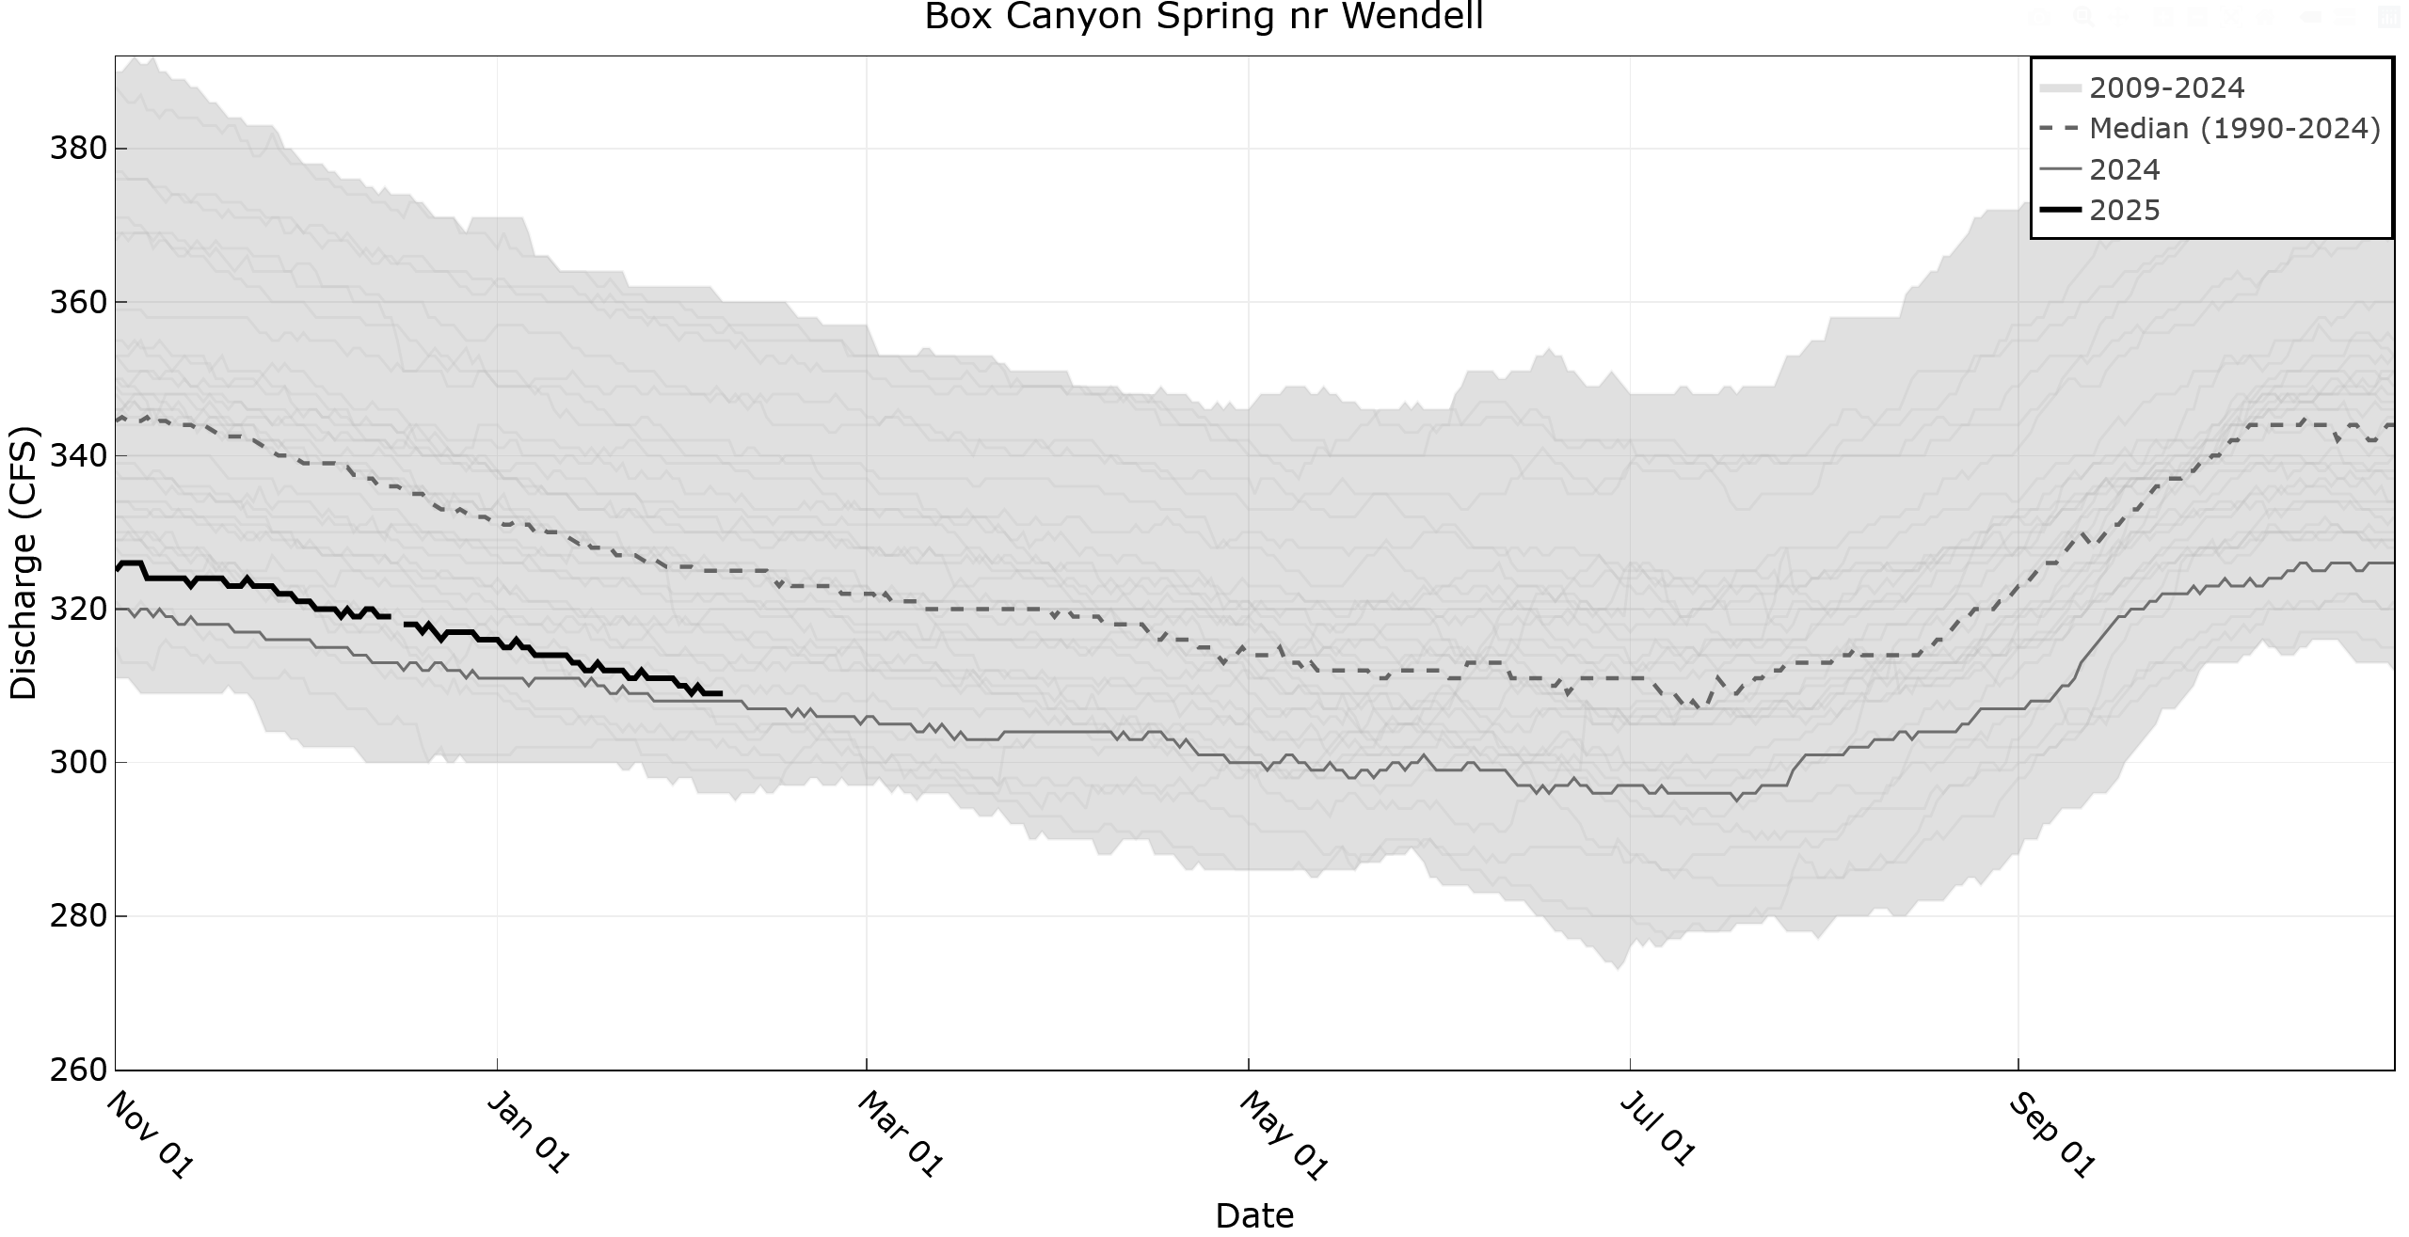
Notes:
Consistently below the median, but higher flows than last year.

