Slide 1
Milner to Swan Fall Reach Gain Statistics
Swan Falls Technical Group Meeting
February 11, 2025

Slide 2
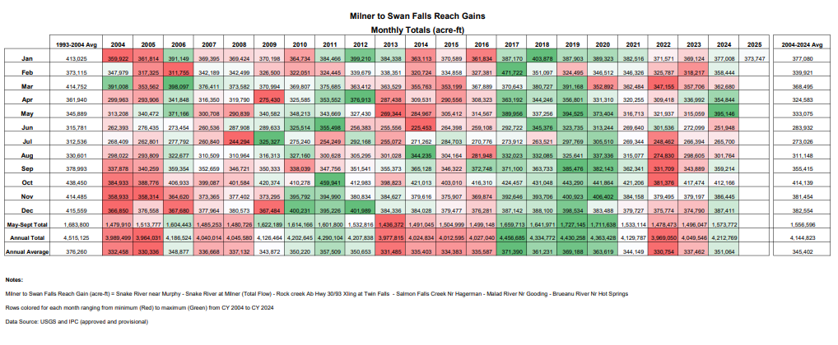

Slide 4
