Slide 1
Swan Falls AADF Update
Presented by Mac Beers
June 27th, 2024

Slide 2
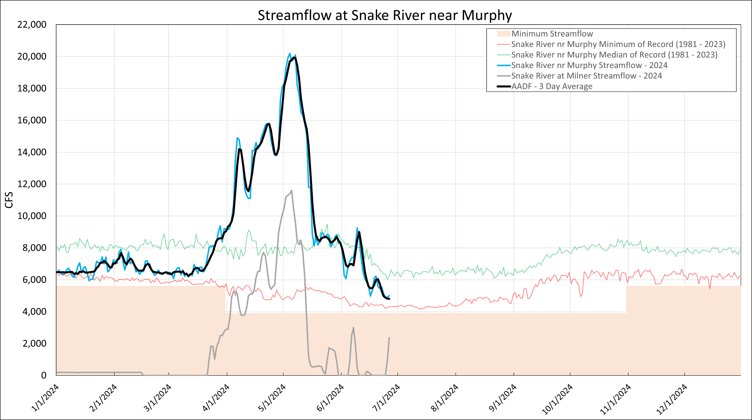
Flood Operations
USBR Flow Aug
Notes:
Key Points:
From January to mid March the AADF is below the Snake near Murphy Median of record.
Late March we see steep increase in flow, which is enhanced by Milner flood control.
This year there was a lot of flood operations, in part due to high carryover from last year and a moderate snowpack this year.
Milner did have a bit of “Off and On” in the last month.
Currently flows are right between the median and the minimum of the Murphy gauge record.

Slide 3
Flood Operations
USBR Flow Aug
6/24/2024
Notes:
Key Points:
In the near future we should expect flow to jump back up due to the USBR releasing water for flow augmentation.
Ethan talked with Chris and this is expected to go through most of July
After flow aug, we suspect IPC will release their storage.

Slide 4
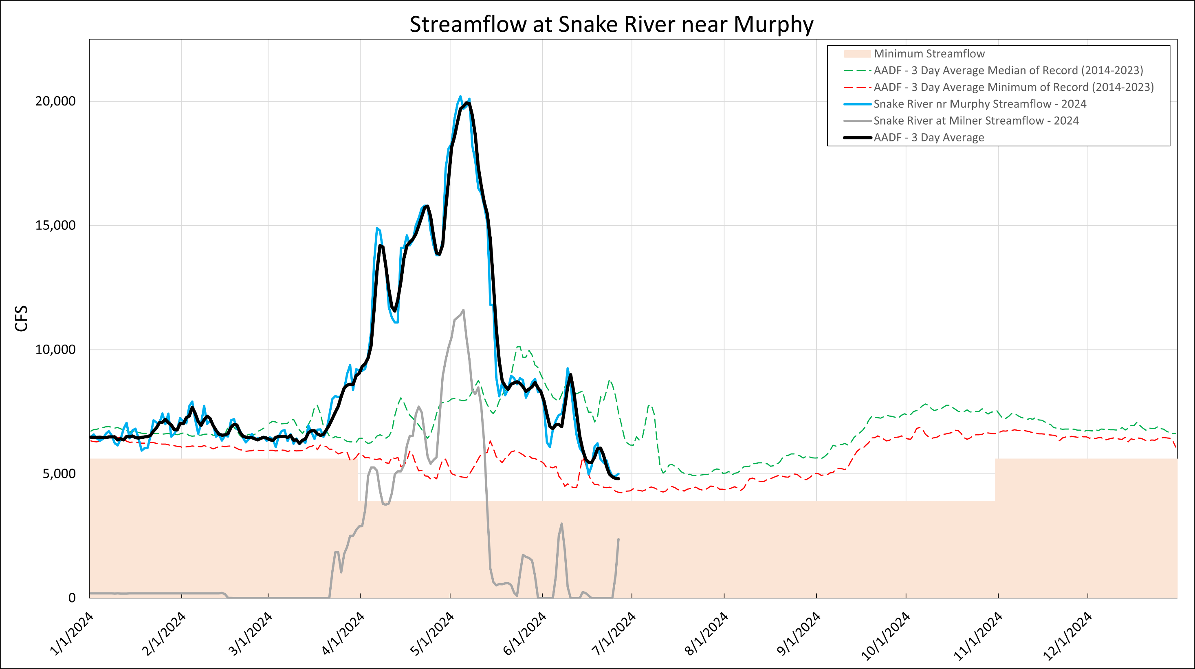
Notes:
AADF with the historic AADF from 2014-2023

Slide 5
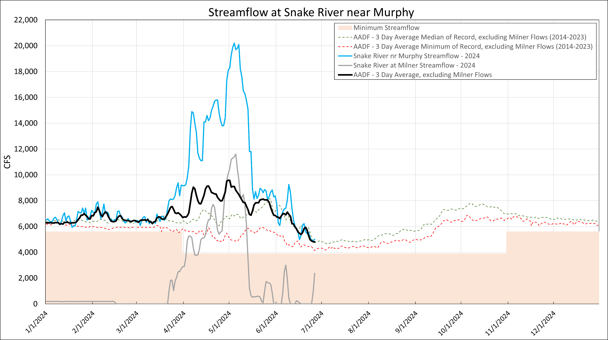
AADF Without Milner Flow
Notes:
Key Points:
Notably, flows this year with Milner releases removed have followed or exceeded the median.
Currently we sit right at the median.

Slide 6
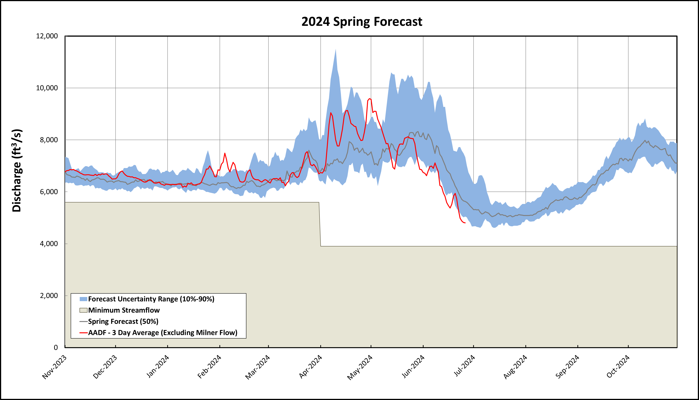
Notes:
Key Points:
Currently the flow is at the bottom end of the forecast.
This in part could be due to earlier release of the water in April
June 26 Forecast AADF = 5632 CFS (wo milner)
June 26 Actual = 4805 CFS (wo milner)
AADF Difference = 827 CFS
June 26 Bruneau SWSI forecast – actual = 1006.5 – 395 CFS =
Bruneau Difference = 611.5 CFS

Slide 7
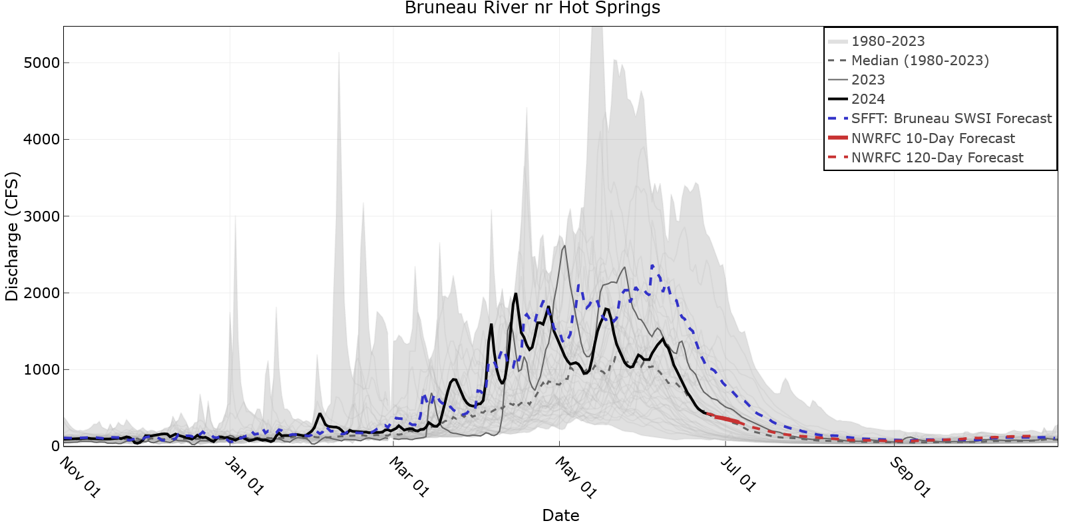
Notes:
For these return flow plots, the thick black line is 2024, the thin grey line is 2023, and the shaded area is this historical range.
In this plot specifically, we also show the SWSI forecasted flow (median of 6 most similar SWSI years) and the NWRFC 120 day forecast.
Notably, the SWSI forecasting high, with differences in flow as high as almost 1000 CFS
June 26 Forecast AADF = 5632 CFS (wo milner)
June 26 Actual = 4805 CFS (wo milner)
AADF Difference = 827 CFS
June 26 Bruneau SWSI forecast – actual = 1006.5 – 395 CFS =
Bruneau Difference = 611.5 CFS

Slide 8
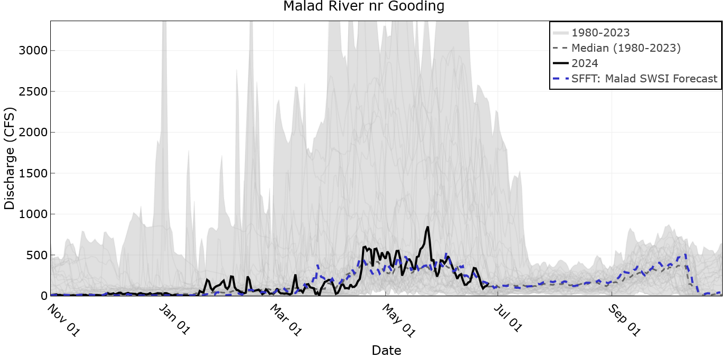

Slide 9
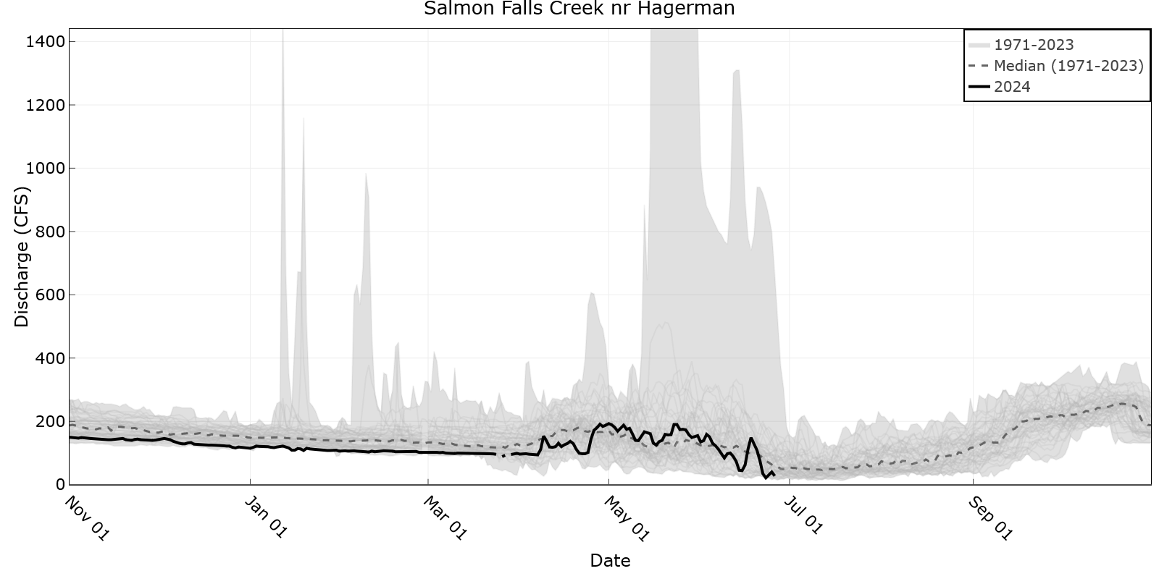
Notes:
Below the median, just recently jumped up near the median.

Slide 10
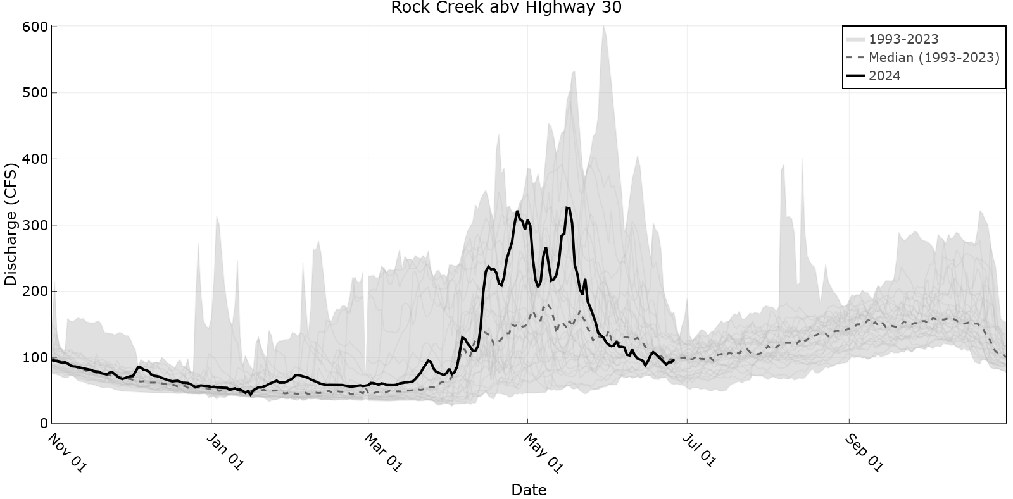

Slide 11
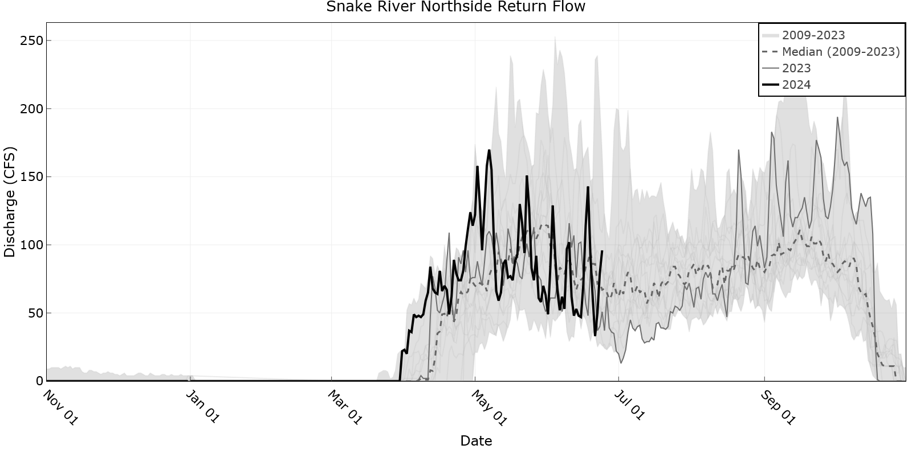
Notes:
Northside returns have fluctuated between high and median values since the start of irrigation.

Slide 12
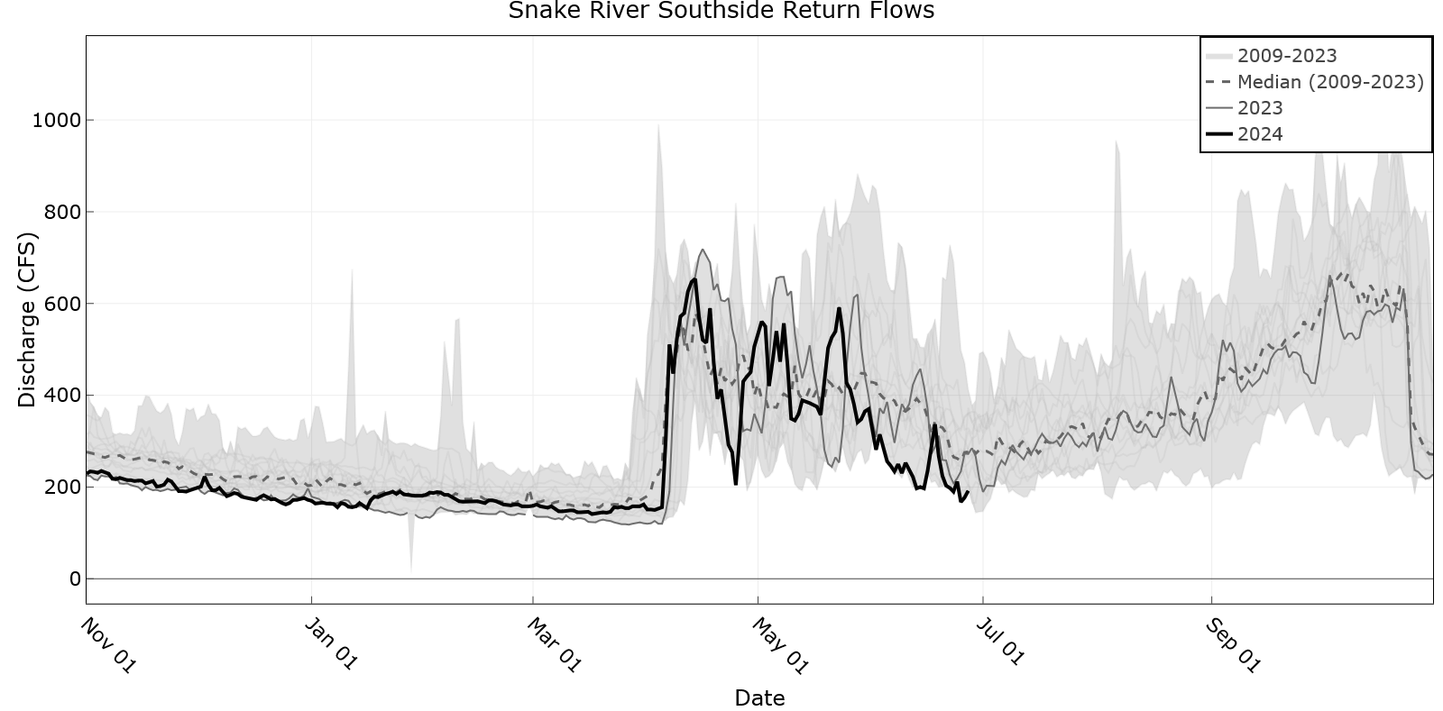
Notes:
Southside was following median, however since June has had flows towards the lower end of the historical range.

Slide 13
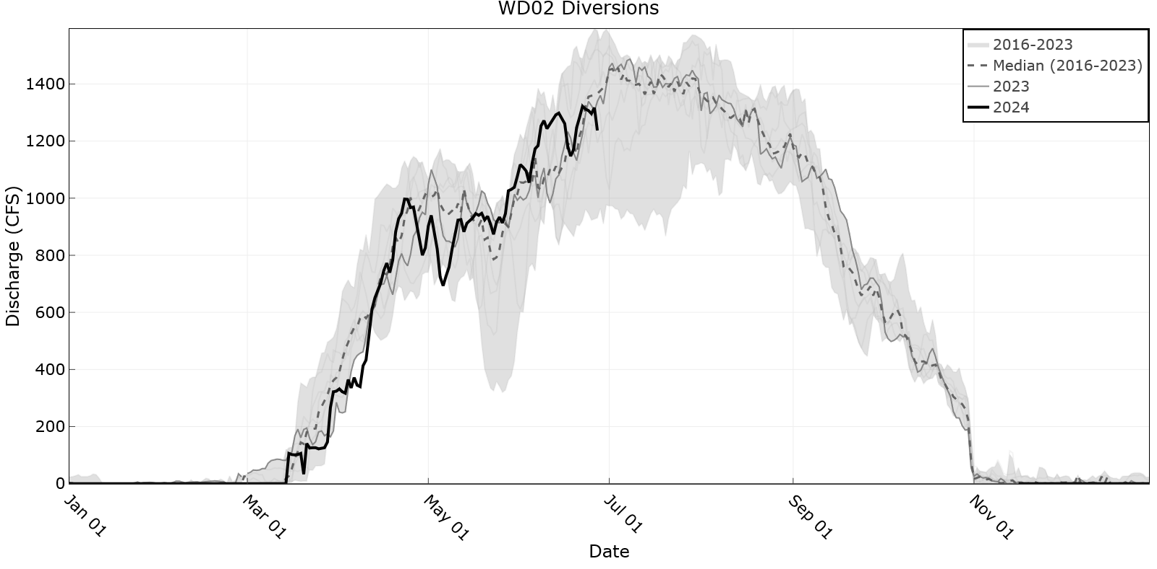
Notes:
Mostly near normal

Slide 14
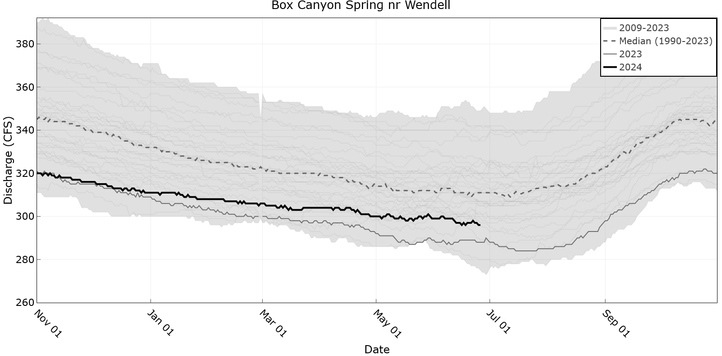
Notes:
Consistently below the median, but higher flows than last year.

Slide 15
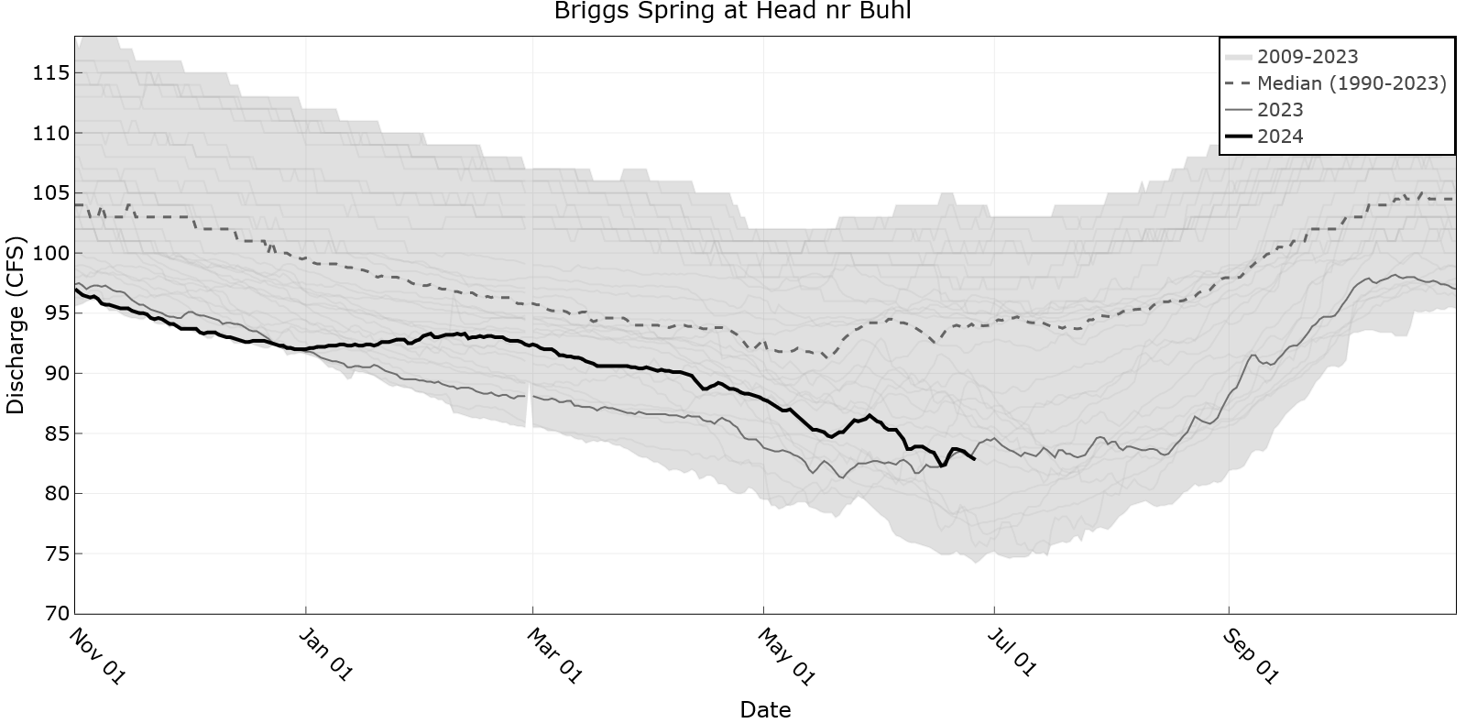

Slide 16
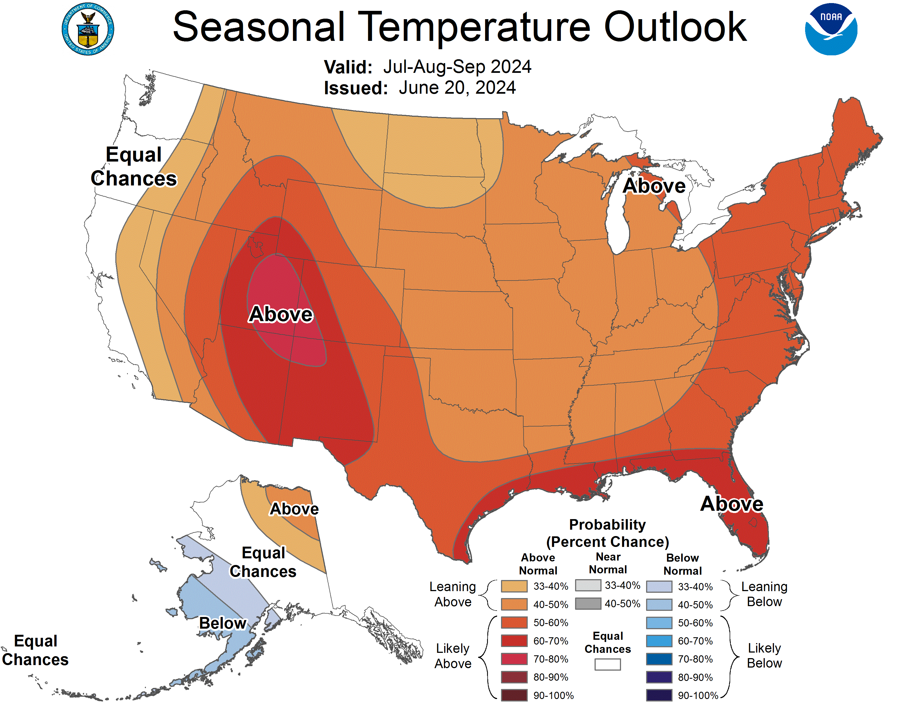
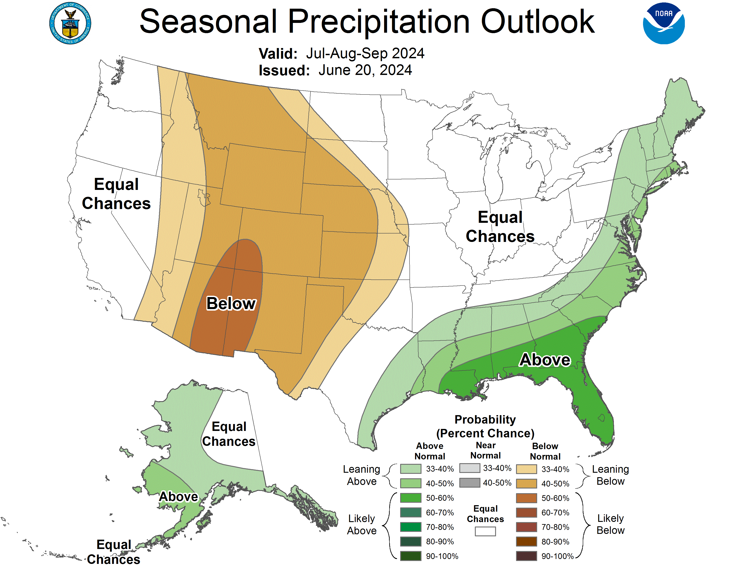
Notes:
Key Points:
Expect slightly warmer and drier conditions for the rest of the summer.
Orange – reds = likely warmer
Tans = likely drier

Slide 17
Milner to Swan Falls Main Points
Higher than normal tributary flows this spring/early summer
Recent data shows natural flow conditions near normal
Diversions and return flows have been mostly normal
NOAA forecasts warmer and drier conditions July-August-September
Possible slight drop in tributary/return flows
USBR flow augmentation will increase the AADF through most of July
USBR flow augmentation and near normal tributary and return flows are expected to maintain flows above the Swan Falls minimum through the summer

