Slide 1
Milner to Swan Fall Reach Gain Statistics
Swan Falls Technical Group Meeting
June 27, 2024

Slide 2
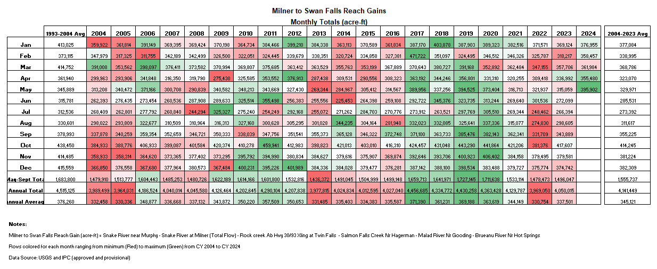

Slide 3
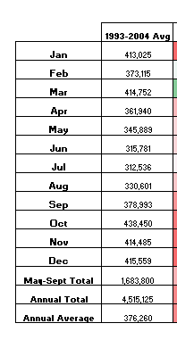
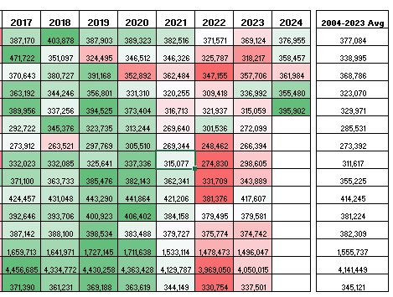

Slide 4
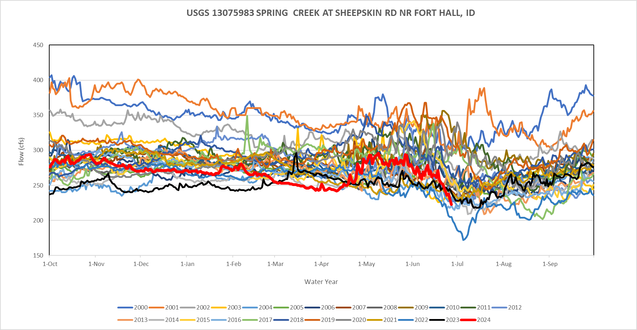

Slide 5
