Slide 1
Progress Report
Swan Falls Technical Working Group
Presented to the Swan Falls Policy Group by Sean Vincent
June 27, 2013

Slide 2
Talking Points
Swan Falls Technical Working Group
Membership
Goals
Work to date
Draft Streamflow Measurement & Monitoring Plan
Summary/Discussion
Concerns
Next steps

Slide 3
TWG Membership
State of Idaho
Christian Petrich, Liz Cresto, Sean Vincent, David Hoekema
Idaho Power Company
Jon Bowling & Pete Vidmar
Consultants
Greg Sullivan (City of Pocatello)
Chuck Brendecke (IGWA)
USGS (non-membership/support role)
Molly Wood & Dave Evetts

Slide 4
TWG Goals
Facilitate determination of “Average Daily Flow” as defined in paragraph 7 of the 1984 Agreement
Transparency
Open, collaborative process w/ stakeholder representation
Webpage to compile and disseminate information
Advise/inform policymakers re: technical issues
Assist with development of management responses/triggers

Slide 5
Work to Date
Pre-TWG work
Workshops on flow measurement 5/14/2009 and 6/11/2009
Dreher report
Reconnaissance field work (IPCO, USGS, and IDWR)
TWG
13 meetings + March 2012 Policy Group debrief + October 2012 fieldtrip
Upstream gage locations identified for CJ Strike and Swan Falls reservoirs
New reservoir stage gage installed by IPCO in Bruneau Arm of CJ Strike
Seepage survey (November 2012 & July 2013)
Collecting, compiling, & analyzing data → IDWR website
Wind analysis report (IPCO)
Draft Streamflow Measurement and Monitoring Plan

Slide 7
Draft M&M Plan - Purpose (Section 1.1)
paraphrasing (inserted text w/in parentheses):
“The purpose of this report is to outline a measurement and monitoring protocol (for calculating the Adjusted Average Daily Flow in accordance with the partial decrees) for use in distribution of water to hydropower rights (list of water right #s) and minimum stream flow water rights (2nd list of water right #s)”

Slide 8
Terminology (1.3)
On partial decrees (& in 1984 Agreement):
“Average Daily Flow” (daily average of flow measurements at the Murphy gage adjusted to account for IPCO operations)
In the Draft M&M Plan:
“Unadjusted Average Daily Flow”
“Adjusted Average Daily Flow”

Slide 9
Partial Decree Provisions (2)
(Adjusted) Average Daily Flow at Murphy includes adjustments to remove effects of IPCO reservoir operations and releases of IPCO water from sources upstream of Milner
(Adjusted) Average Daily Flow at Murphy = 3,900 cfs (4/01 – 10/31) and 5,600 cfs (11/01 – 3/31)
Excludes surface water and groundwater outside the “Trust Area” from consideration in distributing water to the partial decrees

Slide 11
Hydrology (3)
Milner to Murphy reach is 181 miles long (3.2)
Salmon Falls Creek, Malad River, & Bruneau River are the primary tributaries (3.3.7)
8 main-stem and 3 primary tributary streamgages in the reach (3.3.2)
Murphy Gaging Station is among the gages operated by IPCO (3.3.2)

Slide 13
Hydrology (cont’d)
Low flow period is mid-June through mid-August (3.3.3)
Milner to King Hill reach gains ↑ from ~4,200 cfs in 1900s to ~6,700 cfs during the 1950s but have since ↓ to ~5,000 cfs (3.3.6)

Slide 14
Why we’re here

Slide 15
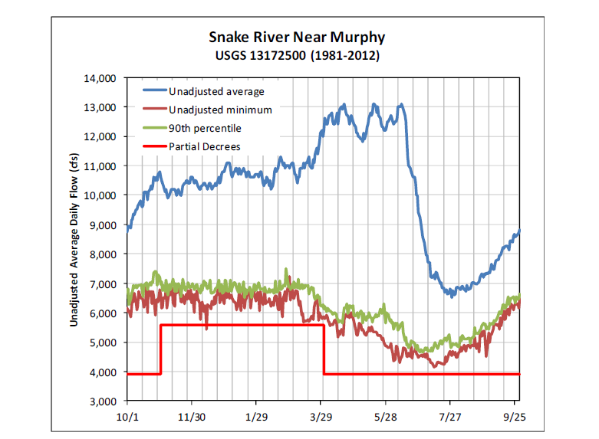

Slide 16
Hydrology (cont’d)
Irrigation diversions (3.5)
Total authorized max. diversion rate between Milner and Murphy > 3,000 cfs
Most rights for diversion are senior to subject hydropower and min. flow rights
Milner releases (3.4)
Flood control
Salmon flow augmentation (part of “actual flow conditions” so no adjustment)
IPCO releases of stored water from above Milner
No flow past Milner during low flow period in low water years

Slide 17
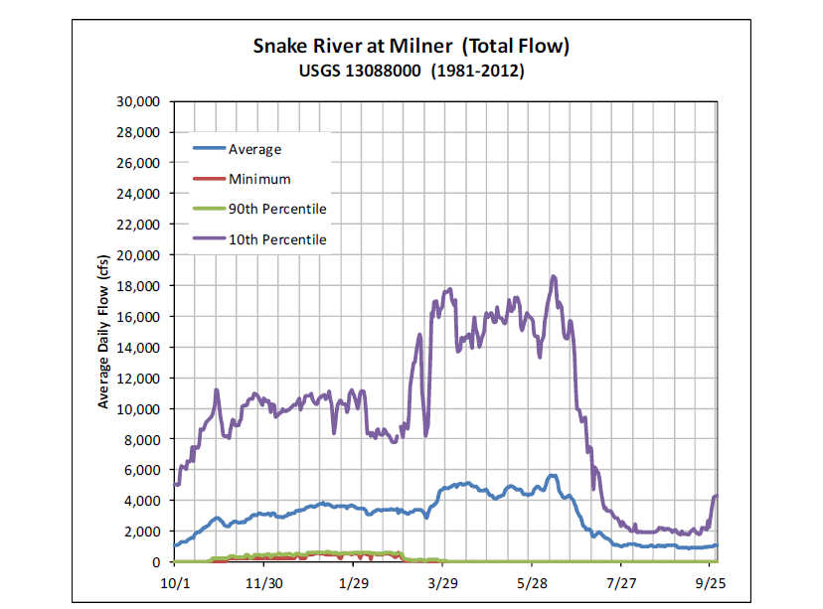

Slide 18
Hydropower Facilities (4)
6 IPCO reservoirs below Milner Dam
4 IPCO reservoirs w/ potential to impact Murphy flow
At equilibrium, unadjusted flow ↓ if a reservoir accumulating storage & unadjusted flow ↑ if a reservoir releasing storage
Impacts are lagged & attenuated
~ 8-hour travel time from CJ Strike to Murphy for flow < 5,000 cfs

Slide 19
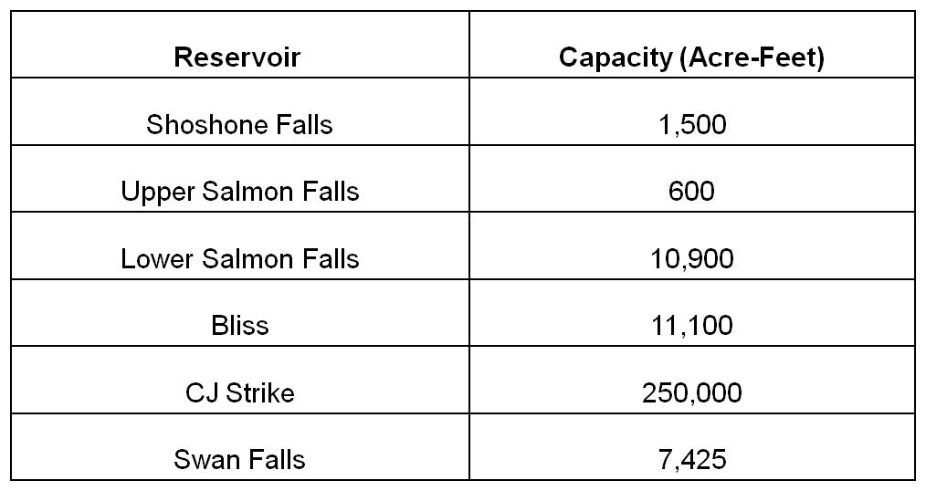
IPCO Reservoir
Capacity (acre-feet)

Slide 20
Reservoir | Lower Salmon Falls | Bliss | CJ Strike | Swan Falls
Capacity (acre-ft) | 10,900 | 11,100 | 250,000 | 7,425
Surface area (acre) | 748 | 255 | 7,500 | 1,525
Permissible stage adjustment (ft) | 2 | 2 | 1.5 | 4
Volume (acre-ft) | 1,496 | 510 | 11,250 | 6,100
Maximum potential reduction to avg. daily flow (cfs) | 754 | 257 | 5,672 | 3,075

Slide 21
Quantifying Impact of IPCO Operations (5)
Calculating Adjusted Average Daily Flow requires determination of storage change for each IPCO reservoir and conversion into equivalent flow rate
Time delay before impacts to Murphy flow so storage changes must be lagged/routed
Also correct for releases of IPCO owned/leased water (subtraction)

Slide 22
Methods for Estimating Change in Storage
Reservoir-Stage Method → requires reservoir stage measurements and stage vs. capacity tables
R-S Method more straightforward and easier to implement because it involves fewer measurements
R-S Method can be unreliable during windy periods
Winds typically are mild during low-flow periods in July and at night
Flow Method (Dreher) → requires upstream and downstream gages plus estimate of all inflows & outflows between the gages
Inflows
Snake River, tributaries, return flows, precipitation, river and reservoir gains
Outflows
Snake River, canals, diversions (high lift pumping plants & canals), reservoir evaporation, river and reservoir losses

Slide 24
Procedure
Calculate Unadjusted Average Daily Flow (UADF) at Murphy
For each IPCO reservoir, measure stage (R-S Method) or identify and quantify inflow and outflow terms (Flow Method)
Determine rate of storage change for each reservoir
Flow Method → ΔS/Δt_{reservoir_x} = ΣInflows_{reservoir_x} – ΣOutflows_{reservoir_x}
R-S Method → ΔS/Δt_{reservoir_x} = (volume_{stage2} – volume_{stage1})/(t2-t1)
Route the storage changes
Perform accounting (sum the routed changes to the UADF)
Adjusted = UADF– (IPCO_{owned/leased}*RF₀) + (ΔS/Δt_{reservoir_1}*RF₁) + (ΔS/Δt_{reservoir_2}*RF₂) + …
where,
RF = routing function for reservoir_x

Slide 25
Important Points
Methods are equivalent except for manner in which change in storage is determined
Flow Method involves calculation of storage change based on flow measurements
R-S Method involves indirect measurements of storage
Routing functions have not yet been determined → planning initially to use rule-of-thumb travel time estimates
Only R-S Method can be implemented using available data

Slide 26
Sources of Uncertainty (7)
Murphy Gaging Station (7.1)
Rated “Good” by USGS (95% of daily values within 10% of true)
Subject to “shifts” during low flow period because of aquatic growth
Lowest achievable uncertainty ~ 1–2% for multiple transects w/ boat
Reservoir Stage Method (7.2)
Waves, wind, bathymetry
Flow Method (7.3)
Uncertainty ↑ w/ the number of measurements

Slide 28
Summary & Recommendations (8)
Two methods for determining Adjusted Average Daily Flow
R-S Method recommended as primary approach
R-S Method is easier to implement (& potentially more reliable) because it involves fewer measurements
R-S Method may be inaccurate during high winds
Implement R-S method for at least a year to refine & evaluate reliability
Flow Method can’t be implemented w/ existing monitoring network

Slide 29
Summary and Recommendations (cont’d)
Continue to work toward implementation of Flow Method as a backup method and to evaluate reliability of R-S Method
Routing required w/ both methods → test and refine routing assumptions
Use multi-day averaging to smooth Adjusted Average Daily Flow fluctuations
Make frequent boat-based flow measurements if approaching minimum flow to reduce uncertainty

Slide 30
Concerns
Lead time for implementation
Draft M&M Plan proposes ≥ 1 year to develop/test/refine R-S Method
Seepage survey results, diversion measurements, and upstream gage data not yet available for implementation of Flow Method
Need to do additional work on routing, wind effects, uncertainty, and multi-day averaging
Public perception
Avoid potential appearance of bias
Gage accuracy
Snake River nr Murphy (13172500) rated “Good” by USGS (± 10%)
Snake River below CJ Strike Dam (13171620) rated “Fair” (± 15%)

Slide 31
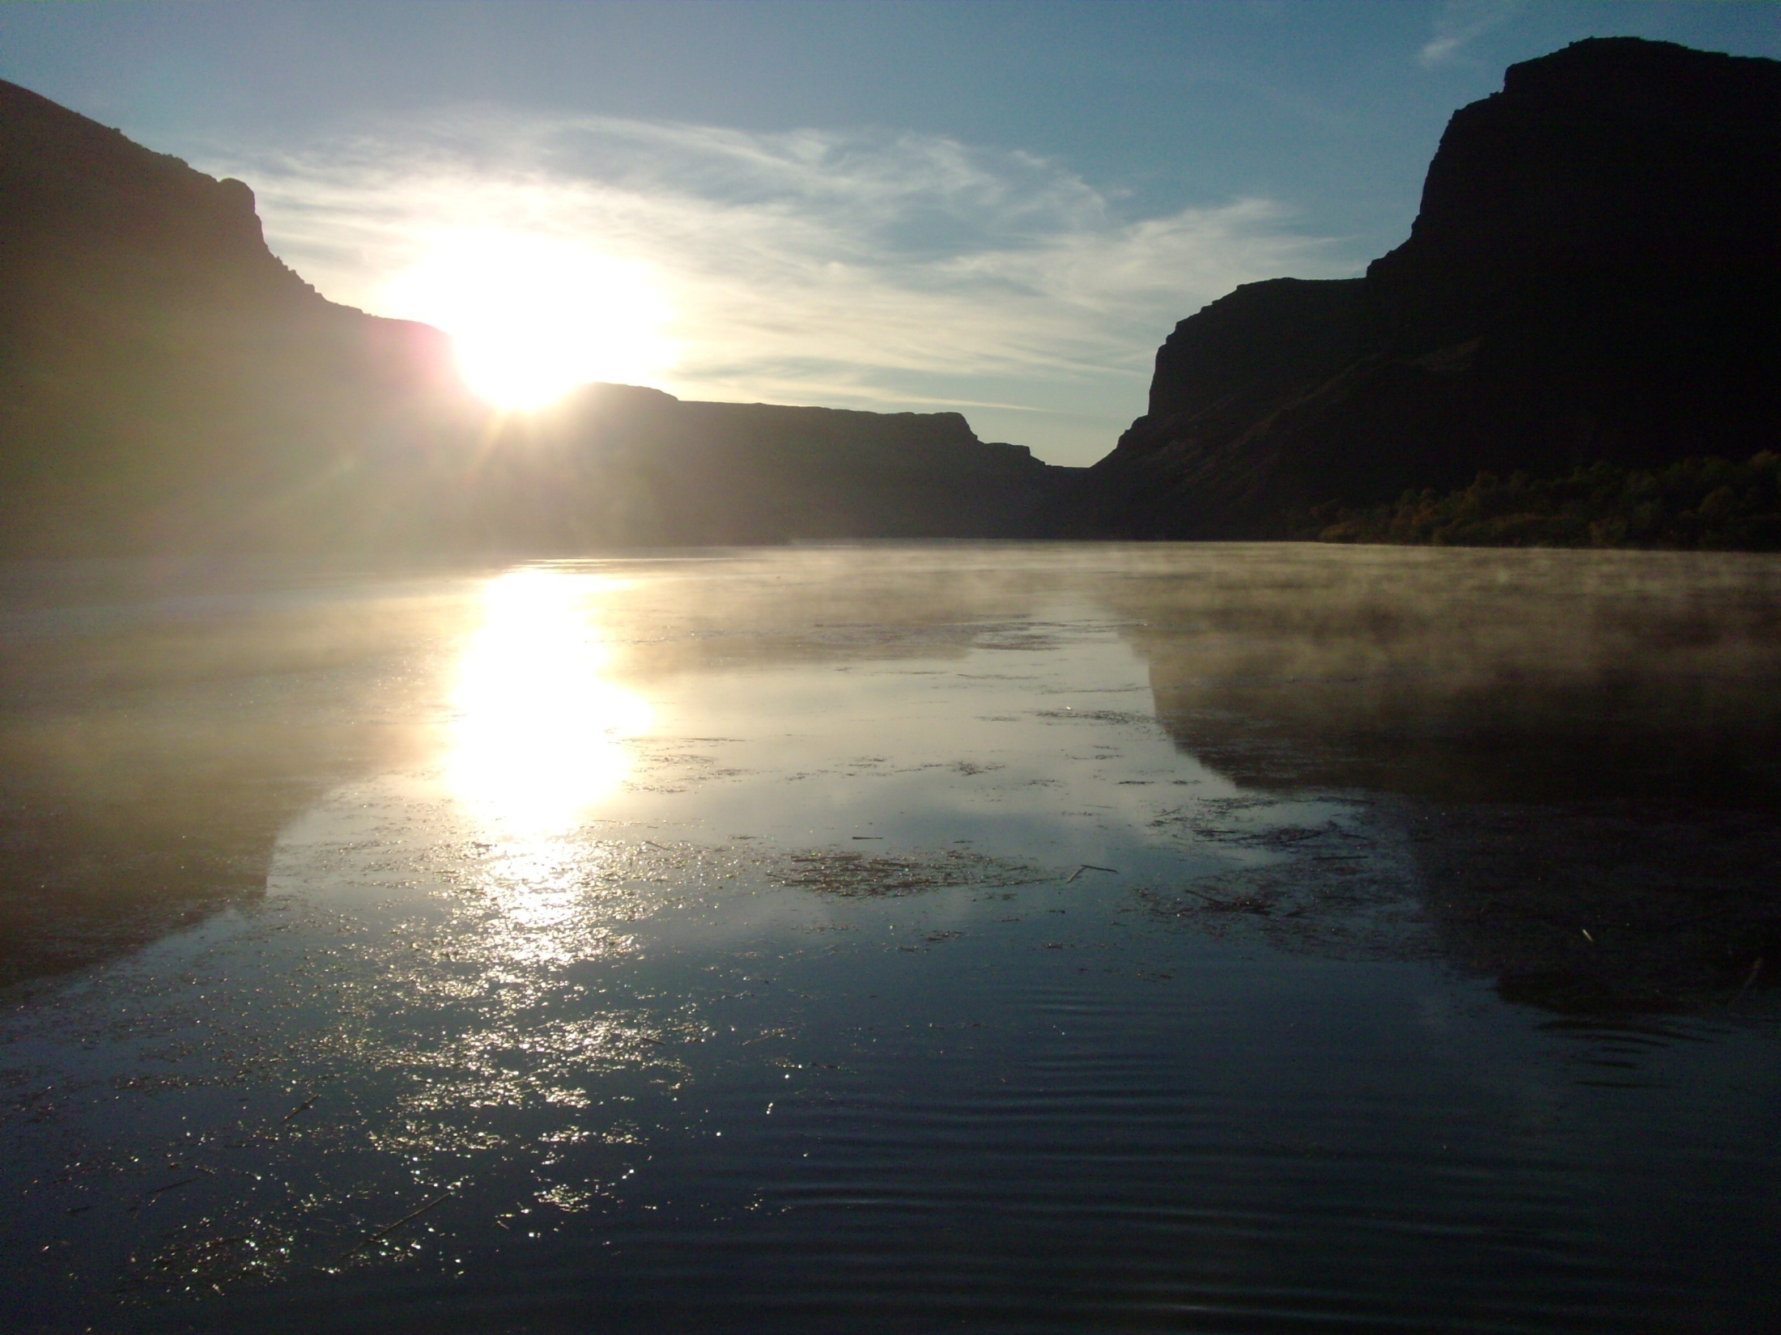
Questions?

Slide 32
Next Steps
Finalize seepage survey
Seepage run #2 = July 16 & 17
Draft report - December 1, 2013
Implement , evaluate, and refine protocol for the R-S Method using IPCO stage data
Evaluate wind impacts & incorporate into protocol
Develop database and/or spreadsheet-based application for calculations
Install new gages
Bruneau River, Loveridge Bridge, & upstream of Swan Falls Reservoir
Additional reservoir stage gages on CJ Strike
Add telemetry and survey Cottonwood Park stage gage (Bruneau Arm)

Slide 33
Next Steps (cont’d)
Implement Flow Method and compare w/ R-S Method
Work with USGS to quantify uncertainty for both methods
Revise Streamflow Measurement & Monitoring Plan
Develop short- and long-range forecasting tools
Develop implementation plan?

