Slide 1
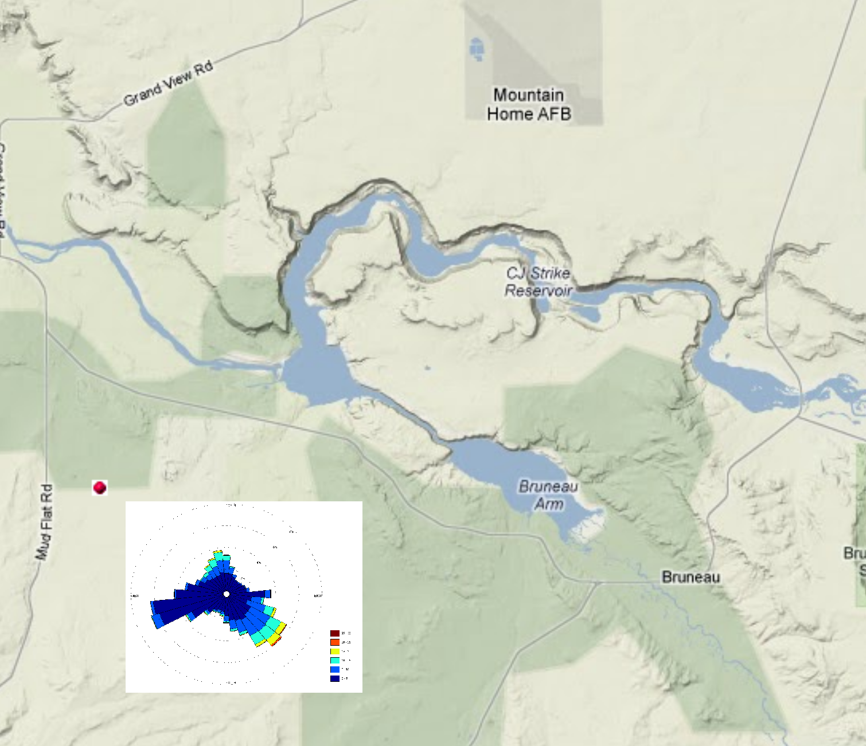
Grand View Weather Station

Slide 2
CJ Strike Wind Rose (2010 & 2011)

Slide 3
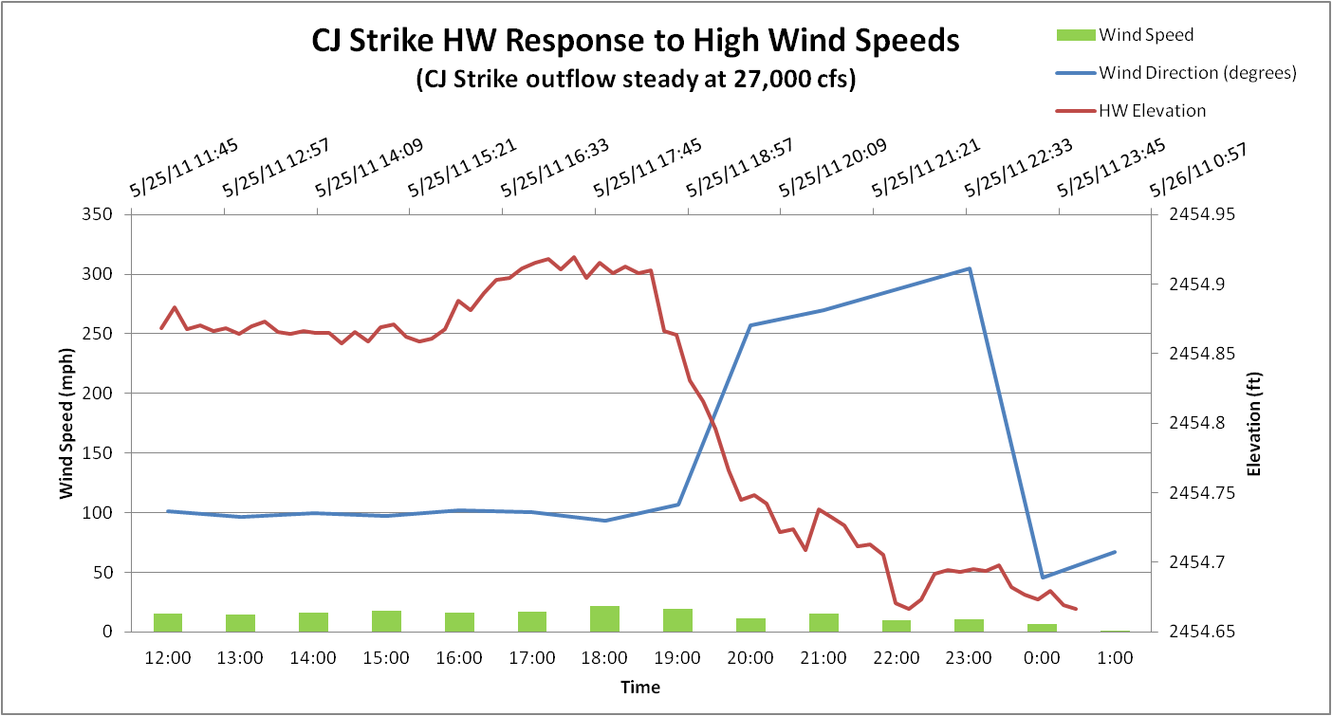
Wind Influence on Headwater Elevation

Slide 4
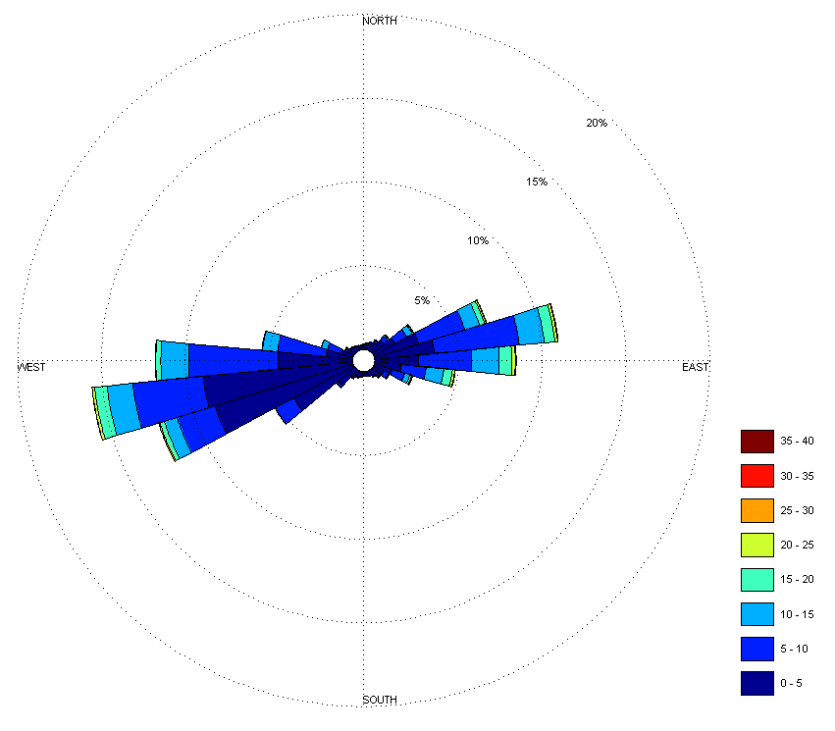
Brownlee Reservoir Wind Rose (2004 & 2005)

