Slide 1
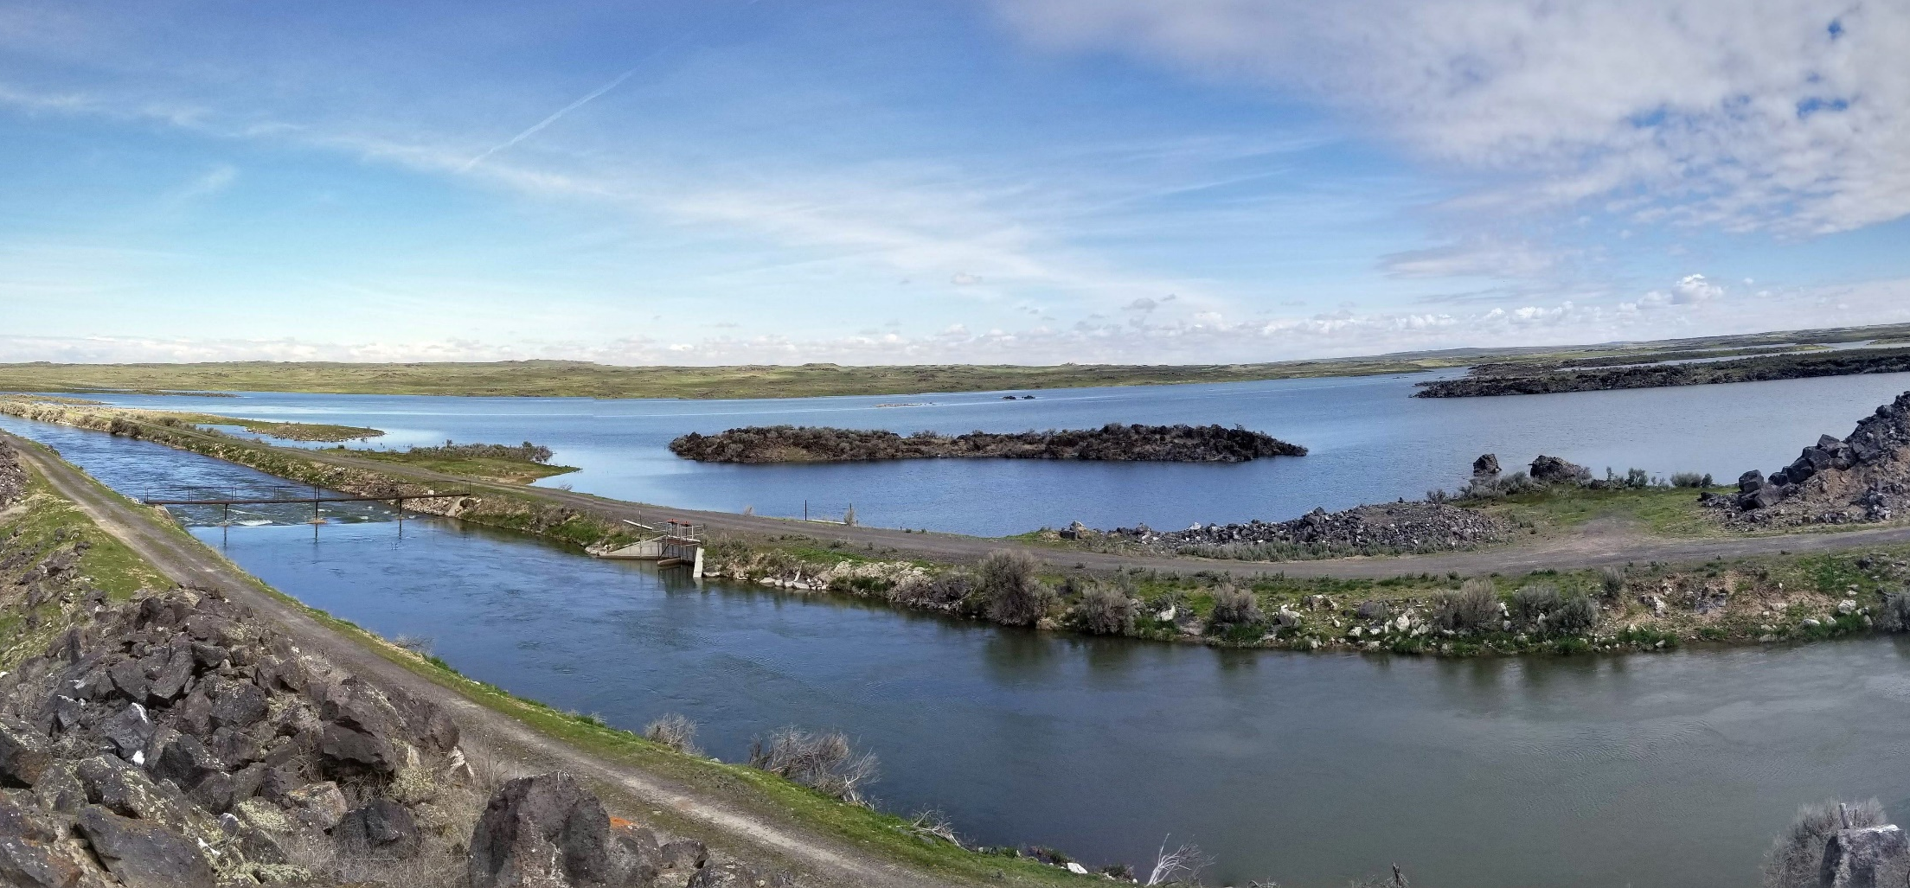



Water Resource Board
ESPA Managed Recharge Program Update
Environmental Resource Technical Working Group – Fall 2020
Wesley Hipke
IWRB Recharge Program Manager
November 24, 2020

Slide 2
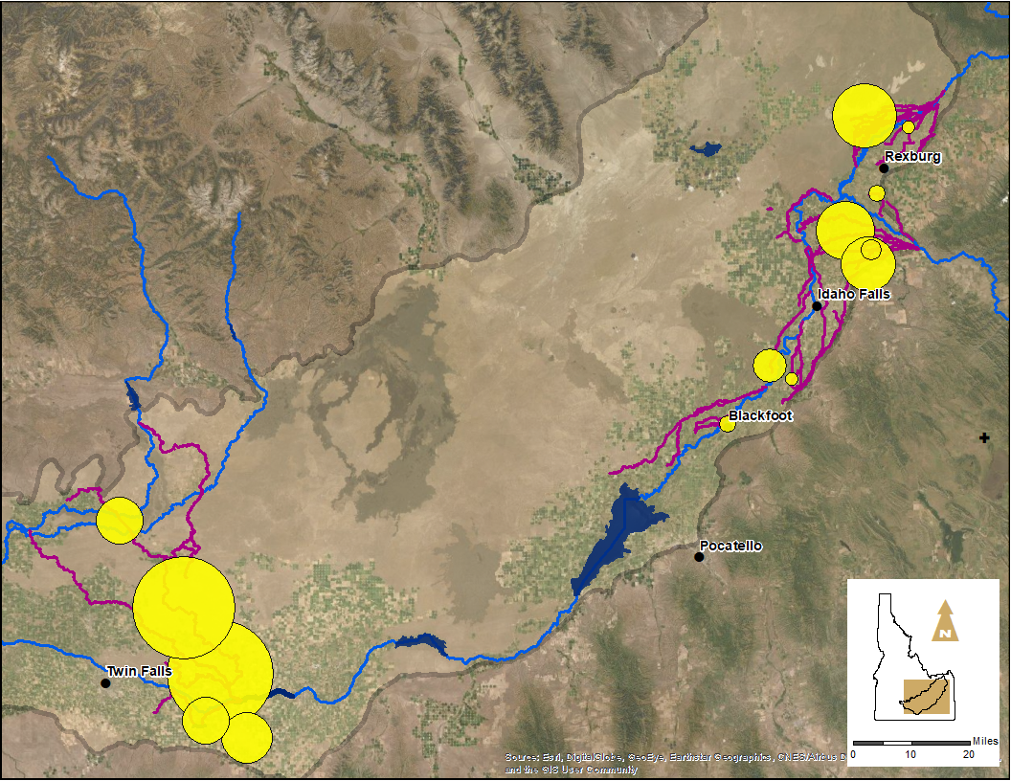
IWRB Natural Flow Managed Recharge – 2019/2020
Total IWRB Recharge
450,323 af
IWRB Diversion Rate
Max. 3,144 cfs
Med. 626 cfs
Oct 24 - May 14

Slide 3
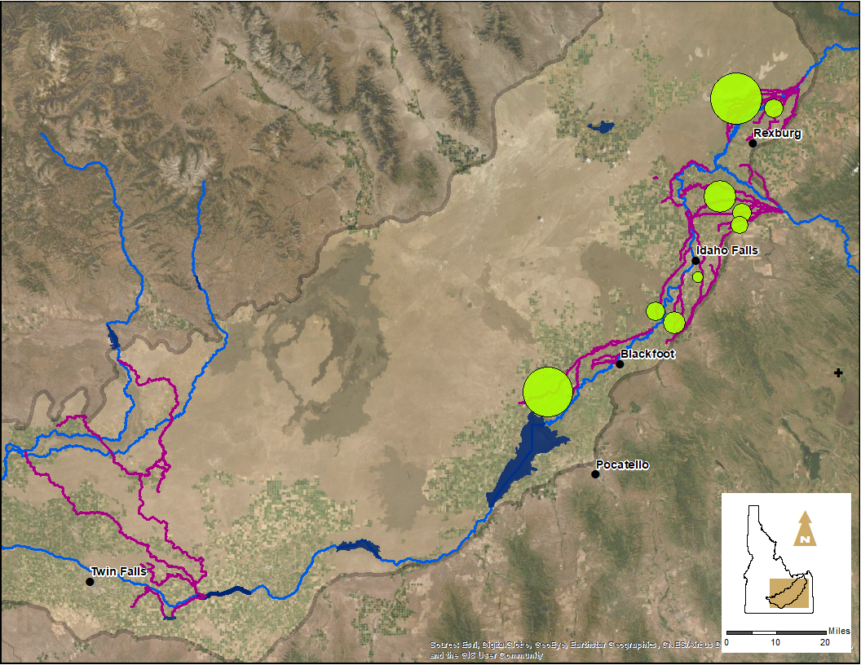
IWRB ESPA Managed Recharge for Others – Fall 2019
Storage Recharge
68,308 af
IWRB Diversion Rate
Max. 1,009 cfs
Med. 342 cfs
Aug 22 - Nov. 26
Notes:
AVG Diversion rate 355 cfs

Slide 4
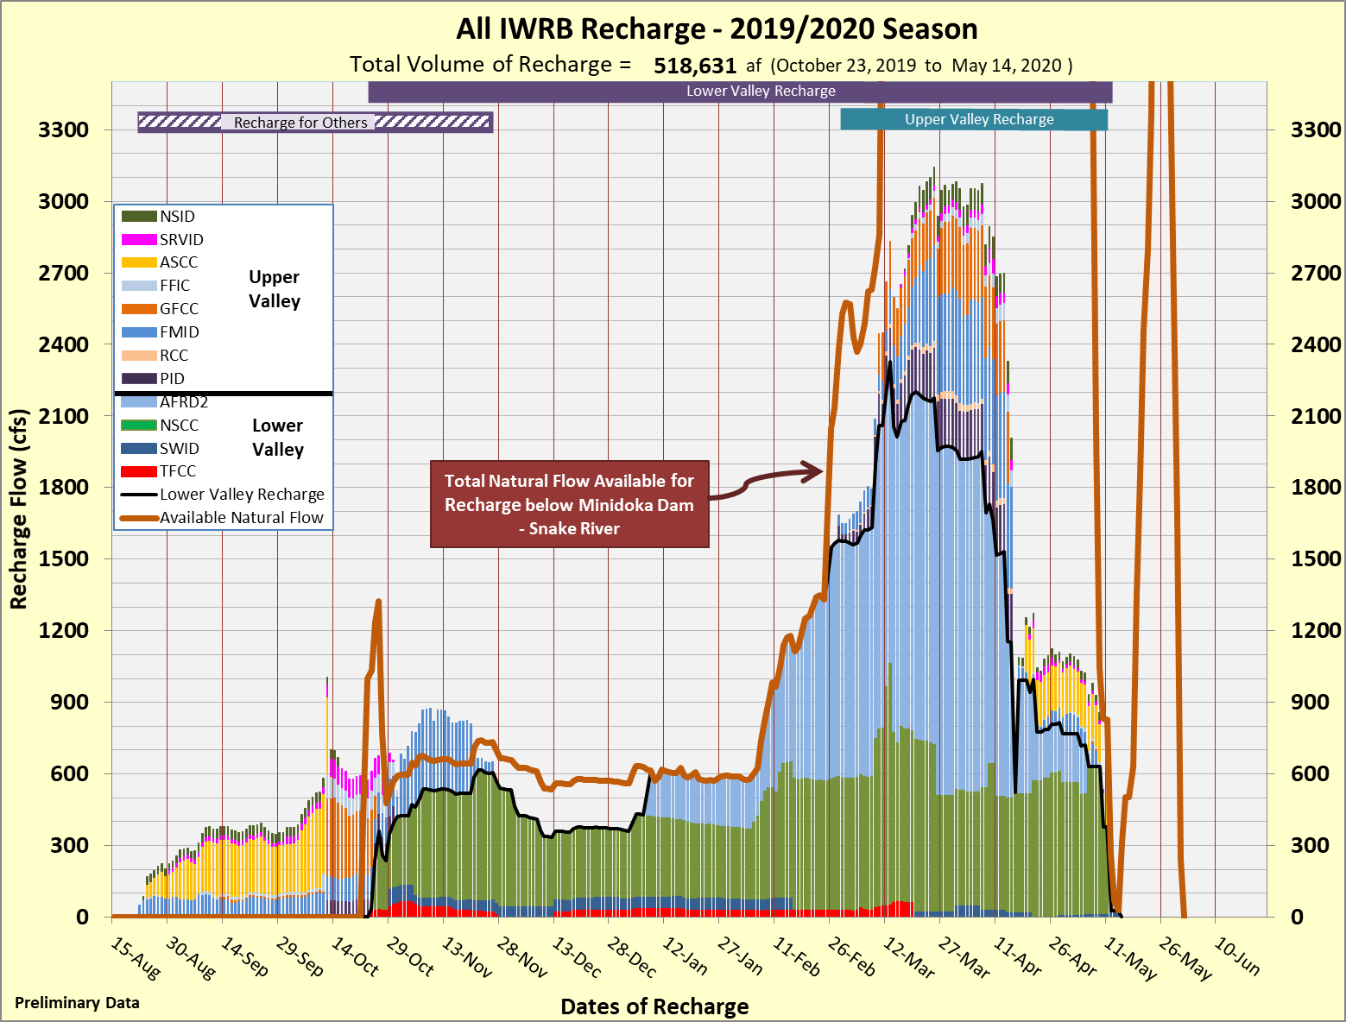
Notes:
NF: Oct 24 - May 14
Milner Flow – 0 Jan 8 – Feb 23

Slide 5
IWRB ESPA Natural Flow Recharge 2014 - 2020
Max
21,000
Max
16,000
Max
16,000

Slide 6
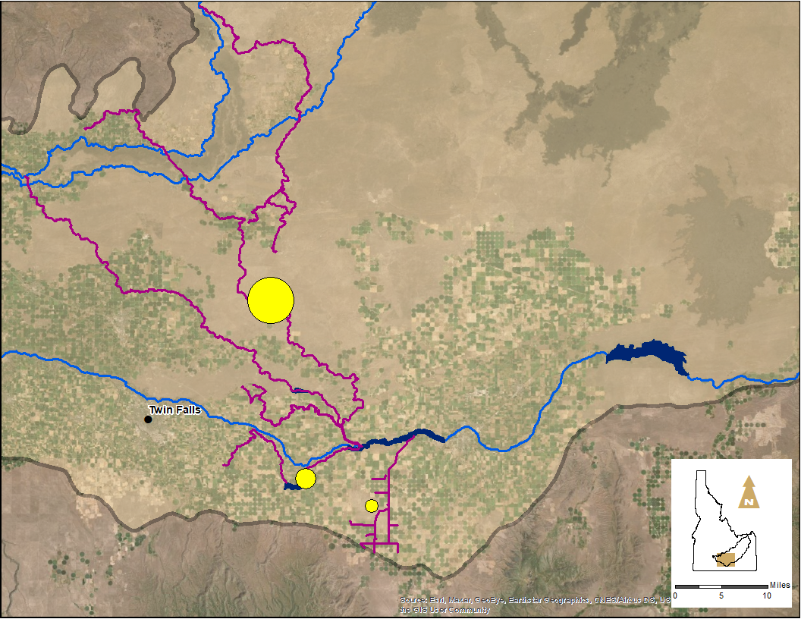
IWRB Natural Flow Managed Recharge – 2020/2021
Total Natural Flow Water Recharged
24,319 af
Oct 29 - Nov. 23
Diversion Rate
Median: 572 cfs
AFRD2
555 cfs
TFCC
SWID
42 cfs
45 cfs

Slide 7
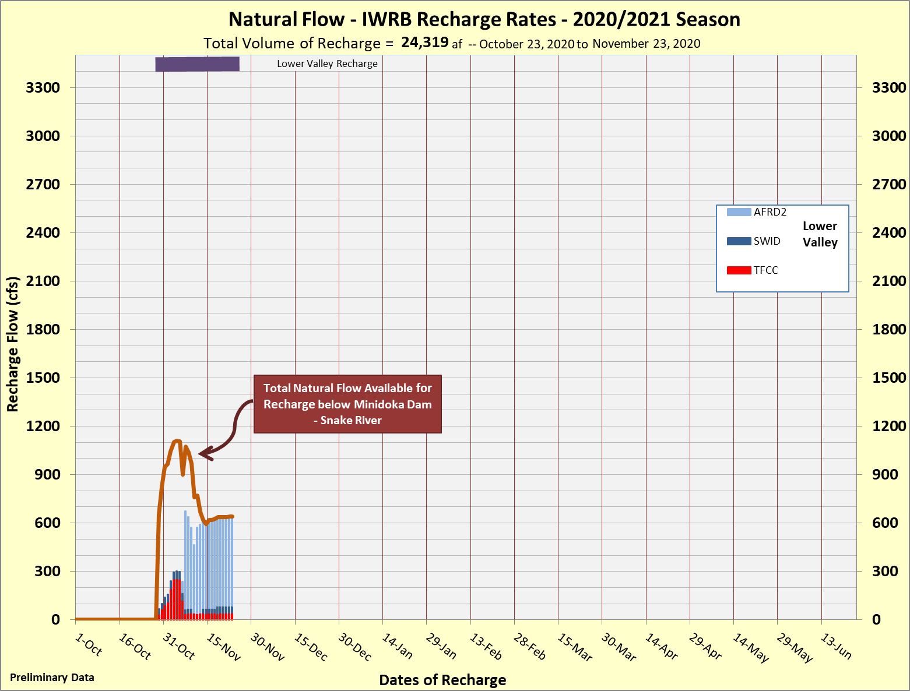
Notes:
Milner Flow 0: Nov 13

Slide 8
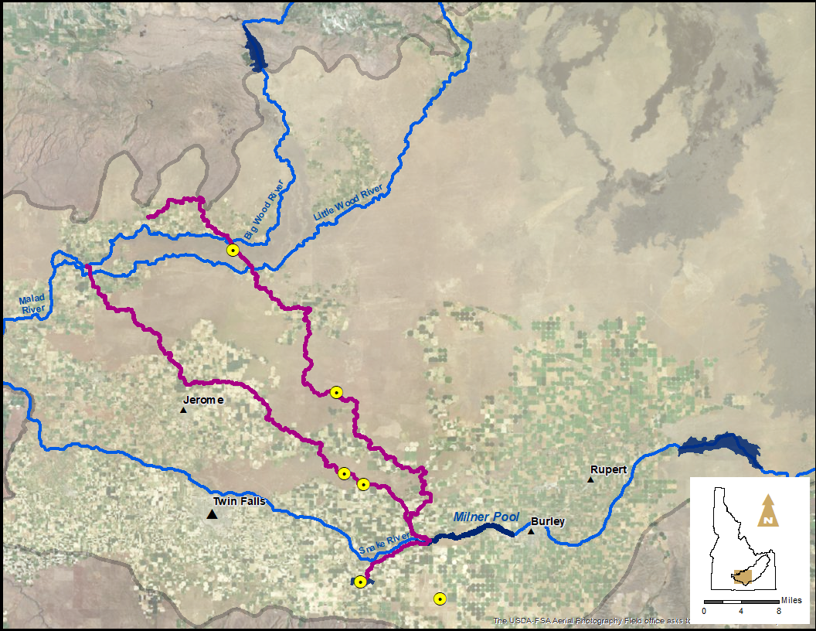
IWRB Recharge – Winter 2020
Current Conditions
IWRB Recharge
Dec 1 – Feb 15
-200 cfs
Current IWRB Recharge
640 cfs
Minidoka Dam Flows
552 cfs
Milner Dam Flows
0 cfs
Notes:
~80-90 cfs gain between Minidoka & Milner

Slide 9
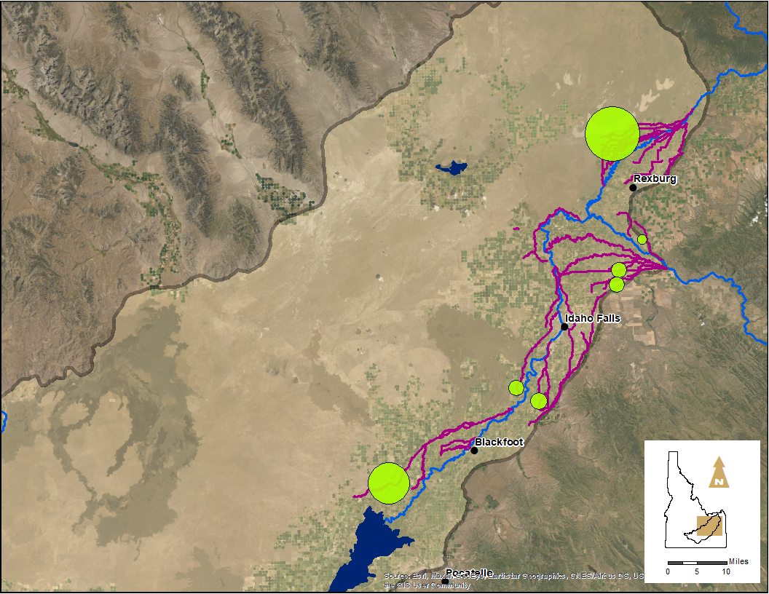
IWRB ESPA Managed Recharge for Others – Fall 2020
Storage Water to Recharge
63,453 af
Storage Recharge
60,350 af
IWRB Diversion Rate
Max. 757 cfs
Med. 399 cfs
Sept 4 - Nov. 23
Notes:
AVG Diversion rate 402 cfs

Slide 10
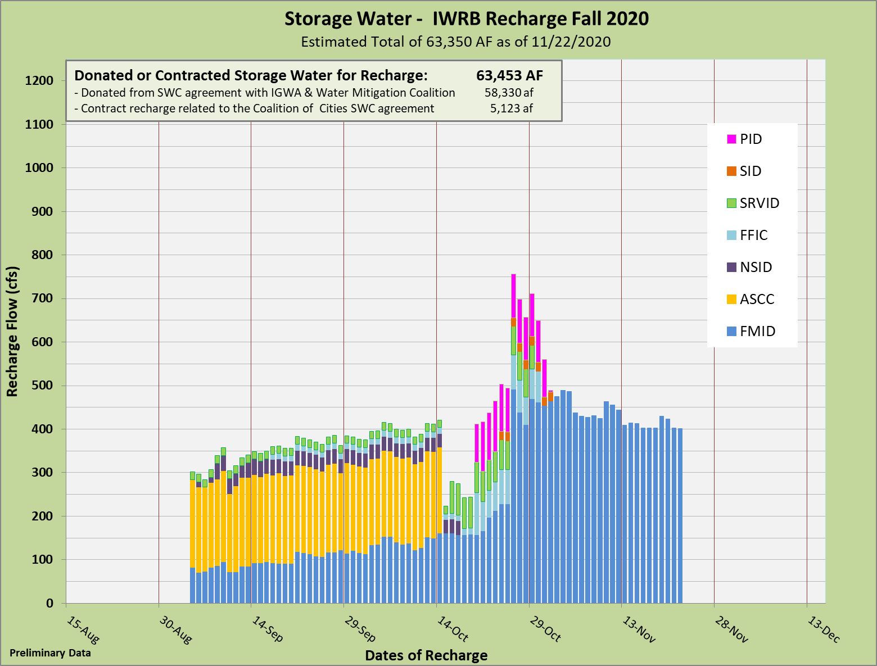

Slide 11
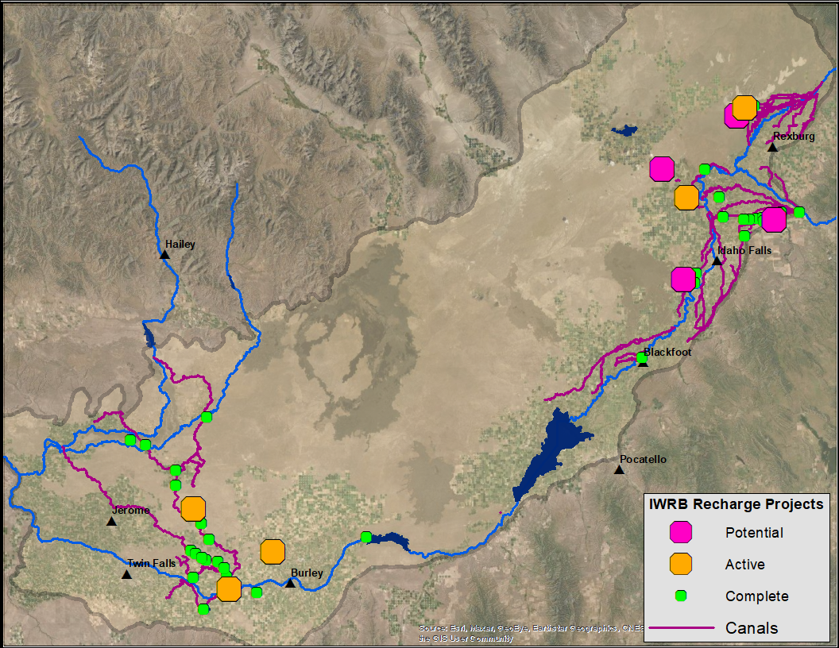
IWRB ESPA Recharge Capacity Projects
Egin Phase II Recharge Site
Egin Phase III Project
Mud Lake Project
Butte Market Lake Recharge Well
Swan Hwy Recharge Project
Hell’s Half-Acre Project
MP31 BLM Embankment
A&B Recharge Wells
Twin Falls Recharge Wells

Slide 12
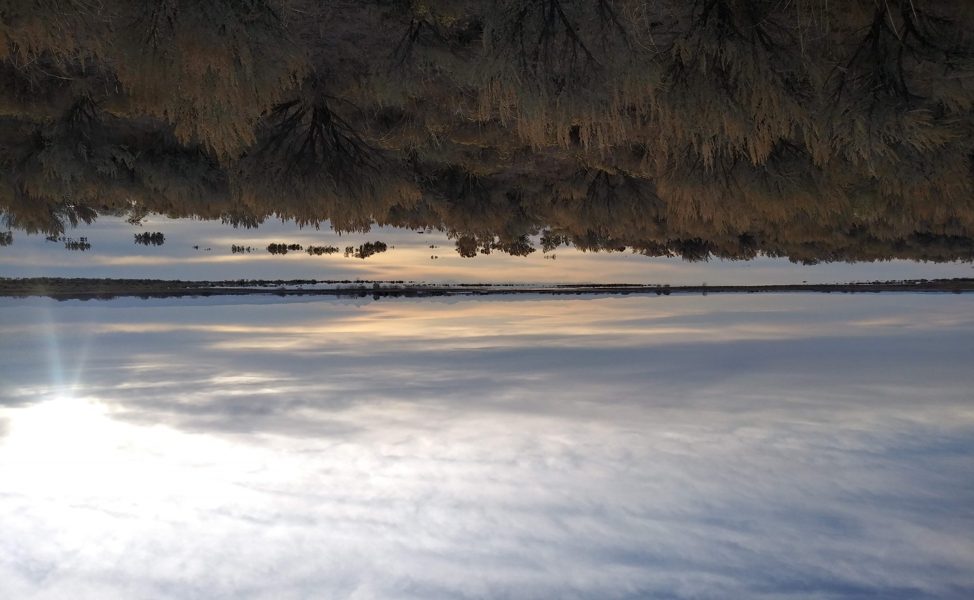
Questions
Mile Post 31 recharge basin on April 8th, 2013.
Notes:
1

