Slide 1
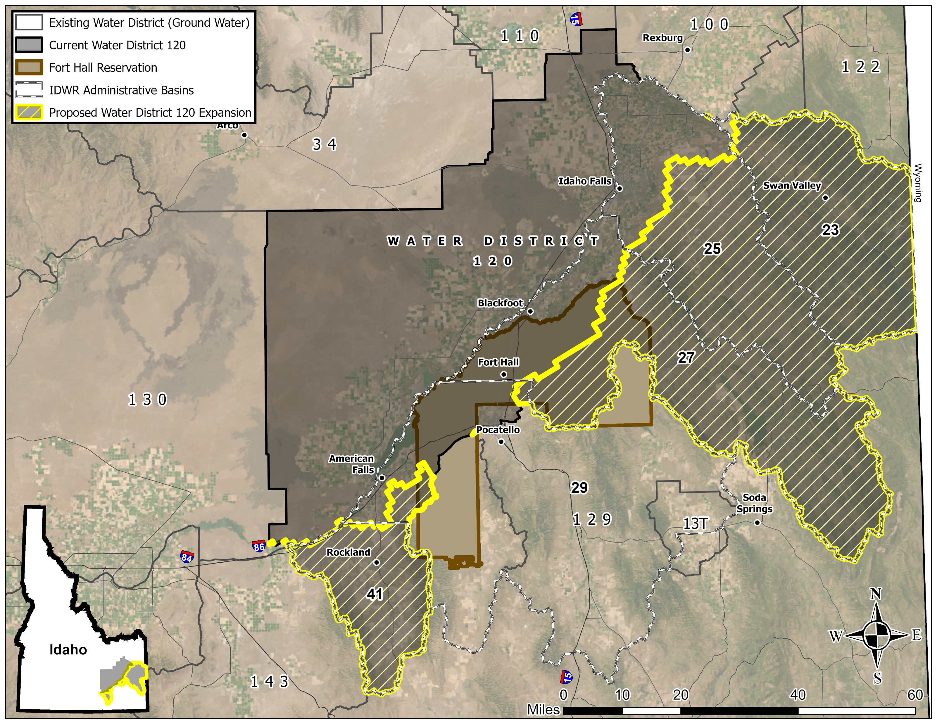
Proposed Water District 120 Expansion

Slide 2
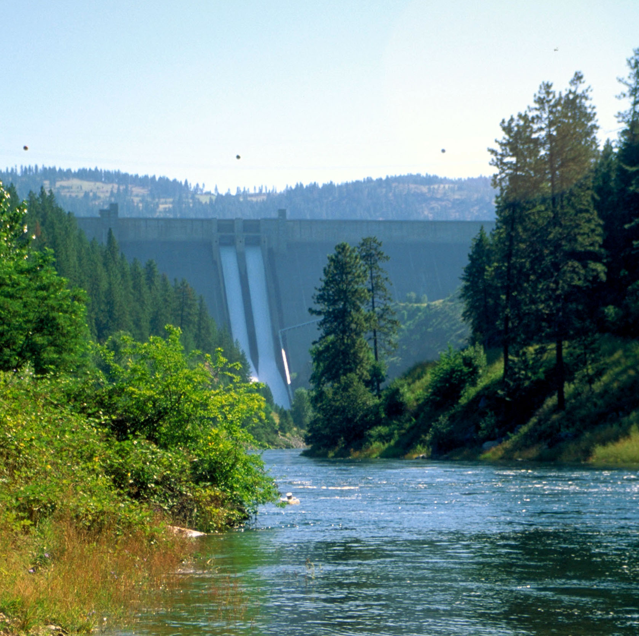

Proposed Modification of Water District 120 (WD120)
Riley Kafka
September 2026

Slide 3

Answer the Following Questions
What is being proposed?
Who was sent notice?
What is Water District 120?
What do water districts do?
What is a ground water district?
Why is IDWR proposing this?
What is the purpose of a water district?
What will be new and required?
What actions and timeframes are next?

Slide 4
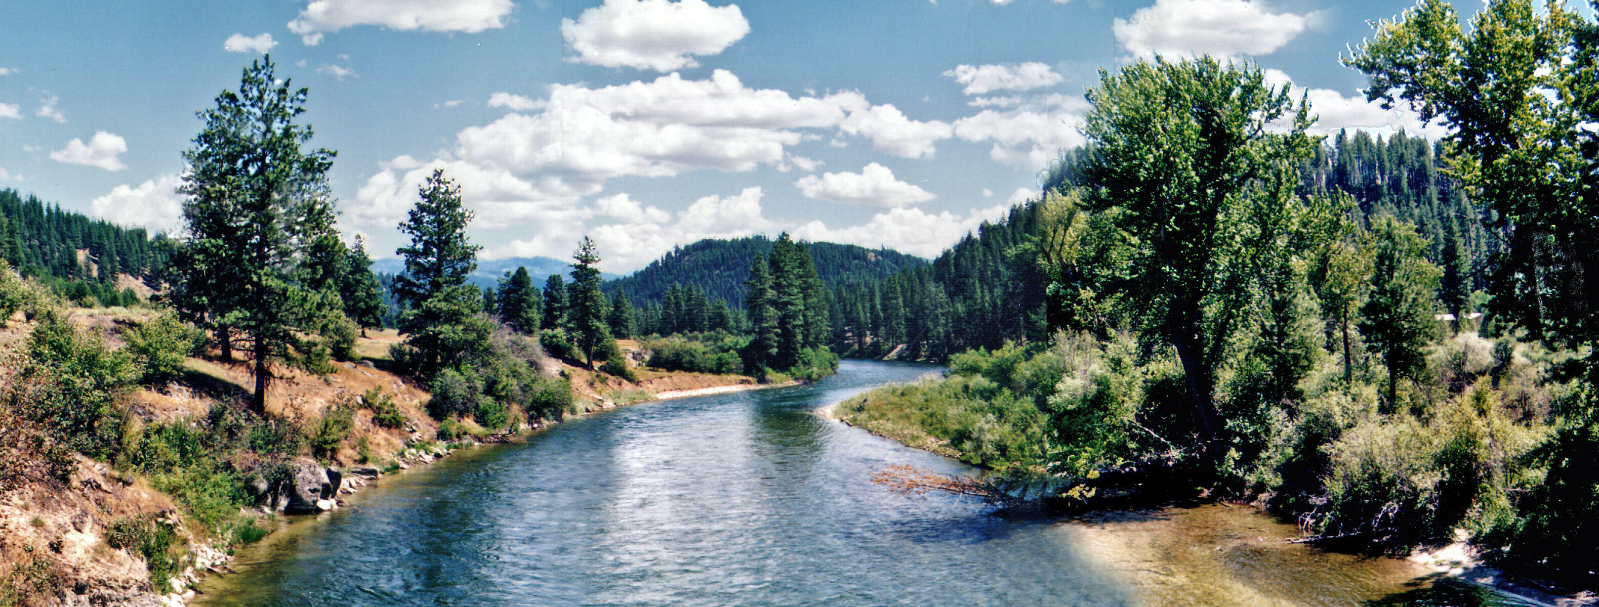
Proposed Action:
The Director proposes to modify Water District 120 to include ground water rights in areas of the Department ‘s Administrative Basins 23, 25, 27, 29, and 41.
  Expand WD120 to administer an additional 180 ground water rights.
  Excludes small domestic and stock uses (§§ 42-111 and 42-1401A(11))
  Excludes water rights administered by Shoshone-Bannock Tribes and the United States pursuant to the 1990 Fort Hall Indian Water Rights Agreement

Slide 5
Who Was Sent a Notice of Hearing?
1,934 notices sent to owners of ground water rights in total; with users in Basins 23, 25, 27, 29, and 41 making up 135 notices
Water users within the proposed expanded area NOT sent notice (will not be included in district):
  Surface water right holders in these basins
  Small domestic and stockwater rights (588)
    §§ 42-111 and 42-1401A(11)
      13K gallons/day and <½ acre of irrigation

Slide 6


Map of Area Sent Notice
&
Proposed Water District 120
Water District 120 was created on 02/19/2002.
Currently administers 4,782 ground water rights.

Slide 7
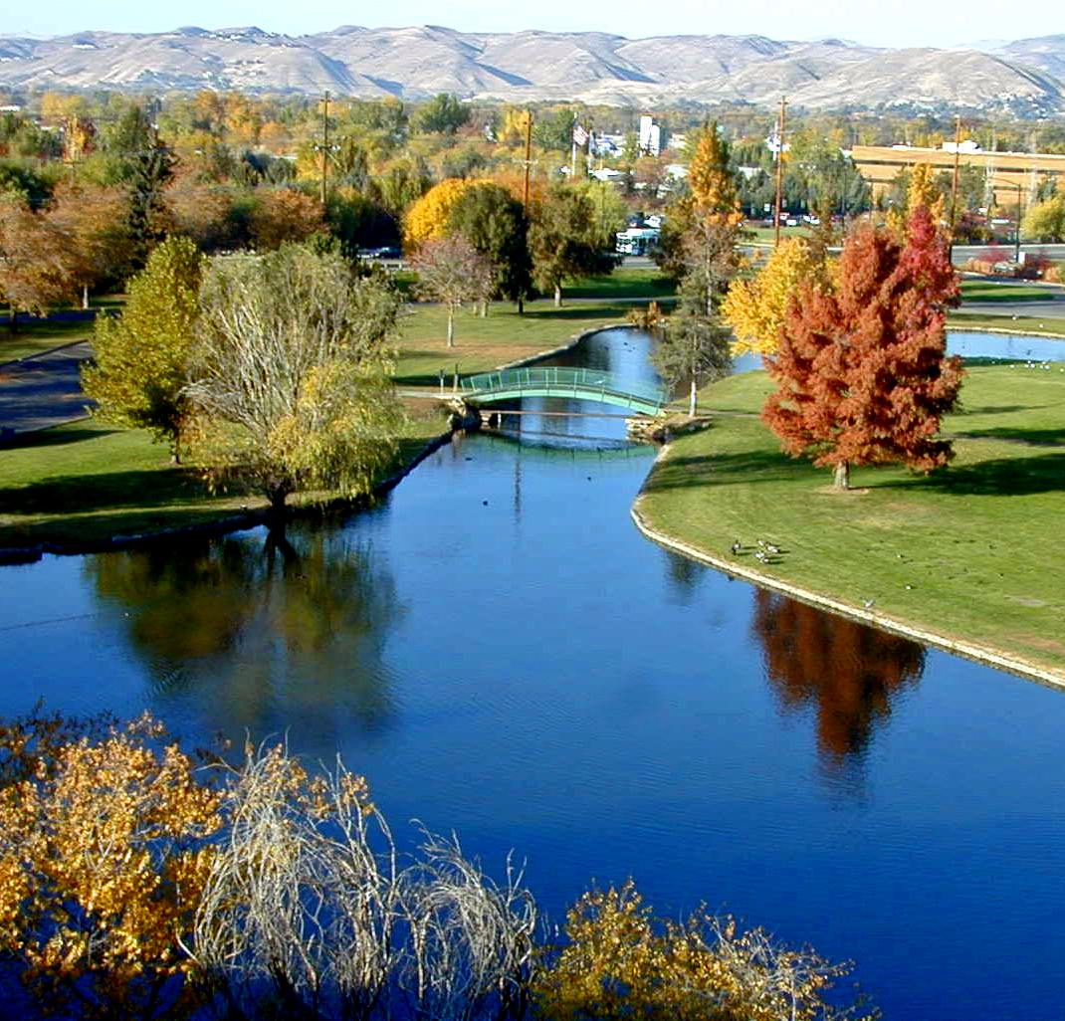
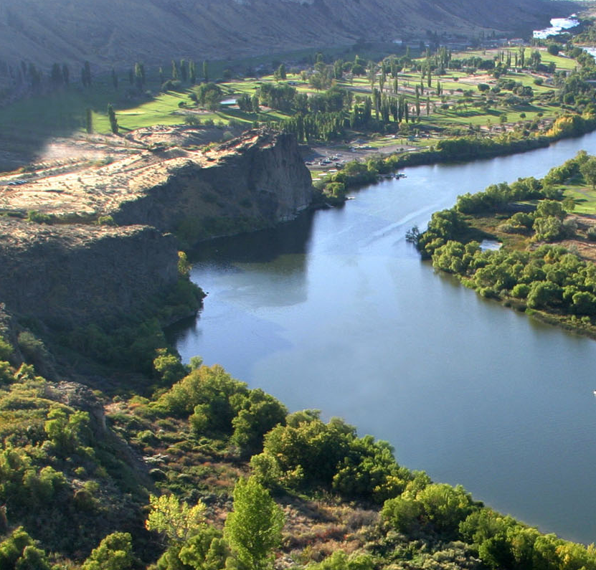
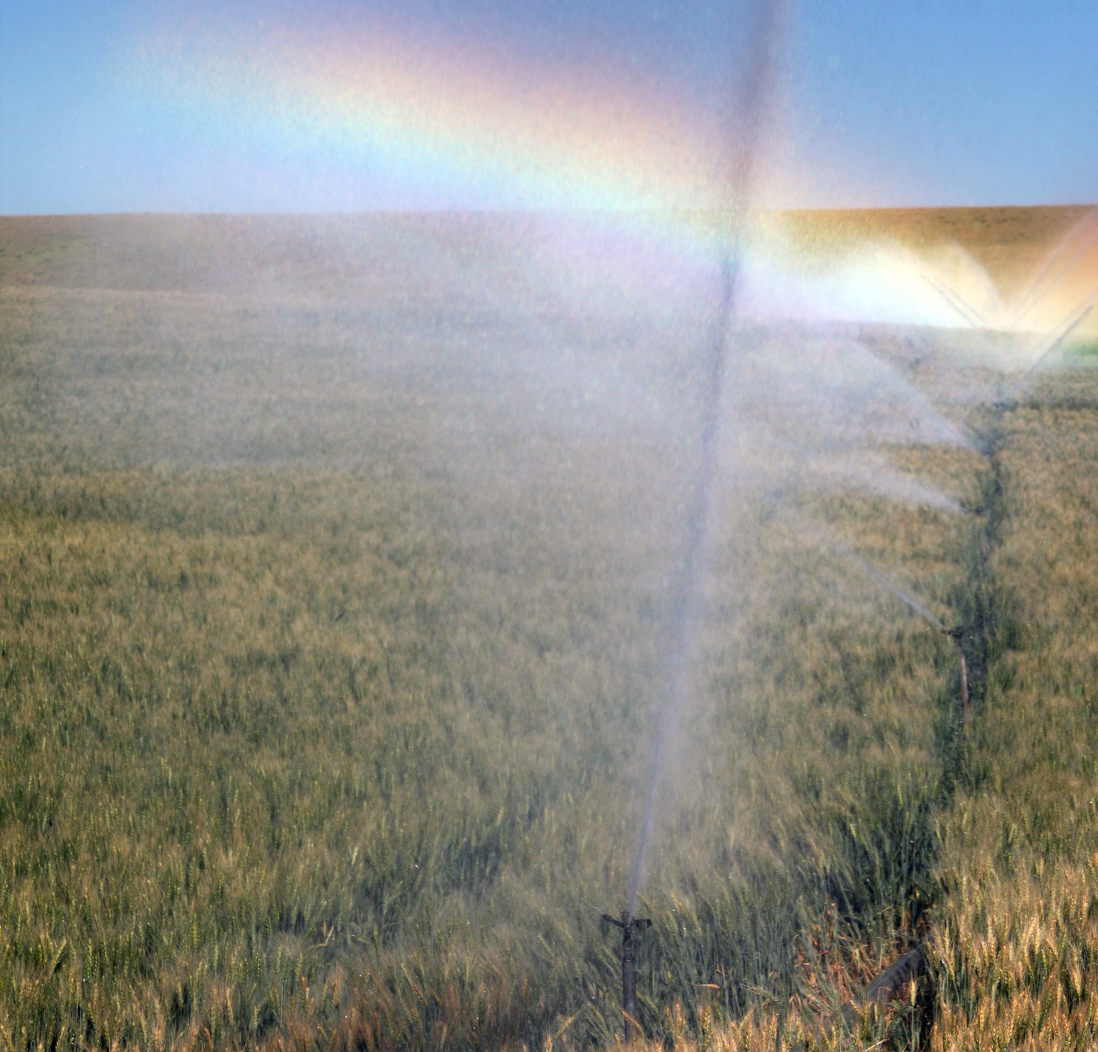
Ground Water Rights in WD120
4,782 ground water rights currently administered by WD120.
  180 ground water rights proposed to be included in the expanded area.
    135 ground water right users proposed to be included in the expanded area.

Slide 8
What is a Water District?
An organized governmental entity (instrumentality of the state) created pursuant to Idaho Code Title 42 Chapter 6 and supervised by IDWR
An organized group of users that hold water rights from a common public source or water system within a specific boundary (basin or aquifer)
Considered an extension of state government to assist IDWR with distribution of water

Slide 9
What is the Purpose of a Water District?
Water districts are necessary to manage and administer the use of Idaho’s public “water systems” at a local level
  A “water system” includes all rivers, streams, lakes, springs, ground water or other water sources within the state
Water districts ensure proper distribution of water consistent with water rights on record with IDWR

Slide 10
A water district is NOT a Ground Water District
  Ground water districts are created by water users, as opposed to being created by IDWR
  Ground water districts can represent users in water use issues, legal matters
  Ground water districts can develop and implement mitigation plans and recharge programs

Slide 11
What Do Water Districts Do?
Administer and distribute water within designated boundaries
Deliver water by priority and consistent with water right limits
Measure and report water use
- Ground Water Districts can measure and report use of their members to the water district.
Assist with unauthorized uses
Assist IDWR and water users with records and local knowledge (ownership changes, diversion locations, transfer reviews, etc.)

Slide 12
Why is IDWR Doing This?
Ground water rights within the proposed district modification boundary are not being administered by a water district
Snake River Basin Adjudication completed – Final Unified Decree signed August 25, 2014.
Measurement and reporting of use is necessary to understand where use is occurring
Answer questions raised by both ground water and surface water users, both inside and outside the basin.
Regulate water rights so that authorized limits are not exceeded

Slide 13
cont… Why is IDWR Doing This?
Because Idaho law requires water districts
Idaho Code Title 42, Chapter 6:
“The director shall divide the state into water districts… such that each public stream and tributaries, or independent source of water supply, shall constitute a water district.”
“The director may create, revise the boundaries of, or abolish a water district or combine two or more water districts by entry of an order… to properly administer uses of water resources.”
Snake River Basin Adjudication has concluded – Final Unified Decree signed August 25, 2014

Slide 14
Why expand WD120 instead of creating multiple new water districts?
More cost effective for water users – economies of scale with water district fixed cost(s)
IDWR’s experience with 101 existing districts is that larger districts simply function better and operate more efficiently than smaller ones and distribute costs better.
Experienced water district staff familiar with water district operations
Feedback from a hearing creating a new water district in basin 41 in the spring of 2026 was to join the existing WD120 instead of creating a new water district in basin 41.
Water District 120 has an excellent track record with its users and IDWR
Water District 120 has elected to contract with IDWR for watermaster services and water district staff are full-time employees

Slide 15
Points of Diversion in Expanded Area
201 wells associated with the 180 water rights to be potentially administered in proposed expanded area.
Approximately 116 wells may require measurement.
  37 wells in Basin 23 that may require measurement.
  1 well in Basin 25 that may require measurement.
  42 wells in Basin 27 that may require measurement.
  1 well in Basin 29 that may require measurement.
  35 wells in Basin 41 that may require measurement.
*wells to be measured are estimates

Slide 16
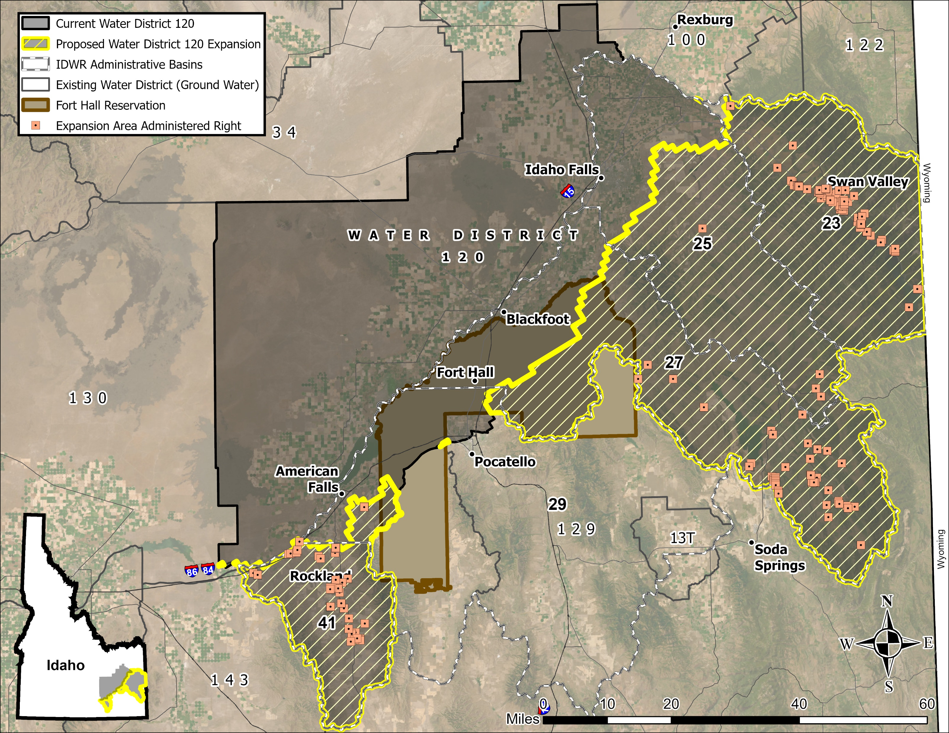
WD120 Expansion Area Wells to Inventory (201)

Slide 17
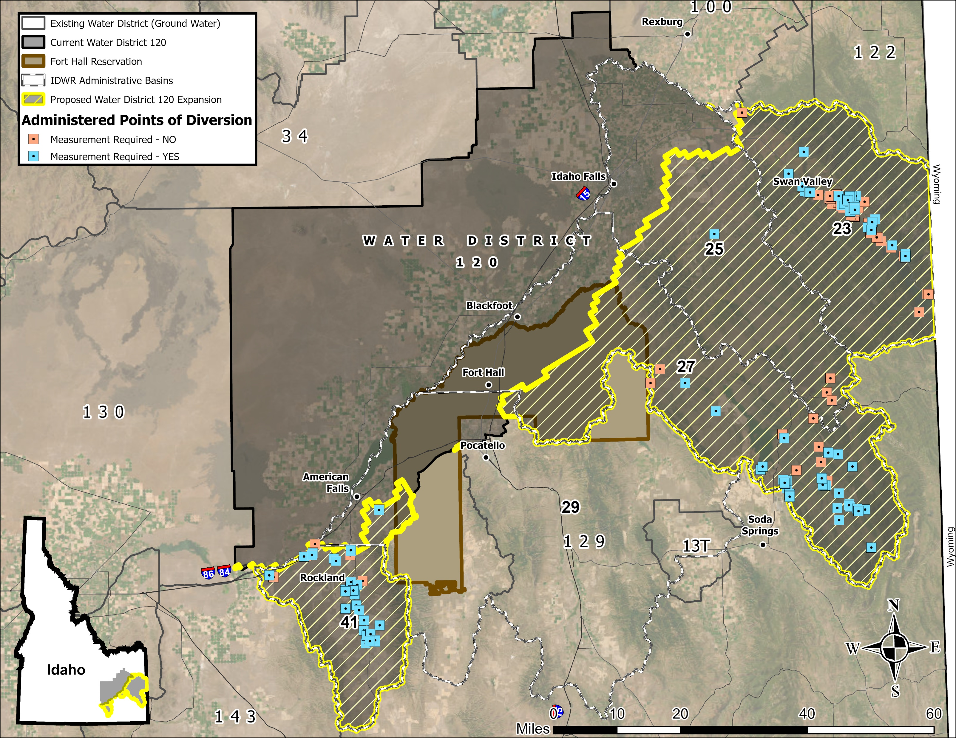
Wells in Expanded Area That May Require Measurement (116)

Slide 18
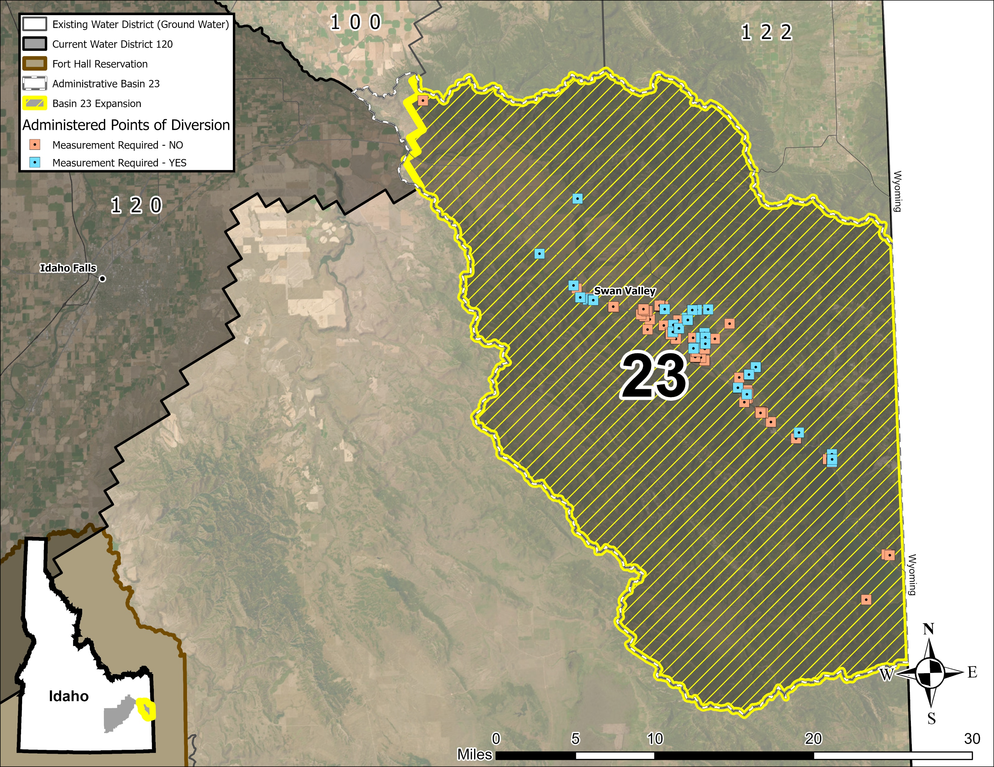
Basin 23 Wells That May Require Measurement (37)

Slide 19
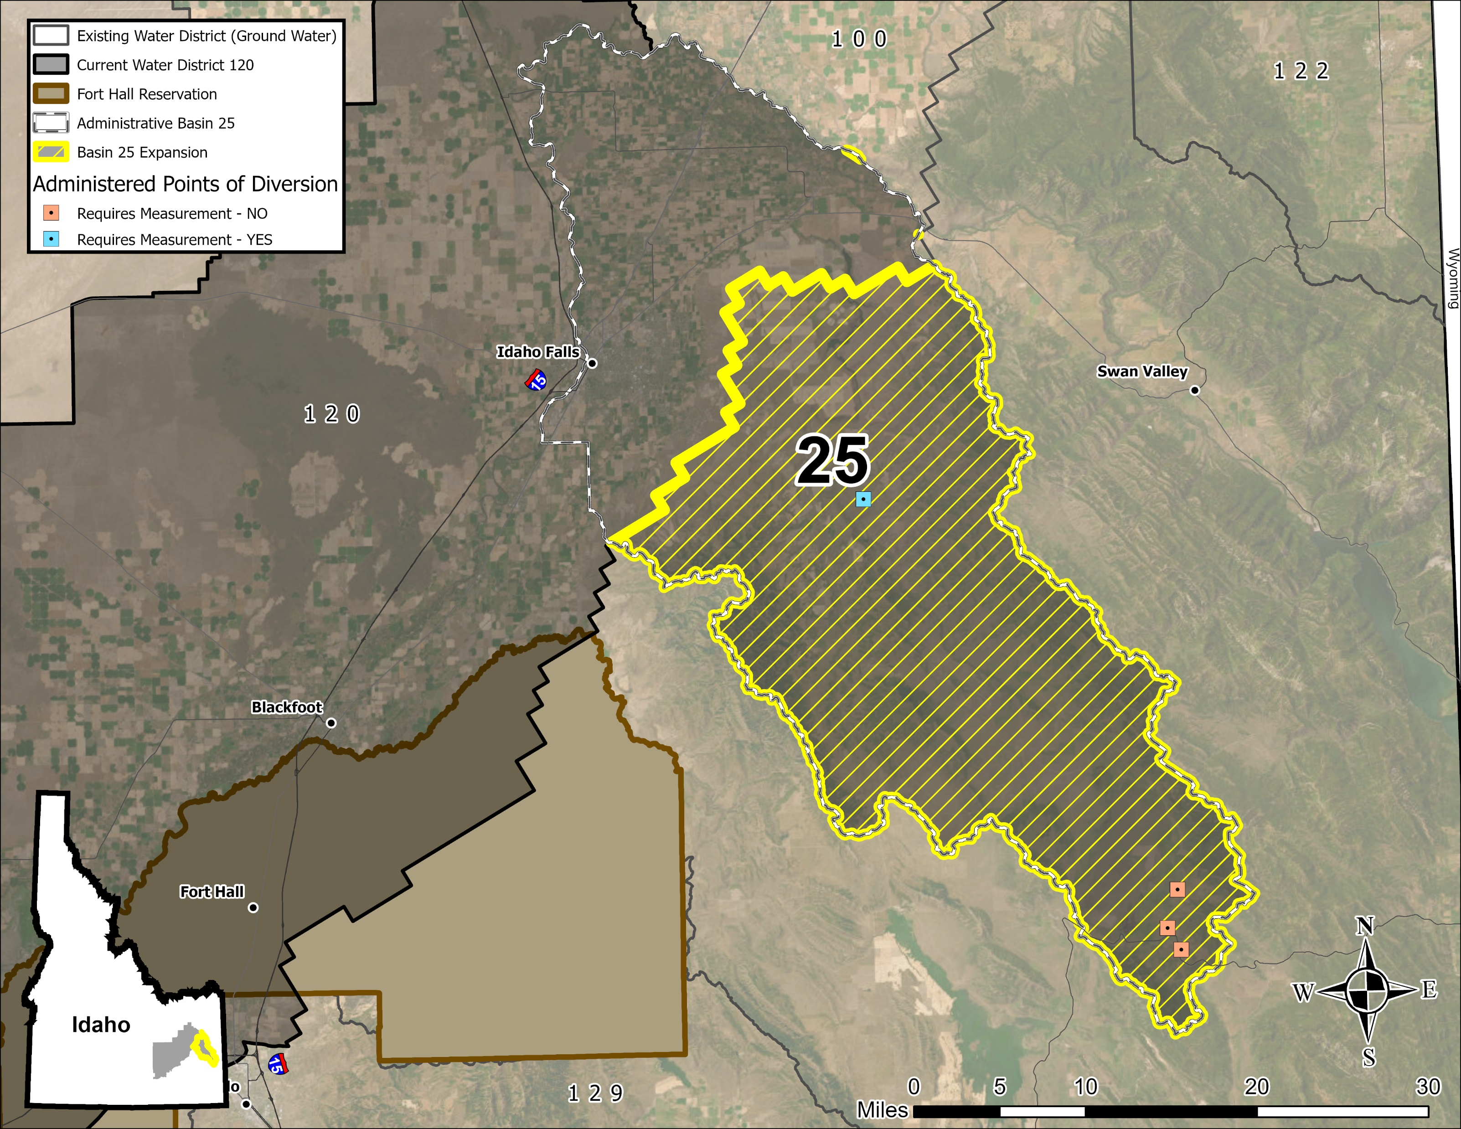
Basin 25 Wells That May Require Measurement (1)

Slide 20
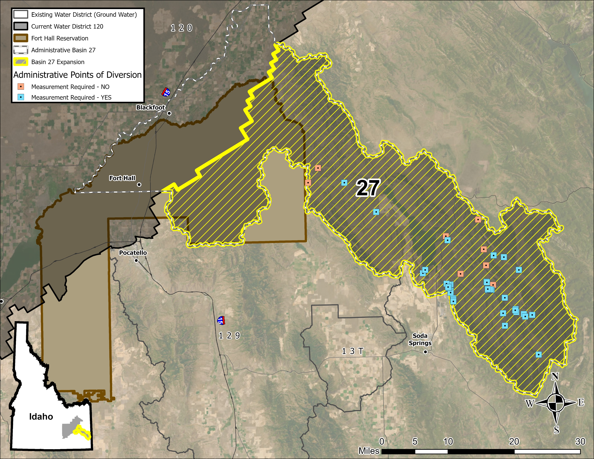
Basin 27 Wells That May Require Measurement (42)

Slide 21
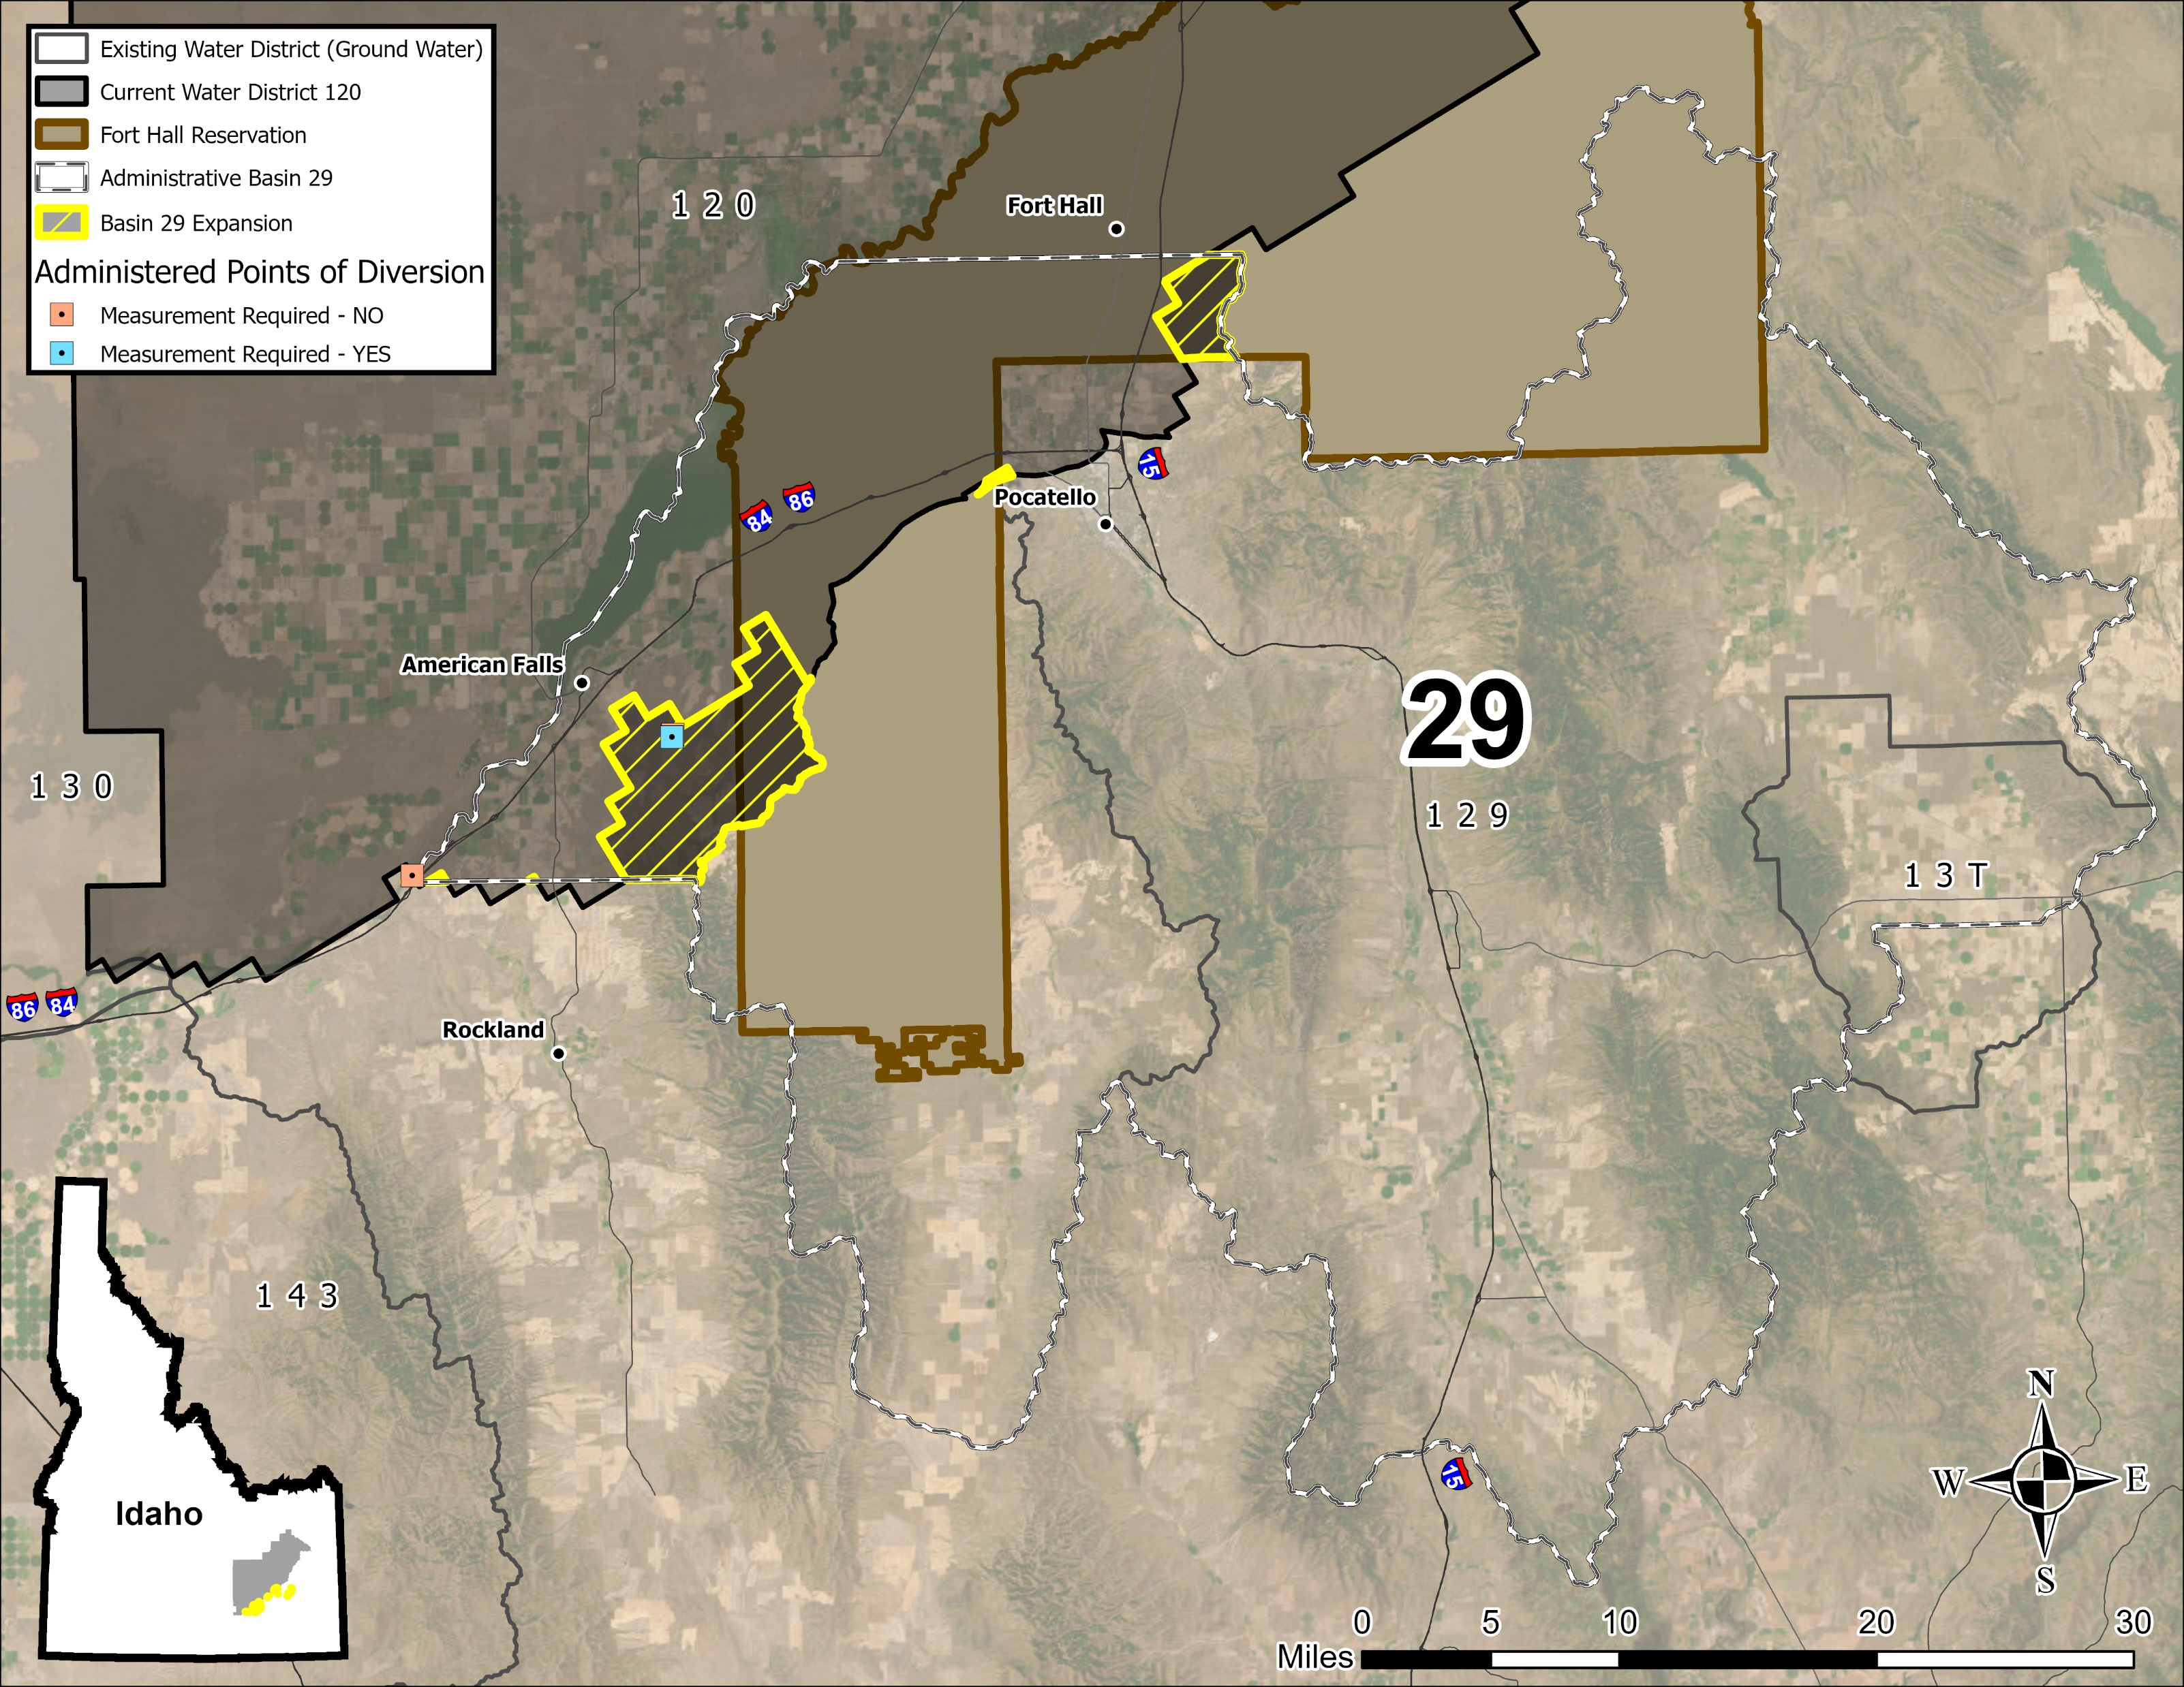
Basin 29 Wells That May Require Measurement (1)

Slide 22
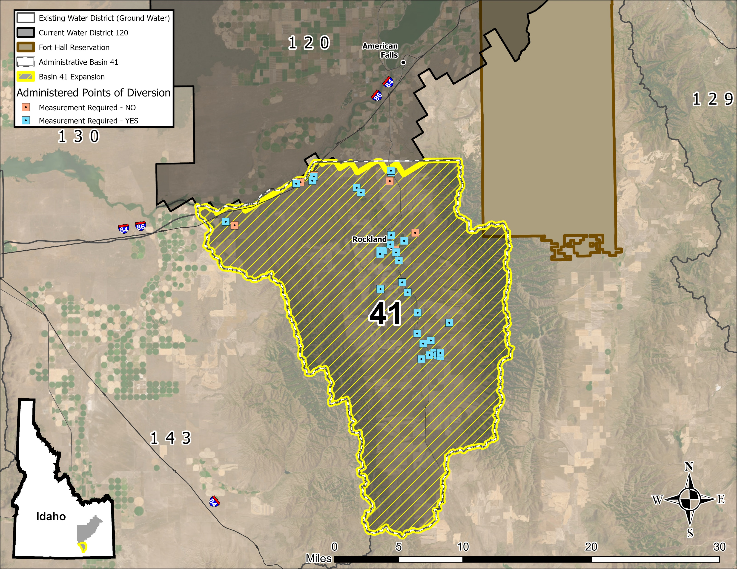
Basin 41 Wells That May Require Measurement (35)

Slide 23
Water District Staff
Watermaster – elected annually at the annual meeting to distribute water
  Elected by water users, appointed by IDWR
  Compensated by users via assessments
  Authorized to employ assistant watermasters – same responsibilities and authority as watermaster
  Blake Jordan is the current watermaster for WD120 and Water Resources Manager at IDWR Eastern Region
Treasurer – elected annually at the annual meeting
  Elected by water users to oversee the collection and distribution of district funds
Advisory Committee – elected annually at the annual meeting
  Assist district in resolving conflicts at the local level before escalation to IDWR

Slide 24
Watermaster Duties
Deliver water in accordance with water right priority dates
Authority to control/regulate diversion works
Measure and report use – unless use is reported by a Ground Water District
Annually reports expenses & water delivered
Watermaster report, daily logbooks or distribution report
Budget proposal for annual meeting
Report and control unauthorized diversions
Local resource/expert; review transfers

Slide 25
Who Pays for Water District Operations?
Assessments are paid by the water users of the district
The state or IDWR does NOT fund the operation of water districts or water district staff
Each water user is assessed a proportion of the water district’s adopted budget, based on the amount of water delivered by the watermaster during the past season(s)

Slide 26
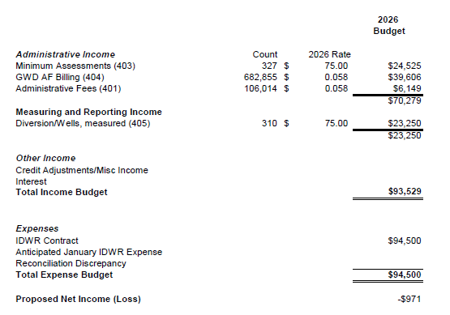
2026 Adopted Budget of WD120
Budget’s can be adjusted year to year at annual meeting.
Water use’s that meet the districts minimum fee will be charged $75 for watermaster services.
Water use’s that are greater than the minimum assessment are based on quantity of water used in past seasons.
WD120 has contracted with IDWR to provide the watermaster and treasurer services for the district.

Slide 27
What Will Be New and Required?
Water users will have to cooperate with watermasters to record amount delivered
Water users will have to pay a water district assessment
  Based on the amount of water delivered
  Minimum assessment fee (currently $75 in WD120)
Certain sized diversions will be required to measure with IDWR-approved meter
Invited to annual meeting to adopt budget, resolutions, and elect water district officials

Slide 28
What Comes Next?
Written comments can be submitted until September 24th, 2026 at 5:00 PM
The Director will make a decision, then issue an order to all the users who received notice for this hearing
If proposed action moves forward, water users will be sent meeting notice at least 21 days before the annual meeting
Annual meeting held on 2nd Monday in February

Slide 29
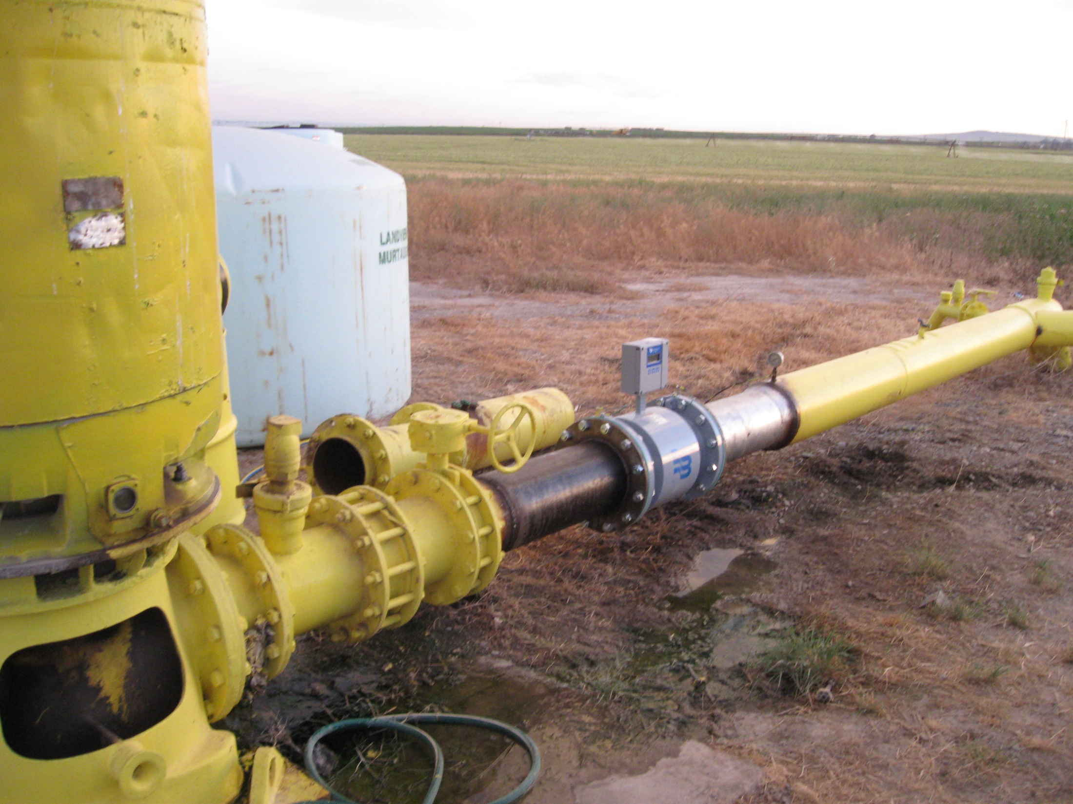
Water Measurement

Slide 30
Reasons for Measurement
Required per Idaho Code, Title 42-701
Measuring devices shall be installed when required for the purpose of assisting the watermaster or IDWR determining the amount of water diverted
Facilitate management of water rights
    How much water is diverted?
State water budget cannot be determined without accounting for inputs and withdrawals.

Slide 31
Measurement Requirements
Measurement order will require the installation of approved measuring devices on certain-sized diversions
  Department will send a measurement order
  One to two-year deadline following the issuance of the order to install
  Meters must be on the IDWR-approved meter list

Slide 32
Measurement Parameters
State standard excludes:
  domestic/stock water uses (42-111 Idaho Code)
  “small” irrigation uses, typically <=5 acres
  “small” rights with diversion rates <= 0.24 CFS (~108 GPM)
  *Shared wells with cumulative acres/diversion rate exceeding thresholds from above are required to measure

Slide 33
Approved Measuring Devices
Standard closed conduit measuring devices are flow meters that have been approved for use by IDWR based on independent third-party testing
IDWR’s totalizing flow meters: electromagnetic, spooled ultrasonic, and clamp-on ultrasonic
  Meter installed in-line with existing piping
  Water passes through the device, with no obstructions
  Spacing and installation requirements that must be met
  - Meter can’t be on downslope
  - Straight length of unobstructed pipe 3 times diameter of meter upstream and 2 times downstream.
  Hardwired to power, or battery powered
* Cost will vary based on meter size and existing pipe configuration

Slide 34
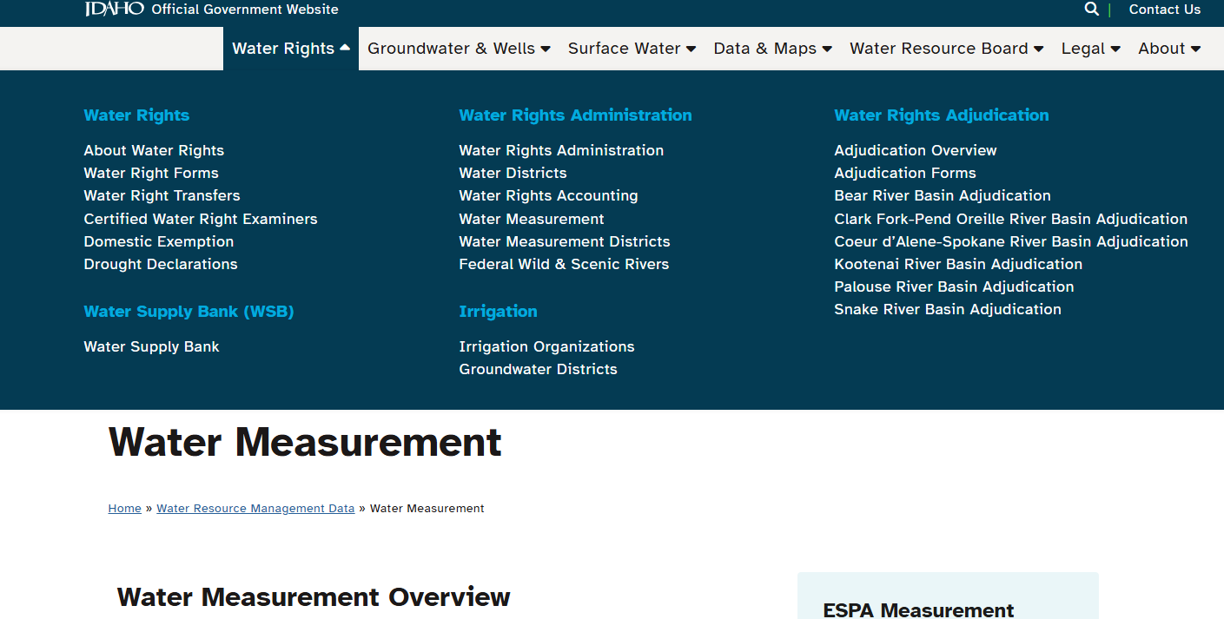
List of Approved Meters and Measurement Information

Slide 35

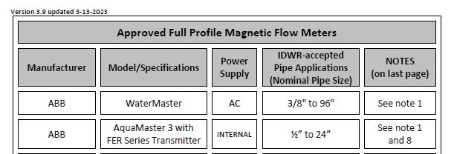
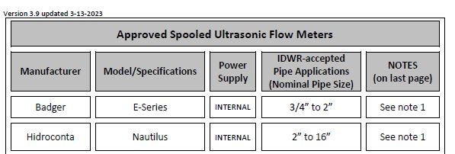
List of Approved Meters

Slide 36
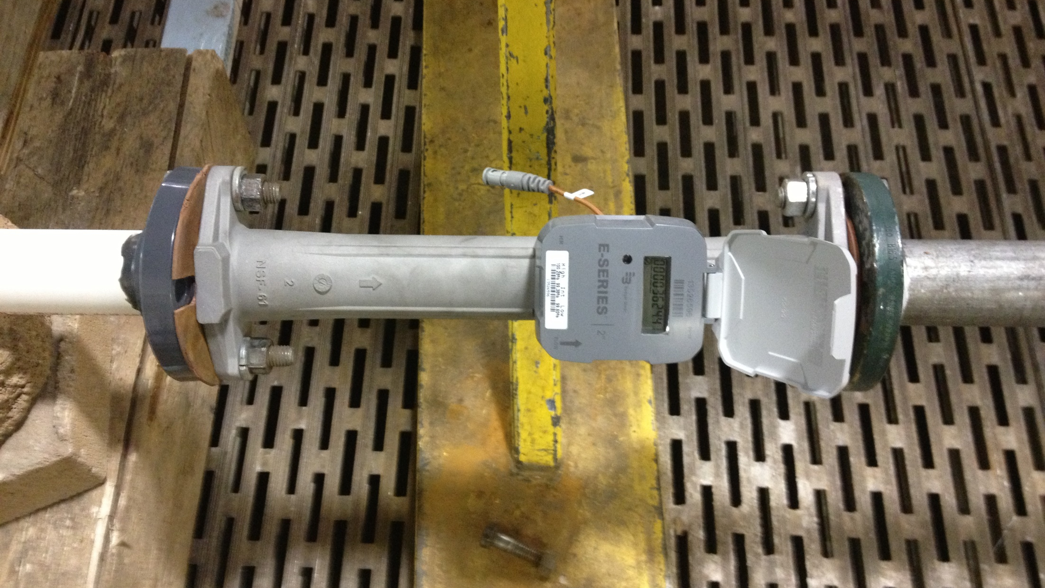

Slide 37
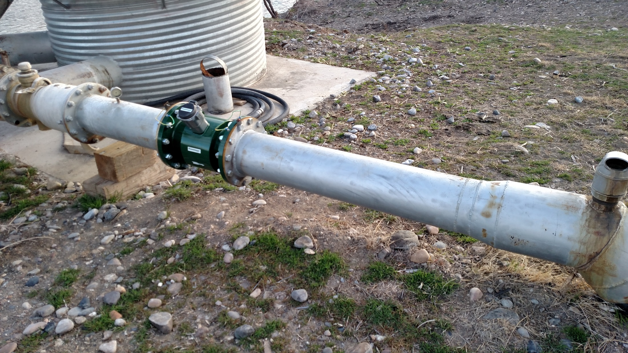

Slide 38
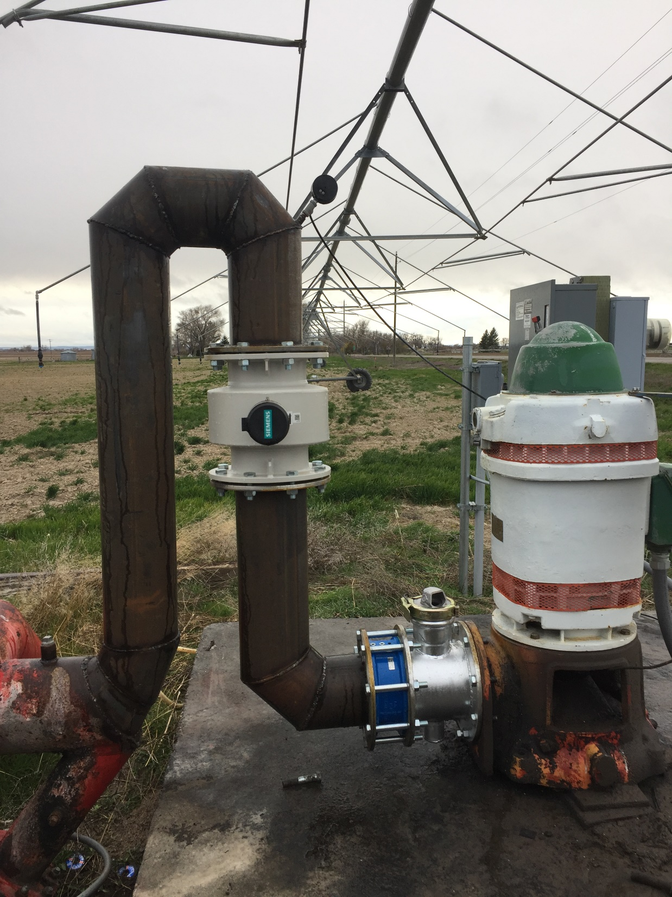

Slide 39
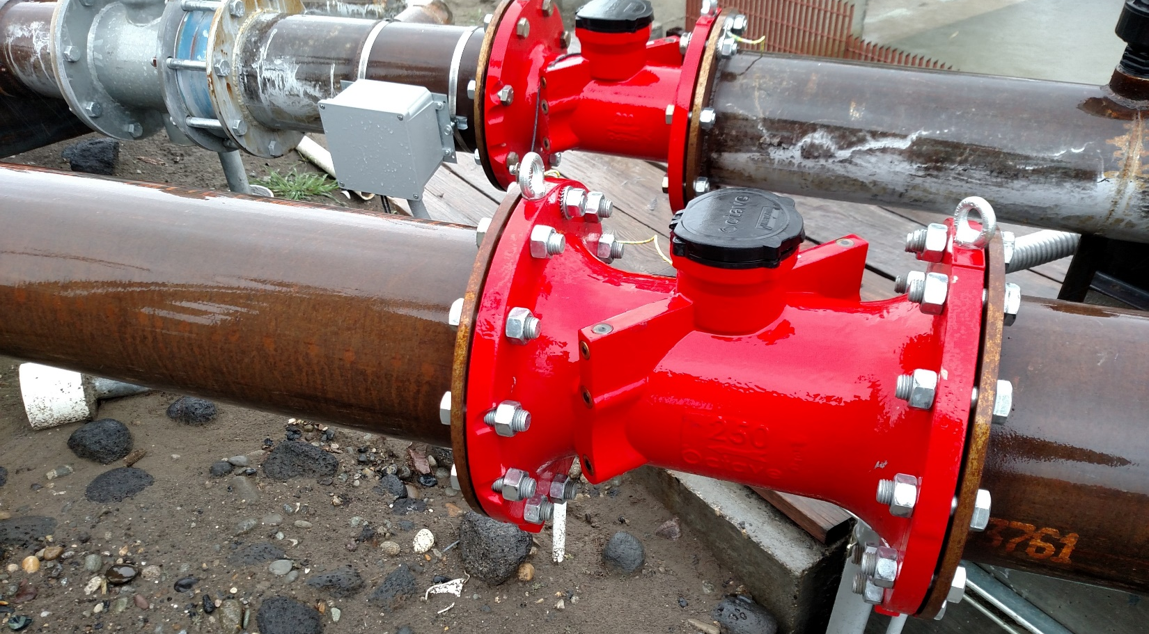

Slide 40
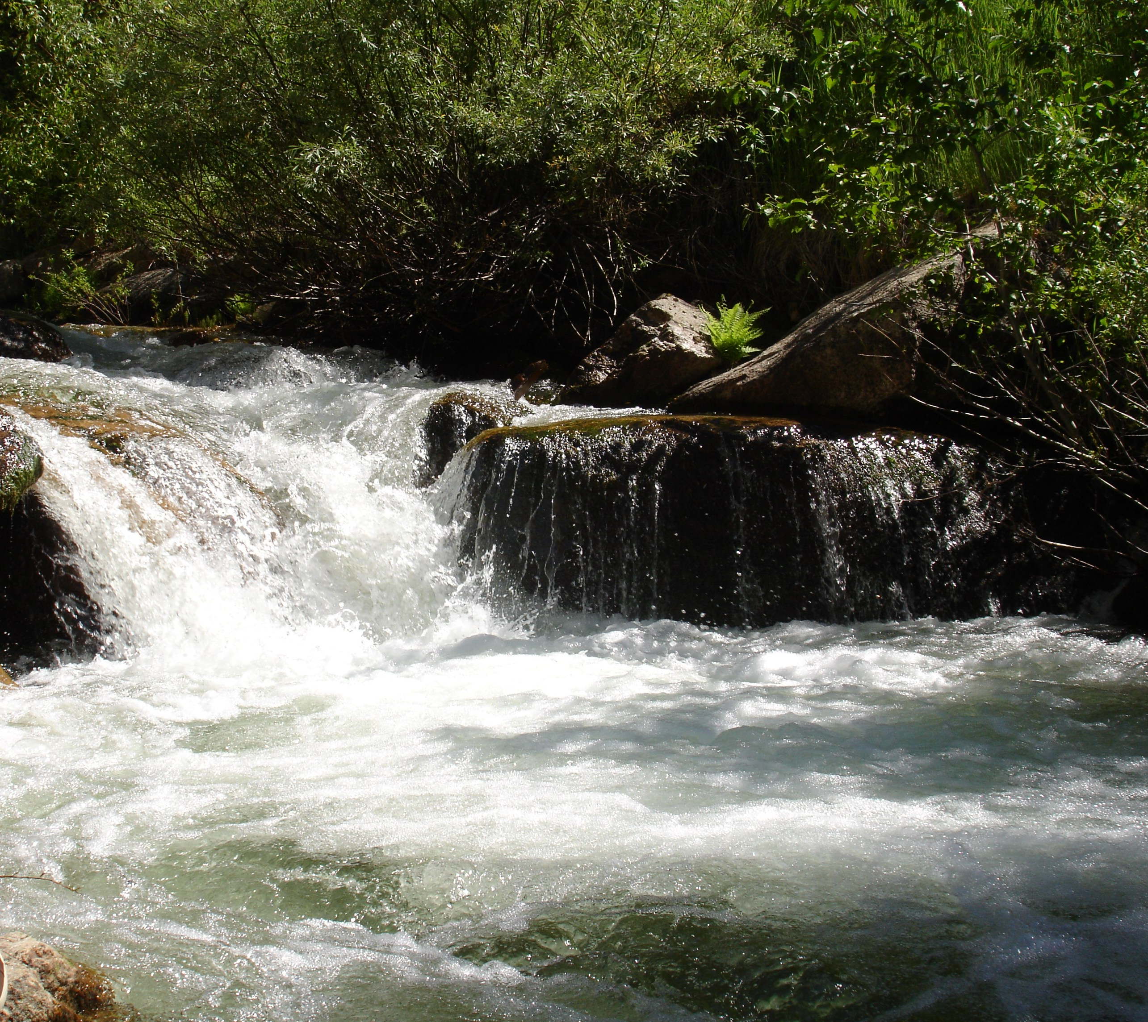
Proposed Modification of Water District 120
Questions?

Slide 41
